Slide 1
Part III: International Finance
BALANCE OF PAYMENTS
Nguyen Thi Minh Phuong
(University of Economics and Business, VNU)
International Economics

Slide 2
Information of Lecturer
Nguyen Thi Minh Phuong
Email: phuongntm.ueb@vnu.edu.vn
Mobile Phone: 083 203 2009
For more details:
  http://ueb.edu.vn/Sub/14/newsdetail/giangvien/9752/Nguyễn%20Thị%20Minh%20Phương.htm

Slide 3




Class policy

Slide 4

PART III: INTERNATIONAL FINANCE
3.1. Balance of Payments
  Definition, book-keeping principles and structure
  Concepts of surplus and deficits
  Current account and other macroeconomic indices
  Some basic methods to adjust deficit of BOP
3.2. Foreign exchange markets and foreign exchange rates
3.3. International Monetary System
Contents

Slide 5

BALANCE OF PAYMENTS
Learning goals
Understand the concept of BOP: what BOP is, structure of BOP, how it is recorded, how to adjust deficit of BOP
Apply well in calculation and analysis
Own study BOP situation of VN and other countries
Materials
D. Salvatore (2004), International Economics, Macmillan Publishing Company, New York, ch.13.
Paul Krugman (2012), International Economics: Theory&Policy, Pearson Education Limited, ch.13.
Khu Thi Tuyet Mai (2009), International Economics, VNU Publishing, ch.5.

Slide 6
Balance of payments
1

Slide 7
DEFINITION
A summary statement: Millions of international transactions cannot appear individually in BOP but have to be classified into a few major categories.
“The balance of payments is a summary statement in which, in principle, all the transactions of the residents of a nation with the residents of all other nations are recorded during a particular period of time, usually a calendar year”.
Dominick Salvatore
International transactions:
Exchange of goods/services and assets;
Exchange of assets and assets
Unilateral transfers (e.g. gift, foreign aid, private remittances,…)
Residents:
(i) Diplomats, military personnel, tourists and workers who temporarily migrate are residents of the nation they hold citizenship;
(ii) Corporation (except for international institutions, e.g. IMF, WTO, WB) is the resident of the nation in which it is located but its foreign branches and subsidiaries are not.
A country’s balance of payments accounts keep track of both its payments to and its receipts from foreigners (including international trading, borrowings and lending).
A particular of time: The BOP has a time dimension, a particular of time is usually a calendar year.

Slide 8
Why is studying BOP important?
BOP
Inform the international position of a nation (Debtor or Lender)
An indicator of economic strength
Governments
Banks, Firms, Individuals
Making monetary, fiscal, and trade policies
Making decision on trading, investment, lending and borrowing abroad

Slide 9
Structure of BOP
BOP are separated into 3 categories:
  Current account
  Capital account
  Financial account

Slide 10
Structure of BOP
I. CURRENT ACCOUNT
A country’s current account reflects all of exports and imports of goods and services, its income receipts and income payments, and its income transfer
1. Imports and exports
    Goods
    Services
  Net Income receipts (Regular repayments/dividends of loans and investment)
  Net unilateral transfers (transactions for which there are no offsetting transfers of value)
    Gifts
    Foreign aids/grants
    Private remittances, etc.

Slide 11
Structure of BOP
II. CAPITAL ACCOUNT
  Capital account records flows of special categories of assets, such as
    Debt forgiveness
    Goods and financial assets that migrants take with them as they leave or enter the country
    Acquisition or disposal of non produced, non financial and possibly intangible assets (e.g. copy rights and trade marks).
  - Often small amount

Slide 12
Structure of BOP
III. FINANCIAL ACCOUNT
A country’s Financial account records its international financial transactions. FA measures foreign investment in the country minus the country’s investment abroad
  Foreign investment in the country (Foreign-owned assets in the nation/ Export of assets)
  The country’s investment abroad (Nation-owned assets abroad/Import of assets)
  Statistical discrepancies (errors and omissions)

Slide 13
BOP Accounting Principles
Credits | Debits
Involve the receipt of payments from foreigners | Involve the making of payments to foreigners
- Export of goods and services, unilateral transfers (gifts) received from foreigners - Financial inflows: (i) An increase in foreign-owned assets in the nation (an increase in export of assets), e.g. a U.K resident purchases a U.S. stock -> foreign-owned assets in U.S increase (ii) A decrease in the nation-owned assets abroad (a decrease in import of assets), e.g. when a U.S. resident sells a foreign stock -> the U.S-owned assets abroad decrease | - Import of goods and services, unilateral transfers or gifts made to foreigners Financial outflows: (i) An increase in the nation-owned asset abroad (an increase import of assets), e.g. a U.S resident purchases a UK treasury bill -> the U.S-owned assets abroad increase (ii) A decrease in foreign-owned assets in the nation, (a decrease export of assets), e.g. a German firm sells its U.S. subsidiary -> foreign-owned assets in U.S decrease
Entered with a positive sign (+) | Entered with a negative sign (-)

Slide 14
BOP Accounting Principles
Double-Entry Bookkeeping
Each international transaction is recorded twice in the balance of payments with equal amounts but opposite signs, once as a credit and once as a debit. For each credited item, there is an offsetting debited item, and vice versa.
Reason: In general, every transaction has two sides - Selling something and receiving payment for it; Buying something and making payment for it.

Slide 15
Example 1
An U.S. company exports $500 of goods to Vietnam.
The VN importer will pay in three months.
How is the transaction recorded in U.S BOP?
Export of goods (current account) | +$500
Increase in U.S. assets abroad (Import of assets) (financial account) | -$500
Notes:
For example, suppose that a U.S. firm exports $500 of goods to be paid for in three months. The United States first credits goods exports for $500 since this goods export will lead to the receipt of a payment from foreigners. The payment itself is then entered as a financial debit because it represents a financial outflow from the United States. That is, agreeing to wait three months for payment, the U.S. exporter is extending credit to, and has acquired a claim on, the foreign importer. This is an increase in U.S-owned assets abroad and a debit (import of assets).

Slide 16
Example 2
A VN firm imports $500 of goods from the U.K.
The VN firm pay cash. The U.K exporters put the payment into its bank account in BIDV Hanoi.
How is the transaction recorded in VN BOP?
Import of goods (current account) | -$500
An increase of U.K–owned assets in VN (export of assets) (financial account) | +$500

Slide 17
Example 3
  A U.S resident visits Vietnam and spends $200 on hotels, meals, etc.
  The payment is made in cash
How is the transaction recorded in VN BOP?
Export of services (current account) | +$200
Increase in VN-owned assets in U.S (Import of assets) (financial account) | -$200

Slide 18
Example 4
A U.K investors purchases $300 of U.S treasury bills
He pays by drawing down his bank balances in the U.S by an equivalent amount.
How is the transaction recorded in U.S BOP?
Foreigner’s purchase of U.S. treasury bills (Export of assets) Increase in foreign-owned asset in U.S (financial account) | +$300
Decrease in foreigner’s bank account balance in U.S/ Decrease in foreign-owned asset in U.S (financial account) | -$300

Slide 19
Example 5
An American invests in the Japanese stock market by buying $500 in Sony stock.
Sony deposits/puts the money in its Los Angeles bank account. The bank credits the account by the amount of the deposit.
How is the transaction recorded in U.S BOP?
U.S resident’s purchase of stock/ assets import Increase in U.S-owned assets abroad (financial account) | –$500
Increase in foreigner’s bank account balance in U.S/ Increase in foreign-owned assets in U.S (financial account) | +$500

Slide 20
Example 6
The U.S forgives a $100M debt owed by Argentina government
U.S. banks who hold the debt thereby reduce the debt by crediting Argentina's bank accounts.
How is the transaction recorded in U.S BOP?
Debt forgiveness (capital account) | -$100M
Increase in foreigner’s bank account balance in U.S/ Increase in foreign-owned asset in U.S (financial account) | +$100M

Slide 21
BOP Identity
Because of double-entry bookkeeping principle, theoretically the sum of current account balance, the capital account balance and financial account balance must be equal to zero
Current account + Capital account + Financial account = 0

Slide 22
BOP Identity
  However, the BOP identity does not usually hold in practice. That’s the reason why statistical discrepancies/errors and omissions are added to make BOP identity happen.
  The discrepancies arise for several reasons:
    The under-recording of economic transactions
    Inconsistent information obtained from different sources
    Time inconsistency
  Discrepancies can arise from any type of accounts (current/capital/financial account), but in practice it is recorded in financial account.

Slide 23
U.S. International Transactions (Millions of dollars), 2012
Source: Survey of Current Business 2013, US Department of Commerce, Bureau of Economic Analysis,

Slide 24

Concepts of surplus and deficits
2

Slide 25
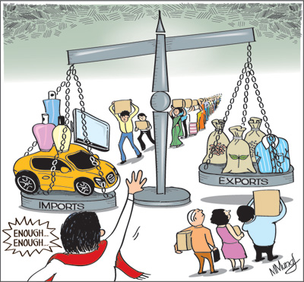

Slide 26
U.S. Current Account (Millions of dollars), 2012
Balance on goods = EX(goods) – IM (goods)
Net export of goods
(2) Balance on services = EX(services) – IM (services)
Net export of services
(3) Balance on trade = EX (goods+services) – IM
Net export (goods+services) (1) + (2)
(4) Balance on income = Income receipts – income payments
(5) Unilateral transfer, net
(6) Balance on current account = (3) + (4) + (5)
> 0: Surplus
< 0: Deficit
Source: Survey of Current Business 2013, US Department of Commerce, Bureau of Economic Analysis,

Slide 27
Euro area
Germany
Arabia
U.K
U.S
Source: IMF, http://elibrary-data.imf.org/FindDataReports.aspx?d=33061&e=170784,

Slide 28
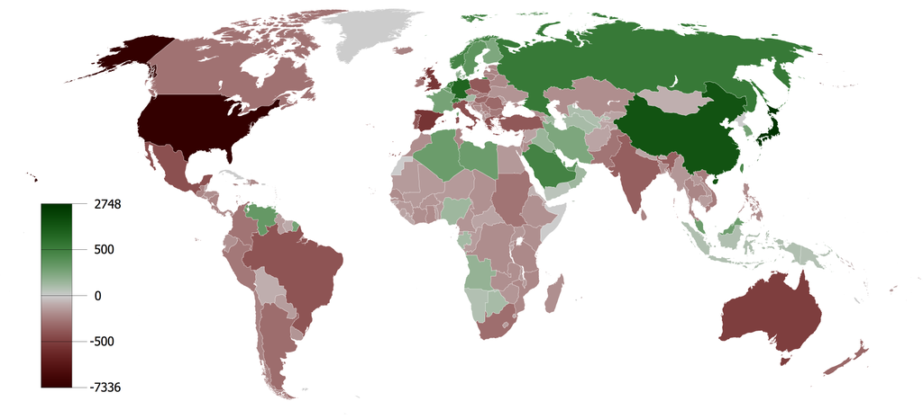
Borrowing and Lending Around the World
Source: http://commons.wikimedia.org/wiki/File:Cumulative_Current_Account_Balance.png,
Note: The graph shows for each country the sum of current account balances in billions of US$ between 1980-2008
Notes:
Deficit in current account: U.S., U.K, Spain, Australia
Surplus in current account: China, Germany, Euro area, Russia, Saudi Arabia.

Slide 29
Structure of BOP
FINANCIAL ACCOUNT
Another type of classification
  Official reserve assets: (Official reserve account)
      A country’s official reserves are its central bank’s holdings of foreign assets (foreign currencies, gold, SDR, reserve position in the IMF, etc.)
      Foreign Official Assets in the nation: reserve assets owned by (sold to) foreign central banks are a credit (+) because the domestic central bank can spend more money to cushion against instability.
      The nation’s Official reserve assets: official reserve assets owned by (purchased by) the domestic central bank are a debit (-) because the domestic central bank can spend less money to cushion against instability.
  All other assets (non-official assets)
  Statistical discrepancy

Slide 30
BOP
Current Account
Capital Account
Financial account
Non-official assets
Statistical discrepancy
Official assets
Current account + Capital account + Financial account = 0

Slide 31
Official settlements balance
The opposite value of the official reserve assets is called the official settlements balance or balance of payments.
It is the sum of the current account, the capital account, the non- official reserve portion of the financial account, and the statistical discrepancies.
A deficit in official settlements balance may indicate that a country
    is decreasing its official international reserve assets or
    may be incurring large debts to foreign central banks so that the domestic central bank can spend a lot to protect against financial instability.
Notes:
A country usually prefers a deficit in official reserves: DCB holds a lot of foreign currencies

Slide 32
BOP
Current account
Capital account
Financial account
Export & Import
Net Income receipt
Unilateral transfer
Non-official reserves
Statistical discrepancy
Official reserves
0
Trade Balance/Net export
> 0: Surplus
< 0: Deficit
Current account Balance
Official Settlements Balance/ Balance of Payment
Notes:
A country usually prefers a deficit in official reserves: DCB holds a lot of foreign currencies
-> prefer a deficit in Official reserves and a surplus in Official Settlements Balance

Slide 33
Current account and other macroeconomics indices
3

Slide 34
National income and current account
The current account is equal to the difference between national income (Y) and domestic residents’ total spending (C+I+G)
CA measures the size and direction of international borrowing: A country with a CA deficit must be increasing its net foreign debts by the amount of the deficit; and vice versus.
Y = C + I + G + (EX-IM)
CA = EX-IM
-> Y = C + I + G + CA
CA = Y – (C+I+G)
Y: National Income
C: Consumption
I: Investment
G: Government purchases

Slide 35
Saving and current account
Saving is the portion of output (Y) that is not devoted to household consumption (C) and government purchases (G).
An economy can save either by building up its capital stock (domestic investment) or by acquiring foreign wealth (foreign investment)
CA surplus is often referred to as net foreign investment
CA = Y – (C+I+G)
CA = Y – C – I – G
S = Y – C - G
S = I + CA
Y: National income
C: Consumption
I: Investment
G: Government purchases
S: National saving

Slide 36
Private saving, Government Saving and Current account
S^{p} = Y – T – C
S^{G} = T – G
S = Y – C – G = (Y – T – C) + (T – G) = S^{p +} S^{G}
S = I + CA
^{->} S^{p} = I + CA – S^{G} = I + CA – (T-G)
Private saving is defined as the part of disposable income (Y-T) that is saved rather than consumed (C)
Government saving is defined as the part of disposable income (T) that is saved rather than consume (G)
A country’s private saving can take three forms: investment in domestic capital (I), purchases of wealth from foreigners (CA) and purchases of the domestic government’s newly issued debt (G-T)
S^{p} = I + CA + (G-T)
Y: National Income
C: Consumption
I: Investment
G: Government purchases
S^{p}: Private saving
S^{G}: Government saving
G-T: Government budget deficit

Slide 37
Some basic methods to adjust Deficit of BOP
4

Slide 38
Improving current account
Encouraging export and restricting import
    - Contractionary monetary and fiscal policy to reduce consumption, including consumption for imports
- Devaluation of domestic currencies
- Other controls on trade and foreign exchange

Slide 39
Improving financial account
Appeal for FDI, FPI, Loans or International Aids
    -> Increase the capital/financial inflow -> improve balance of capital account and financial account
    -> To improve the investment environment, incentives,…

Slide 40





Homework
Access the website of The State Bank of Vietnam and study Vietnam’s Balance of Payment in 2017. http://www.sbv.gov.vn/
Preparation for the next class
- Read D. Salvatore, chapter 14, p. 461-465
- Read P. Krugman, chaper 13, p. 306-311

Slide 41
THANK YOU!

