Slide 1
FOREIGN EXCHANGE MARKETS
AND FOREIGN EXCHANGE RATES
Nguyen Thi Minh Phuong
(University of Economics and Business, VNU)
International Economics

Slide 2
REVIEW…
BOP
Current account
Capital account
Financial account
Export & Import
Net Income receipt
Unilateral transfer
Non-official reserves
Statistical discrepancy
Official reserves
0
Trade Balance
> 0: Surplus
< 0: Deficit
Current account Balance
Official Settlements Balance/ Balance of Payment

Slide 3

PART III: INTERNATIONAL FINANCE
3.1. Balance of Payments
3.2. Foreign exchange markets and foreign exchange rates
  Definition, characteristics, functions and actors in foreign exchange markets
  Exchange rates: Definition, classification and the equilibrium exchange rates
  Factors impact on exchange rates
  Arbitrage, hedging and speculation in foreign exchange market
3.3. International Monetary System
Contents

Slide 4
FOREIGN EXCHANGE MARKETS
1

Slide 5
1. DEFINITION
Foreign currency
Gold
The foreign exchange market (Forex / FX market) is the market in which individuals, firms,
and financial institutions buy and sell foreign exchange.
Means of payment quoted in foreign currency, e.g. checks, payment cards, bills of exchange, promissory notes…
Valuable papers quoted in foreign currency, e.g. government bonds, corporate bonds, shares,…
Notes:
In the normal market we sell and buy goods and services, in FX market we sell and buy foreign exchange. Foreign exchanges are the goods in FX market.
Mainly, the foreign exchange market is the market for converting the currency of one country into that of another.
E.g. you want to travel to New York, you have to go to the FOREX market, use VND you have to buy USD

Slide 6
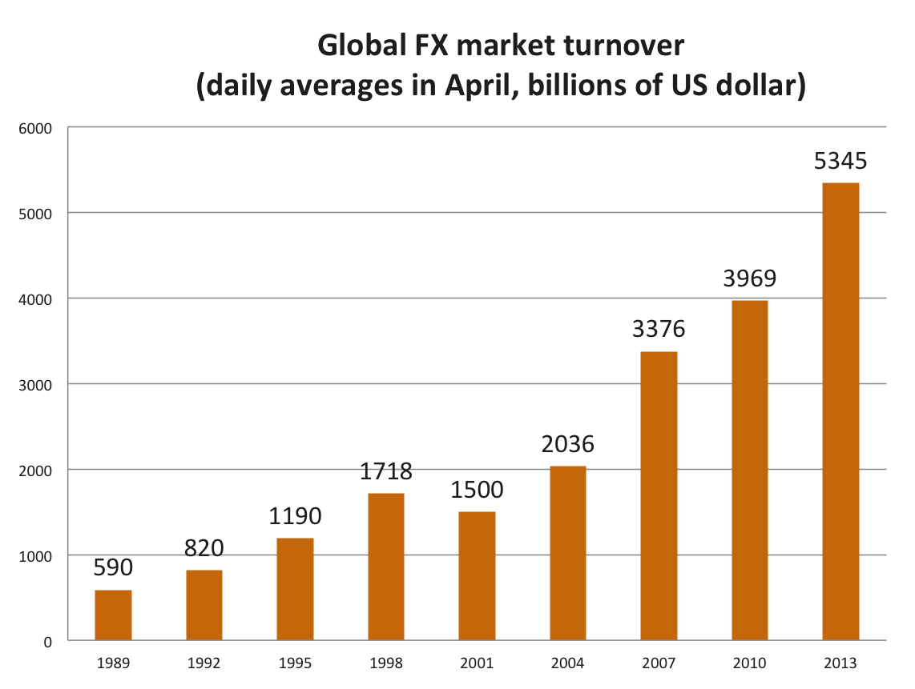
The worldwide volume of foreign exchange trading is enormous and has significantly increased in recent years
TOTAL
MERCHANDISE
EXPORT (1 year - 2013)
18,609
US$ billion
Characteristics
Source: Bank for International Settlements, Triennial Central Bank survey

Slide 7
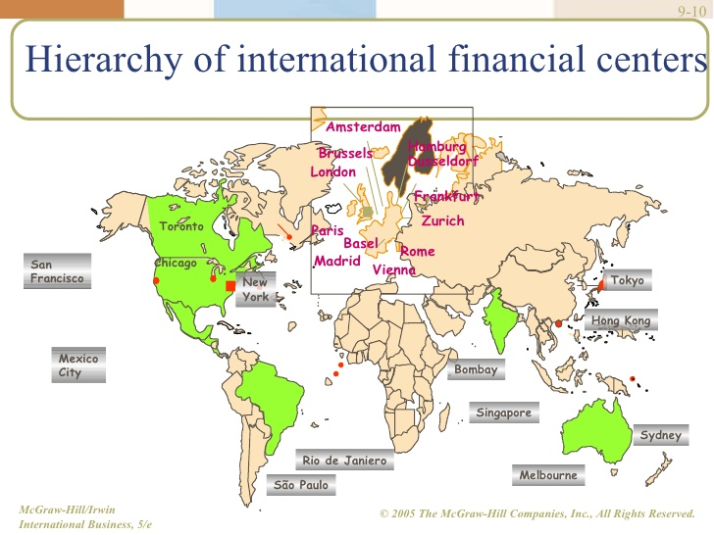
FX trading takes place in many financial centers; Trading is concentrated in the largest ones
(London, New York, Tokyo, Frankfurt, Singapore, etc.)
Characteristics

Slide 8
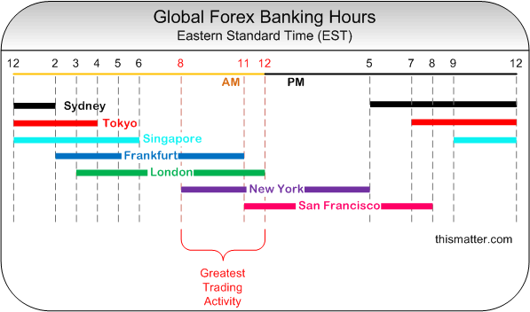
FX trading centers are connected electronically 24h/day
The market never sleeps
Characteristics

Slide 9
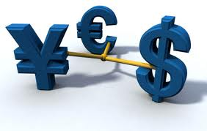
Currencies traded in FOREX market:
    Most frequently traded: USD, EUR , JPY
    Increasingly important: JPY, MXN, CNY
Characteristics
Source: Bank for International Settlements, Triennial Central Bank survey
Notes:
CHF: Swiss franc
SEK: Sweden krona
RUB: Russian Ruble
TRY: Turkish Lira

Slide 10
Currencies traded in FOREX market:
  USD is often referred to as the dominant vehicle currency because:
  The USD is widely used in international transactions, including the transactions that do not involve US residents
  The USD serves a unit of account, the medium of exchange and store of value in both domestic and international transactions.
Characteristics

Slide 11
No significant difference between exchange rate quoted in different financial centers
  € 1 = $1.1 in New York
  € 1 = $1.2 in London
        -> use $110 to buy € 100 in New York
        -> sell € 100 in London for $120
        -> profits of USD 10
  In NY: demand for EUR increases
  -> USD price of EUR increase ( 1 EUR >1.1 USD)
  In LD: Supply of EUR increases
  -> USD price of EUR decreases (1EUR <1.2 USD)
  -> Until the USD price of EUR equals in both markets
Characteristics

Slide 12
Functions of Foreign Exchange Market
1. Transfer from one nation’s currency to another nations’ currency
-> Facilitating international trade, tourism and investment
2. Providing some insurance against foreign exchange risks
(The FX market provides the facilities for hedging and speculations)
3. State’s tool of macroeconomics management: The Central Bank increases or reduces the foreign exchange reserve to influence on the exchange rate
Time consuming, inefficient
U.S importers
U.S tourists
U.S investors
U.K importers
U.K tourists
U.K investors
Foreign exchange markets
$
$
£
£
Notes:
When do you need foreign exchange? When we travel abroad, import sth, invest overseas, etc. When you export sth and get foreign currencies, you may want to exchange for VND.
When you need foreign currencies, where do you go to buy foreign currencies?

Slide 13
Individuals, firms and households,
Commercial banks
Foreign exchange brokers
Central bank
Actors
1. Immediate users: Individuals and firms can sell (suppliers) or buy (users) foreign exchange in the foreign exchange market.
2. Commercial banks: Banks operate as a clearing house for the suppliers and users of foreign exchange.
3. Foreign exchange brokers: brokers act as intermediaries between commercial banks (the interbank or whole sale market)
4. The central bank act as the seller/buyer of last resort when there is an excess supply or excess demand in FOREX market.
Notes:
Firms that provide currency traders with access to a trading platform that allows them to buy and sell foreign currencies. A currency trading broker, also known as a retail forex broker, or forex broker, handles a very small portion of the volume of the overall foreign exchange market. Currency traders use these brokers to access the 24-hour currency market.
Read more: http://www.investopedia.com/terms/forex/c/currency-trading-forex-brokers.asp#ixzz3gkrH9mt5
Follow us: @Investopedia on Twitter

Slide 14
The retail part of the market is the forex trading that is done by banks with their customers
The interbank part of the foreign exchange market involves banks trading with other banks in forex
Actors
Notes:
Firms that provide currency traders with access to a trading platform that allows them to buy and sell foreign currencies. A currency trading broker, also known as a retail forex broker, or forex broker, handles a very small portion of the volume of the overall foreign exchange market. Currency traders use these brokers to access the 24-hour currency market.
Read more: http://www.investopedia.com/terms/forex/c/currency-trading-forex-brokers.asp#ixzz3gkrH9mt5
Follow us: @Investopedia on Twitter

Slide 15

exchange rates
2

Slide 16
Definition of exchange rate
Exchange rate is the PRICE of one country's currency in units of another country's currency
An exchange rate can be quoted in two ways:
  Direct way (American way): as the amount of domestic currency that one unit of foreign currency can buy
  1 unit of foreign currency = x units of domestic currency
  E.g. In VN: 1 USD = 20.000 VND
  Indirect way (European way): as the amount of foreign currency that one unit of domestic currency can buy .
  1 unit of domestic currency = x units of foreign currency
  E.g. In EU: 1 EUR = 1.3 USD
  In GB: 1 GBP = 1.5 USD
Notes:
Write on board

Slide 17





Exercises
1. Which is a direct quotation and which is an indirect quotation from the US perspective?
a. 1 GBP = 1.5 USD
b. 1 USD = 120 JPY
Answer: a. Direct; b. Indirect
2. Which way of quotation is applying in Vietnam?
Answer: Direct
1 USD = 21.000 VND

Slide 18
Equilibrium Foreign Exchange Rate
Under a flexible exchange rate system
R = $/€
S€
1.5
G
1.0
E
0.5
H
D€
0
100
200
250
Million Eur/day
The exchange rate is the PRICE of domestic price of foreign currency or the PRICE of foreign currency in terms of domestic currency
-> Basically, the equilibrium exchange rate is determined at the intersection of the nation’s aggregate demand and supply curves for the foreign currency (E.g. R=1.0)

Slide 19
Depreciation and Appreciation of a Currency
Currency Depreciation occurs when the value of one currency falls against another currency
  E.g. Before 1 USD = 20.000 VND-> Now 1 USD = 21.000 VND
  Price of U.S T-Shirt $20 -> before 400.000đ, now 420.000đ
  -> Vietnamese buy less U.S T-Shirt
  Price of VN T-Shirt 200.000đ -> before $10, now $9.52
  -> American buy more VN T-Shirt
-> VND depreciates against USD <-> USD appreciates against VND
-> Depreciation encourages export, reduces import
-> Improve trade account and current account

Slide 20
Depreciation and Appreciation of a Currency
Currency Appreciation occurs when the value of one currency rises against another currency/ refers to a decline in the domestic price of the foreign currency
  E.g. Before 1 USD = 20.000 VND -> Now 1 USD = 19.000 VND
  Price of U.S T-Shirt $20 -> before 400.000đ, now 380.000đ
  -> Vietnamese buy more U.S T-Shirt
  Price of VN T-Shirt 200.000đ -> before $10, now $10.53
  -> American buy less VN T-Shirt
-> VND appreciates against USD <-> USD depreciates against VND
-> Appreciation facilitates import, restrain export
-> Worsen trade account and current account

Slide 21
Devaluation and Revaluation of a Currency
Under fixed exchange rate system
  To get a desired/fixed exchange rate, the central banks have to intervene into the supply curve of foreign currency through buying/selling foreign exchange from/into FOREX market.
  If a country’s government acts to reduce the fixed value of its currency (buying foreign currency), the change is called Devaluation.
  If a country’s government acts to raise the fixed value of its currency (selling foreign currency), the change is called Revaluation.

Slide 22
Exercises
3. If the U.S. wants to devaluate the USD against the GBP, what should Federal Reserve System (FED, U.S Central bank) do?
Answer:
- It should sell USD or/and buy GBP in the foreign exchange market

Slide 23
Classification
Spot rate
  A spot transaction involves agreement between two parties to exchange currencies and execute the deal immediately or within two business days.
  Spot rate is the rate agreed in spot transactions (reported on a real-time basis on many financial websites).
  E.g. Today, A goes to VCB to buy USD
  The spot rate (the rate at that time) is 1 USD = 20.000 VND.
  VCB -> A: 1.000 USD and A -> VCB: 20.000.000 VND immediately or within two business days.

Slide 24
Classification
Forward rate
  A forward transaction involves agreement between two parties to exchange currencies on a specific future date and at a specific rate that agreed today.
  Forward rate is the rate agreed in forward transactions, often quoted for 30, 90 or 180 days into the future
  E.g. On 01/01, A&B agree to exchange €100 with USD in 3-months (01/04) from today at $1.01 = € 1.
    + No currencies paid out at the time the contract is signed (01/01)
    + Three months later (01/04), A get the €100 from B for $101, regardless of what the spot rate is at that time.

Slide 25
Classification
Forward rate (continue)
  The different between the current forward rate value of a currency and its current spot exchange rate value is identified as the forward premium or forward discount
  If the forward rate is below the current spot rate, the foreign currency is said to be at a forward discount
  If the forward rate is above the current spot rate, the foreign currency is said to be at a forward premium.

Slide 26
Classification
FD: Forward discount
FP: Forward premium
FR: Forward rate
SR: Spot rate
t: term (e.g. 3m forward rate -> t=3)
E.g. The spot rate is $1 = €1 and the 3m forward rate is $0.99 = €1

Slide 27
Exercises
4. The spot rate is $1 = €1 and the six month forward rate is $1.01 = €1. Calculate the FD or FP in these cases
5. The 3 month forward rate is 1EUR= 1.21 USD while the spot rate is 1EUR = 1.20 USD. What is the annualized forward premium or discount of the euro?
A. 6.67 percent premium
B. 6.67 percent discount
C. 3.33 percent premium
D. 3.33 percent discount

Slide 28
Classification
Cross exchange rate
  the exchange rate between a pair of currencies (other than $) determined when the exchange rate between each of currencies with respect to the $ is established.
  For example: $2 = £1; $1.25 = €1
  -> £1 = €1.6

Slide 29
Exercises
6. Suppose the exchange rates between euro, Yen and dollar are as follows:
1 dollar = 95 Yen
1 euro = 1.3112 dollars
What is the cross rate between Yen and euro
A. 1 euro = 124.5640 Yen
B. 1 euro = 98.3133 Yen
C. 1 euro = 72.4527 Yen
D. None of the above
Notes:
A

Slide 30
Exercises
7. Suppose the exchange rates between British pound, euro and dollar are as follows:
1 pound = 1.5672 dollars
1 euro = 1.3112 dollars
What is the cross-rate between British pound and euro
A. 1 pound = 0.8367 euro
B. 1 pound = 1.1952 euro
C. 1 pound = 2.0549 euro
D. None of the above
Notes:
B

Slide 31
Classification
  Bid rate
      The rate at which the quoting bank is willing to buy the foreign exchange.
  Ask (Offer rate)
      The rate at which the quoting bank is will to sell the foreign exchange.
  Bank note rate
      The rate applied to foreign coins, paper money, travel’s check and credit cards
  Transaction rate
      The rate applied to FX deposit accounts
  Opening rate
      The rate of the first FX contract of the day
  Closing rate
      The rate of the last FX contract of the day

Slide 32
Tỷ giá các ngoại tệ của Hội sở chính Ngân hàng TMCP Ngoại thương Việt Nam ngày 08/11/2013
Mã NT | Tên ngoại tệ | Mua tiền mặt/Bid rate (Cash) | Mua chuyển khoản/ Bid rate (transaction) | Bán/ Ask rate/ Offer rate
AUD | AUST.DOLLAR | 19657.77 | 19776.43 | 20034.17
CAD | CANADIAN DOLLAR | 19872.38 | 20052.86 | 20314.19
CHF | SWISS FRANCE | 22703.75 | 22863.8 | 23161.77
DKK | DANISH KRONE | 0 | 3752.69 | 3832.14
EUR | EURO | 28010.58 | 28094.86 | 28461
GBP | BRITISH POUND | 33494.84 | 33730.96 | 34102.28
HKD | HONGKONG DOLLAR | 2679.61 | 2698.5 | 2744.62
INR | INDIAN RUPEE | 0 | 331.29 | 345.14
JPY | JAPANESE YEN | 206.06 | 208.14 | 215.59
KRW | SOUTH KOREAN WON | 0 | 18.03 | 22.05
KWD | KUWAITI DINAR | 0 | 73845.91 | 75409.2
MYR | MALAYSIAN RINGGIT | 0 | 6574.42 | 6660.1
NOK | NORWEGIAN KRONER | 0 | 3450.96 | 3524.02
RUB | RUSSIAN RUBLE | 0 | 590.47 | 722.37
SAR | SAUDI RIAL | 0 | 5458.46 | 5801.6
SEK | SWEDISH KRONA | 0 | 3196.07 | 3250.7
SGD | SINGAPORE DOLLAR | 16690.42 | 16808.08 | 17095.38
THB | THAI BAHT | 659.59 | 659.59 | 687.16
USD | US DOLLAR | 21080 | 21080 | 21145
Tỷ giá được cập nhật lúc 08/11/2013 09:00 và chỉ mang tính chất tham khảo
http://www.vietcombank.com.vn/exchangerates/

Slide 33
Exercises
8. Suppose the exchange rate between dong and dollar is quoted at TECHCOBANK as follows: 21027~21123 (bid-ask rates). Suppose you need to purchase 1000 dollars. How much do you have to pay?
A. 21123000 dong
B. 21027000 dong
C. 21095000 dong
D. None of the above
Notes:
A

Slide 34
Exercises
9. Suppose the exchange rate between dong and US dollar is quoted at TECHCOBANK as follows: 20860~20910 (bid-ask rates). You sell 1000 dollars to the bank. How much would you receive?
A. 20910000 dong
B. 20860000 dong
C. 20900000 dong
D. None of the above
Notes:
B

Slide 35
Homework
Preparation for the next class
- Read D. Salvatore, chapter 14, p446-485
- Read K.T.T.Mai, chapter 6, section 6.2, 6.3

Slide 36
THANK YOU!

