Slide 1
INTERNATIONAL MONETARY SYSTEM
Nguyen Thi Minh Phuong
(University of Economics and Business, VNU)
International Economics

Slide 2

PART III: INTERNATIONAL FINANCE
3.1. Balance of Payments
3.2. Foreign exchange markets and foreign exchange rates
3.3. International Monetary System
  Overview of IMS
  Development of alternative IMS
    The Gold standard period
    The interwar period/Genoa system
    The Bretton Woods system
    Flexible exchange rate system
  Problems with present international monetary system
Contents

Slide 3

CHAPTER 7 – International monetary system (IMS)
LEARNING GOALS
After learning this chapter, you should be able to:
Describe how alternative IMS were operated, developed and collapsed in the past
Know how the present international monetary system works
Identify the major international monetary problems facing the world today

Slide 4
Overview of IMS
1

Slide 5
Definition - Characteristics
Definition:
  International monetary system refers to the rules, customs, instruments, facilities and organizations for effecting international payments
  IMS is a system of institutional arrangement that countries adopt to govern exchange rate.
Characteristics
  IMS facilitate international economic relations through adjusting and ensuring the stability of monetary relations among countries.
  In a specific period, there is a certain international monetary system in accordance with the specific conditions of that period.

Slide 6
Classification
Based on Exchange rate regime
    Fixed exchange rate system: The values of a set of currencies are fixed against each other at some mutually agreed on exchange rate
    Fixed exchange rate system with bands : the exchange rate can fluctuate slightly within a band of rates around the fixed rate.
    Pegged rate system: the value of a currency is fixed relative to a reference currency (always major currency, e.g. USD, EUR)
      Adjustable peg: a currency is largely pegged or fixed to a major currency, but can be readjusted from time to time within a narrow interval
      Crawling peg : a fixed exchange rate is adjusted often according to a predetermined set of indicators.
    Managed floating rate system: a system of floating exchange rates with central bank intervention to reduce currency fluctuations -> the exchange rate is determined by market forces and government’s intervention
    Freely floating system: The exchange rate is determined by the foreign exchange market without the intervention of government
Notes:
IMS can be classified according to the exchange rate regimes or the form of international reserve assets.
Based on exchange rate regimes, we have fixed exchange rate system, fixed exchange rate system with bands, pegged rate system, managed floating rate, freely floating
VN’s exchange rate regime is officially described as a managed floating regime and yet has some characteristics of a crawling peg, with a steady pace of depreciation against the USD

Slide 7
Classification
Based on Form of international reserves
    Gold standard: gold is the only form of international reserves
    Exchange standard: foreign currencies are the form of international reserves
    Gold exchange standard: combination of both gold and foreign currencies as forms of international reserves

Slide 8
Convertible vs. Non-convertible currency
Convertible currency
    A currency is freely convertible when the government allows both residents and nonresidents to purchase unlimited amount of foreign currency with it.
Nonconvertible currency
        A currency is non-convertible when neither residents and nor nonresidents are allowed to convert it into foreign currency.
Notes:
- A currency that is freely exchangeable (i.e. without government restrictions) into other currencies or gold.
Most major currencies are fully convertible, that is, they can be freely traded without restriction and without required authorization.
Partially convertible: control of Central Bank on the international on the currency inflows and outflows of the country
- A currency that is not available to trade on the forex market, and therefore cannot be exchanged for any other currency
E.g. Cuba, North Korea currencies

Slide 9
What are the requirements of a good IMS?
Criteria | Definition | A good IMS
Adjustment | The process by which BOP disequilibria are corrected | A good monetary system should minimize the cost and the time of the BOP adjustment
Liquidity | The amount of international reserve assets available to settle temporary BOP disequilibria | A good monetary system should provide adequate international reserves to correct temporary deficits in the BOP
Confidence | The belief that the adjustment mechanism is working adequately and that international reserves will retain their absolute and relative values. | The adjustment mechanism is believed to work adequately and international reserves will retain their relative and absolute value.
Notes:
An IMS can be assed in terms of its adjustment, liquidity and confidence
Adjustment: a good monetary system should minimize the cost and the time of the BOP adjustment
Liquidity: A good monetary system should provide adequate international reserves to correct temporary deficits in the BOP
Confidence: refers to the knowledge that the adjustment mechanism is working adequately and international reserves will retain their relative and absolute values.

Slide 10

DEVELOPMENT OF alternative IMS
2

Slide 11
Development of International Monetary Systems
Present exchange rates regime
(1973 - present )
Bretton Woods System
(1944 - 1973)
Gold-Exchange Standard/ Inter-war-period (1919-1939)
Gold Standard (1880-1914)

Slide 12
1. THE GOLD STANDARD
(1880-1914)

Slide 13
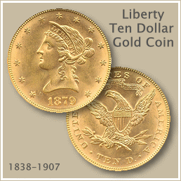
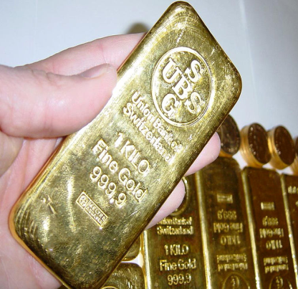
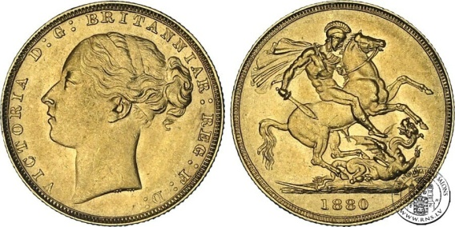
ORIGINS
The gold standard has it origin in the use of gold coins/ gold bullion as a medium of exchange, 1880-1914 (before WWI)
Gold was used as a medium of
exchange because of its:
  Scarcity
  Durability
  Transportability
  Divisibility
  Homogeneous
Process of Gold standard
  1819 : Great Britain (de jure in 1819 and de facto in 1717)
  1870s: Germany and other European countries
  1879 : Japan
  1900: U.S (de jure in 1900 and de facto in 1834)
  -> Gold standard as an International Monetary System
THE GOLD STANDARD
Notes:
England formally adopted the gold standard in 1819 (in fact it had replaced the silver standard by the gold standard since 1717).
The United States, though formally on a bimetallic (gold and silver) standard, switched to gold de facto in 1834 and de jure in 1900 when Congress passed the Gold Standard Act

Slide 14
PRINCIPLES
The gold standard was a commitment by participating countries to fix the prices of their domestic currencies in terms of a specified amount of gold
National money were freely converted into gold at the fixed price (Government ensured the convertibility from domestic currency into gold -> passively buy or sell any amount of gold at the promised price.)
Gold was allowed to freely move between countries and became source of official international reserves.
The central bank could not print more money unless it got more gold reserves. -> the role of central bank under gold standard was limited
In USA: 1 ounce of gold = $20.67
In GB: 1 ounce of gold = £4.24
THE GOLD STANDARD

Slide 15
ADJUSTMENT MECHANISM OF EXCHANGE RATE
The official exchange rate between two currencies was calculated as the ratio of their prices in terms of gold
E.g. In USA: the price of 1 ounce was $20.67
In GB : the price of 1 ounce was £4.24
-> Exchange rate = $20.67/£4.24 = 4.87$/£
THE GOLD STANDARD

Slide 16
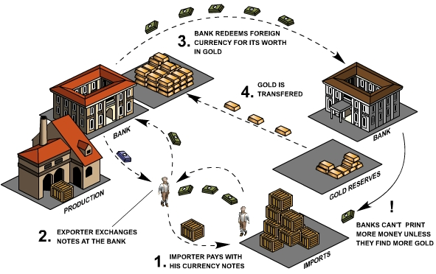
THE GOLD STANDARD (1880-1914)
Export (surplus in BOP)
<-> Inflows of gold
Import (deficit in BOP)
<-> Outflows of gold

Slide 17
ADJUSTMENT MECHANISM OF BOP
Price – specie – flow mechanism (Hume)
The price-specie-flow is an automatic adjustment mechanism, in which prices will adjust to restore the balance-of-payment in both deficit and surplus countries
  In deficit countries, gold flows out and the supply of money decreases. The resulting decrease in prices stimulates exports and discourages imports, leading to the improvement in the balance of payments.
  There is an inflow of gold in surplus countries, and the supply of money increases. The resulting increase in prices stimulates imports and discourages exports, reducing the surplus in the balance of payments.
  -> a perpetual deficit or surplus is impossible under the gold standard.
THE GOLD STANDARD

Slide 18
ADJUSTMENT MECHANISM OF BOP
Price – specie – flow mechanism (Hume)
    BOP deficit -> Outflow of gold -> Money supply⬇
    -> Internal prices⬇
    -> Export⬆; Import⬇
    -> Until BOP deficit eliminated
    BOP surplus -> Inflow of gold -> Money supply⬆
    -> Internal prices⬆
    -> Export⬇; Import⬆
    -> Until BOP surplus eliminated
THE GOLD STANDARD

Slide 19
ADJUSTMENT MECHANISM OF BOP
Rules-of-game mechanism
Under the rule of game of the gold standard the adjustment process was reinforced by restricting credit in deficit countries and expanding credit in surplus countries.
  In a deficit nation,
  -> Central bank raises interest rate (restrict credits) to attract capital inflows to cover the deficit, thus restoring the BOP equilibrium
  In a surplus nation
  -> Central bank decrease interest rate (expand credit) leading to capital outflows to offset the surplus in the current account
THE GOLD STANDARD
Notes:
under the gold standard, the role of central bank is limited because it cannot print more money. It means that central cannot influence the money supply and the internal price as price-specie-flows did. However, central bank is still be able to facilitate the adjustment of BOP by influence on the interest rate. For example, … The process that central bank impacts on the interest rate is called rules-of-games mechanism

Slide 20
GOLD STANDARD IN PRACTICE
During gold standard period, the world economy developed quickly and smoothly; BOP of countries adjusted efficiently; virtually no conflicts between countries’ policies.
However, most of the adjustment did not take place as described by the price-specie-flow mechanism
    Very little actual transfers of gold among nations
    BOP disequilibria were settled mostly through the international capital flows rather than through gold transfer
      In the deficit nation, the money supply falls and interest rates rise. This attracted short-term capital inflows to cover the deficit.
      The government can reinforce this adjustment by deliberately raising interest rates to attract even more capital inflows.
THE GOLD STANDARD
Notes:
We have discussed the BOP adjustment mechanism from the theoretical perspectives. How does the adjustment take place in practice?

Slide 21
GOLD STANDARD IN PRACTICE
Reasons of quick and smooth economic development: Special conditions of the world economy during the period of the gold standard
A period of economic expansion and stability
Applied in only some main industrialized countries (strictly followed the fixed exchange rate; similar growth level and cycle)
The preeminence of Britain -> high confidence on the regime
THE GOLD STANDARD

Slide 22
COLLAPSE OF THE GOLD STANDARD
Outbreak of World War I 1914:
  Countries made it illegal for citizens to cash in their certificates to take the gold from the central bank
  Countries stopped exporting gold to maintain the gold reserve
  -> THE END OF THE GOLD STANDARD
THE GOLD STANDARD
Notes:
With the outbreak of World War I, the classical gold standard came to an end.

Slide 23
2. THE INTER-WAR PERIOD/
GOLD EXCHANGE STANDARD
(1919-1939)

Slide 24
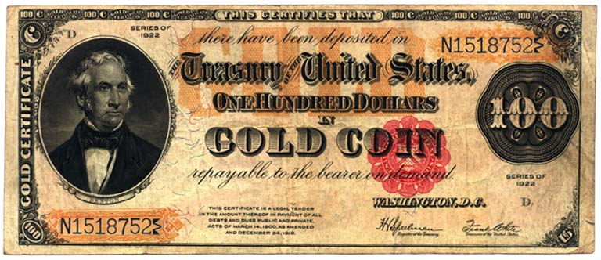
GOLD-EXCHANGE STANDARD/ GENOA SYSTEM
1919-1924: exchange rates fluctuated wildly, monetary instability -> A desire to return to the gold standard.
04/1925: the GB reestablished the convertibility of the pound into gold at the prewar price. Other nations followed GB and went back to gold standard (US had already returned to gold in 1919)
Gold-exchange standard (Genoa Conference 1922)
  International reserves: Both gold and currencies convertible into gold (GBP, USD and FRF)
THE INTER-WAR PERIOD
Notes:
Between 1919 and 1924, exchange rates fluctuated wildly, and this led to a desire to return to the stability of the gold standard. In April 1925, the United Kingdom reestablished the convertibility of the pound into gold at the prewar price Other nations followed the United Kingdom’s lead and went back to gold.
However, the new system was more in the nature of a gold-exchange standard than a pure gold standard in that both gold and currencies convertible into gold (mostly pounds but also U.S. dollars and French francs) were used as international reserves.

Slide 25
GOLD-EXCHANGE STANDARD/ GENOA SYSTEM
Applying prewar price of convertible currencies in terms of gold led to overvaluation and undervaluation of currencies
  Overvaluation of GBP -> British BOP deficits
  Undervaluation of FRF -> France’s large BOP surpluses
1928: French government promoting Franc as international currency by accumulating gold
  Requiring settlement of BOP surpluses in gold, not in GBP or other currencies
  Converting all of its previously accumulated GBP into gold
-> A serious drain on GB gold reserves -> a lack of confidence on GBP
-> a shift of short-term capital from London to Paris and New York
1931: Britain suspended convertibility of pound for gold and devalued pound by 30% -> gold exchange standard came to an end.
1933-1934: US left gold standard; $ devaluated 40% (from $20.67/ounce to $35/ounce)
THE INTER-WAR PERIOD
Notes:
Since the United Kingdom had lost a great deal of its competitiveness and had liquidated a substantial portion of its foreign investments to pay for the war effort, reestablishing the prewar parity left the pound grossly overvalued. This led to balance-of-payments deficits and to deflation as the United Kingdom attempted to contain its deficits. On the other hand, France faced large balance-of-payments surpluses after the franc was stabilized at a depreciated level in 1926.

Slide 26
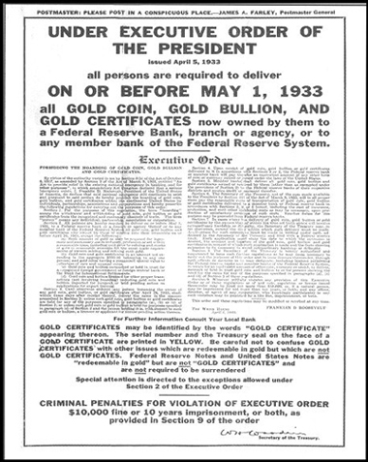

Slide 27
GOLD-EXCHANGE STANDARD/ GENOA SYSTEM
1931-1936:
  A period of great instability and competitive devaluations (to stimulate export) -> exchange rates among major currencies did not change much with those in 1930 but the value of gold reserves was increased. -> Accumulation of gold.
  Growth of high tariff and other serious import restrictions -> 50% of decline in world trade
  Strict control on the foreign exchange
-> Chaotic conditions in international trade and finance
THE INTER-WAR PERIOD
Notes:
There followed, from 1931 to 1936, a period of great instability and competitive devaluations as nations tried stimulate export. By 1936, exchange rates among the major currencies were approximately the same as they had been in 1930, before the cycle of competitive devaluations began. The only effect was that the value of gold reserves was increased. However, most foreign exchange reserves had been eliminated by mass conversions into gold as protection against devaluations.
This was also a period when nations imposed very high tariffs and other serious import restrictions, so that international trade was cut almost in half. For example, in 1930 the United States passed the Smoot–Hawley Tariff Act, which raised U.S. import duties to an all-time high By 1939, of course, depression gave way to full employment—and war.

Slide 28
REASONS OF COLLAPSE
The lack of an adequate adjustment mechanism in the face of grossly inappropriate parities
The huge destabilizing capital flows from London to the emerging international monetary centers of New York and Paris.
The outbreak of the Great Depression (1929-1933) forced countries to promote exports and protect domestic industries through competitive devaluation and tariffs
THE INTER-WAR PERIOD
Notes:
the interwar experience clearly indicated the prevalence of desta- bilizing speculation and the instability of flexible exchange rates. More recently, the inter- war experience has been reinterpreted to indicate that the wild fluctuations in exchange rates during the 1919–1924 period reflected the serious pent-up disequilibria that had developed during World War I and the instability associated with postwar reconstruction, and that in all likelihood no fixed exchange rate system could have survived during this period.

Slide 29
3. THE BRETTON WOODS SYSTEM/
FIXED EXCHANGE RATE AGAINST USD
(1944-1973)

Slide 30
ORIGINS
After WWII: Europe was devastated; British Empire was gone -> The need of recovery with a new international financial and political system.
US became the strongest country in international trade and finance with largest gold reserve (70%)
-> USD was used as international reserve (replacing gold)
In 1944, 44 nations met at Bretton Woods to establish the basic framework for the post-WII international monetary system
    Establishment of IMF + WB
    Establishment of Bretton Woods exchange rate system
BRETTON WOODS SYSTEM

Slide 31
IMF vs. WB
IMF _ 2 functions:
  Overseeing that nations followed a set of agreed upon rules of conduct in international trade and finance.
  Providing credit to member countries facing temporary deficit in BOP
    Short-term loans (repaid within 3-5 years)
    Borrowings were often attached by conditions, e.g. controls on government spending, in growth of money supply, wage increases,…)
WB: Providing concessional loans to finance long-term development projects.
Notes:
The IMF opened its doors on March 1, 1947, with a membership of 30 nations. With the admission of the Soviet Republics and other nations during the 1990s, IMF membership reached 187 at the beginning of 2012. Only a few countries, such as Cuba and North Korea, are not members. VN 21/09/1956

Slide 32
MAIN FEATURES OF BWS
Gold exchange standard/ Fixed exchange rate against USD
    USD is served as the base currency (only USD remained convertible to gold)
    The price of gold was fixed at $35/oz.
    US guaranteed to exchange on demand dollars for gold at that price.
    Other nations were to fix the price of their currencies in terms of dollars (par value) and keep the x-rate from moving by more than 1% above or below the par value.
BRETTON WOODS SYSTEM
German mark
British pound
French franc
1950s-1960s:
Gold-dollar standard
US dollar
Pegged at $35/oz.
Gold
Notes:
The United States was to maintain the price of gold fixed at $35 per ounce and be ready to exchange on demand dollars for gold at that price without restrictions or limitations. Other nations were to fix the price of their currencies in terms of dollars (and thus implicitly in terms of gold) and intervene in foreign exchange markets to keep the exchange rate from moving by more than 1 percent above or below the par value. Within the allowed band of fluctuation, the exchange rate was determined by the forces of demand and supply.
Until the late 1950s and early 1960s, when other currencies became fully convertible into dollars, the U.S. dollar was the only intervention currency, so that the new system was practically a gold-dollar standard.

Slide 33
MAIN FEATURES OF BWS
To keep the exchange rate within the agreed par value ± 1%
  A nation would purchase dollars with its own currency to prevent an appreciation of its currency by >1% from the par value
  A nation would sell dollars to purchase its own currency to prevent an depreciation of its currency by >1% from the par value
Nations could borrow from the IMF to finance temporary BOP deficits
Only in a case of fundamental BOP disequilibrium (large and persistent BOP deficits or surpluses) was a nation allowed to change the par value of its currency
  Exchange rate changes < 10%: allowed without the Fund approval
  Exchange rate changes ≥ 10%: approval of the Fund needed
-> Adjustable peg system -> Flexibility of BWS
BRETTON WOODS SYSTEM
Notes:
Thus, the Bretton Woods system was in the nature of an adjustable peg system
Borrowing from the Fund (to be described below) was restricted to cover temporary balance-of-payments deficits and was to be repaid within three to five years so as not to tie up the Fund’s resources in long-term loans. Long-run development assistance was to be provided by the International Bank for Reconstruction and Development (IBRD or World Bank) and its affiliates, the International Finance Corporation (established in 1956 to stim- ulate private investments in developing nations from indigenous and foreign sources) and the International Development Association (established in 1960 to make loans at subsidized rates to the poorer developing nations).
Today the IMF publishes, among other things, International Financial Statistics and Direction of Trade Statistics, the most authoritative sources of comparable time series data on the balance of payments, trade, and other economic indicators of member nations.

Slide 34
MAIN FEATURES OF BWS
Nations were to remove all restrictions on the full convertibility of their currencies into other currencies and into the US dollar
Nations were forbidden to impose additional trade restrictions and existing trade restrictions were to be removed gradually in multilateral negotiations under GATT
However, restrictions on international liquid capital flows were permitted to allow nations to protect their currencies against destabilizing/ hot international money flows.
BRETTON WOODS SYSTEM

Slide 35
BWS IN PRACTICE
Infrequent changes in par values during 1950-1971
  U.K devalued only in 1967
  France devaluated in 1957, 1969
  West Germany revalued in 1961, 1969
  United States, Italy, Japan never changed their par values
Effects of the unwillingness of industrial nations to change their par values:
  Gave rise to hug destabilizing international capital flows
  Rob the flexibility of BWS and therefore the mechanism for adjusting BOP disequilibria.
BRETTON WOODS SYSTEM
Notes:
While the Bretton Woods system allowed changes in par values in cases of fundamental disequilibrium, deficit nations rarely devalued their currencies because they regarded this as a sign of national weakness. Surplus nations resisted needed revaluations, preferring instead to continue accumulating international reserves.
Thus, from 1950 until August 1971, the United Kingdom devalued only in 1967; France devalued only in 1957 and 1969; West Germany revalued in 1961 and 1969; and the United States, Italy, and Japan never changed their par values. Meanwhile, Canada (defying the rules of the IMF) had fluctuating exchange rates from 1950 to 1962 and then reinstituted them in 1970. Developing nations, on the other hand, devalued all too often.
Specifically, a nation such as the United Kingdom, with chronic balance-of-payments deficits over most of the postwar period, was plagued by huge liquid capital outflows in the expectation that the pound would be devalued. Indeed, these expectations became self-fulfilling, and the United Kingdom was forced to devalue the pound in 1967 (after a serious deflationary effort to avoid the devaluation). On the other hand, a nation such as West Germany, with chronic balance-of-payments surpluses, received huge capital inflows in the expectation that it would revalue the mark. This made revaluation of the mark inevitable in 1961 and again in 1969.

Slide 36
BWS IN PRACTICE
1944-1957: Dollar shortage (large US trade surplus)
1958-1971: Dollar “glut” (US large and persistent deficits due to increased expenditure on VN war and growing overseas direct investment (mainly in Europe)
-> During the late of 1950s and 1960s: the US suffered from a large and increasing deficit in BOP, which was mainly settled in dollars. Surplus countries were willing to accept dollars, so foreign-held dollar reserves increased.
-> In the early 1960s, foreign-held dollar reserves exceeded the U.S. gold reserves -> other countries to convert their excess dollar reserves into gold and further reduced the U.S. gold reserves.
-> A sharp decline in the US gold reserves
BRETTON WOODS SYSTEM
Notes:
1944-1958 was period of dollar shortage. US ran huge BOP surpluses with Europe
Up to 1957, U.S. deficits were rather small, averaging about $1 billion each year
However, starting in 1958, U.S. balance-of-payments deficits increased sharply and averaged over $3 billion per year. Contributing to the much larger US deficits since 1958 was an increased expenditure on VN war, and growing US overseas direct inverstment (mainly in Europe)

Slide 37
BWS IN PRACTICE
US responses: The US was not willing to devaluate USD, instead, a number of policies were adopted with limited success, including:
    Keeping short-term interest rates high to discourage short-term capital outflows.
    Selling forward strong currencies to increase forward discount and discourage liquid capital outflows.
    Intervening in the spot market to support the dollar
    Imposing direct controls on capital outflows
    Taking measures to encourage exports and reduce military expenditures
    Persuade surplus nations, particular West Germany and Japan to revaluate their currencies -> unsuccessful
-> Expectation of USD devaluation -> led to huge destabilizing capital movements out of dollars and into stronger currencies (German mark, Japanese yen, Swiss franc)
BRETTON WOODS SYSTEM
Notes:
1944-1958 was period of dollar shortage. US ran huge BOP surpluses with Europe
Up to 1957, U.S. deficits were rather small, averaging about $1 billion each year
However, starting in 1958, U.S. balance-of-payments deficits increased sharply and averaged over $3 billion per year. Contributing to the much larger US deficits since 1958 was an increased expenditure on VN war, and growing US overseas direct inverstment (mainly in Europe)

Slide 38
COLLAPSE OF BWS
15/08/1971: US President Nixon was forced to suspend the convertibility of dollars into gold -> the end of BWS
12/1971: Group of Ten nations met at Smithsonian Institution in Washington, D.C. agreed to devaluate of USD (from $35 to $38 per ounce of gold); revaluate of DM, yen and other currencies -> Nixon regarded Smithsonian Agreement as “the most significant monetary agreement in the history of the world” and promised that the dollar “would never again be devaluated”
However, with another huge US BOP deficit in 1972 -> another devaluation of USD -> 03/1973 major industrial nations decided to let their currencies float
-> The end of fixed exchange rates and a move to floating exchange rates
BRETTON WOODS SYSTEM
Notes:
15/08/1971: US President Nixon was forced to suspend the convertibility of dollars into gold -> the end of BWS
the dollar remained an international currency without any backing of gold after the Bretton Woods system collapsed in August 1971 and even after the dollar was allowed to fluctuate in value in March 1973. Indeed, the amount of foreign-held dollars has risen dramatically in the years since 1971

Slide 39
COLLAPSE OF BWS
Explanations for collapse of Bretton Woods System
The immediate cause of the collapse of the Bretton-Woods system is the huge U.S. balance-of payment deficits in early 1970s.
The fundamental causes includes:
  Liquidity: foreign-hold dollars far exceeded US gold reserves
  Adjustment: the lack of adjustment mechanism for correcting the balance-of-payment deficits
    Countries were allowed to adjust exchange rates when they faced a persistent disequilibrium in the BOP. In reality, however, currency devaluation/revaluation was difficult.
    The inability to devaluate the dollar left the U.S. with persistent deficits in the BOP. Meanwhile, surplus countries like Germany or Japan were not willing to revaluate their currencies.
  Confidence: the lack of adequate adjustment mechanism undermined the confidence on the dollar _ people expected that dollar would be devaluated
BRETTON WOODS SYSTEM

Slide 40
4. THE PRESENT IMS
(1973-present)

Slide 41
Jamaica Accords
After BWS’s collapse (03/1973) -> Managed floating exchange rate system
  Exchange rates determined by supply and demand in foreign exchange market -> automatic adjustment mechanism.
  Central banks may intervene in foreign exchange markets to smooth short-run fluctuations in exchange rates
1976: Jamaica Accords formally recognizing managed floating exchange rate system; ratified and took effect in 04/1978
Notes:
Since March 1973, the world has had a managed floating exchange rate system. Under such a system, Exchange rates determined by supply and demand in forex market -> automatic adjustment mechanism. Central banks may intervene in foreign exchange markets to smooth short-run fluctuations in exchange rates.
Indeed, the 1976 Jamaica Accords formally recognized the managed floating system and allowed nations the choice of foreign exchange regime as long as their actions did not prove disruptive to trade partners and the world economy. These Jamaica Accords were ratified and took effect in April 1978.

Slide 42
Principles
Nations are allowed to choose exchange rate regimes
  Industrial countries and large developing countries tend to adopt managed floating exchange rate regimes
  Other countries adopt more-inclined fixed exchange rate regimes with different degrees of fixity.
Gold is abandoned as an international reserve asset
  The official price of gold was abolished
  No gold transactions between IMF and member nations
  IMF has gradually sold its gold holdings on the free market
USD still plays as principal reserve currency

Slide 43
Problems with the present ims
3

Slide 44
Problems of the present IMS
The large volatility of exchange rate
  Recently, the increasingly integrated global capital market leads to an increasingly wave of volatile international capital flows, particularly short-term speculative capital flows -> the major cause for exchange and macroeconomic instability.
  Large capital inflows will cause the appreciation of domestic currency and/or domestic inflation. By contrast, a massive capital withdrawal lead to huge currency depreciation or even currency and financial crises.
Wide and persistent misalignments of exchange rates: Exchange rates are not kept at the equilibrium level, with domestic currency being undervalued in some countries and overvalued in other countries
The failure to promote greater coordination of economic policies among the leading nations
The inability to prevent international financial crises in emerging market economies or to deal with them adequately when they arise
Notes:
There have been six crises in emerging markets since the mid-1990s: Mex- ico in 1994–1995, Southeast Asia in 1997–1999, Russia in summer 1998, Brazil in 1999, and Turkey and Argentina in 2001–2002
Causes of financial crisis
Excessive foreign borrowing
A weak banking system
A poorly regulated banking system
Volatile capital flows

Slide 46
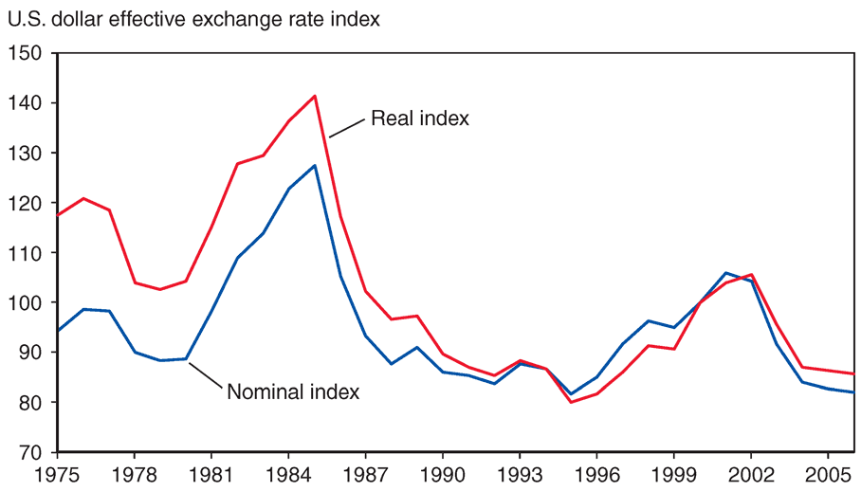
Nominal and Real Effective Dollar Exchange Rate Indexes, (1975–2006)
Source: International Monetary Fund, International Financial Studies.

Slide 48
Proposals for Reform
‘Target zones’ for exchange rate (Williamson, 1986)
Leading industrial nations estimate the equilibrium exchange rate and agree on the band of fluctuations (10% suggested) -> allow for a large range of fluctuations.
The exchange rate is determined by the forces of demand and supply within the allowed band of fluctuation and is prevented from moving outside the target zones by official intervention in foreign exchange markets.
-> Help to reduce exchange rate fluctuations and avoid exchange rate misalignment.
Notes:
One proposal, first advanced by Williamson (1986), is based on the establishment of target zones. Under such a system, the leading industrial nations estimate the equilibrium exchange rate and agree on the range of allowed fluctuation. Williamson suggested a band of allowed fluctuation of 10 percent above and below the equilibrium exchange rate. The exchange rate is determined by the forces of demand and supply within the allowed band of fluctuation and is prevented from moving outside the target zones by official intervention in foreign exchange markets. The target zones would be soft, however, and would be changed when the underlying equilibrium exchange rate moves outside of or near the boundaries of the target zone. Though not made explicit, the leading industrial nations seemed to have agreed upon some such “soft” target or “reference zones” for the exchange rate between the dollar and the yen and between the dollar and the German mark at the Louvre agreement in February 1987 (but with the allowed band of fluctuation much smaller than the ±10 percent advocated by Williamson). During the early 1990s, however, this tacit agreement was abandoned in the face of strong market pressure which saw the dollar depreciate very heavily with respect to the yen.

Slide 49
Suppose the spot exchange rate and the 3 month fwd rate between the dong and dollar are 20.000đ/dollar and 20.500 đ/dollar respectively. The annual interest rates paid on dong and dollar deposits are 10% and 4% respectively. Suppose you have 20 million dong to invest.
A. Calculate the profit of investing in dong and dollar deposits
B. Explain why investing in dollar deposits is more profitable than investing in dong deposits.

Slide 50
Proposals for Reform
‘Dual exchange rate’ (Dornbush and Frankel, 1987)
In the proposal of dual exchange rates, less flexible rates are applied to trade and investment transactions. This would increase the exchange rate stability for international trade and investment.
More flexible exchange rates will be applied to purely financial transactions not related to international trade and investment to discourage these transactions.
‘Tobin Tax’ (Tobin, 1978)
A transaction tax imposed, in which the progressively higher the tax becomes, the shorter the duration of transaction.
-> Both proposals are to restrict international “hot money”/speculative capital flows
Notes:
The exchange rate fluctuations create foreign exchange risks for traders and investors and thus discourage international trade and investment.
In the proposal of dual exchange rates, less flexible rates are applied to trade and investment transactions. This would increase the exchange rate stability for international trade and investment.
More flexible exchange rates will be applied to purely financial transactions not related to international trade and investment to discourage these transactions.

Slide 51
Proposals for Reform
Measures to prevent or minimize the cost of financial crises
  Increasing transparency in the international monetary system: adequate, reliable and timely information and analysis help investors to know potential problems in the country where they invest.
  Strengthening the banking and financial system: a sound financial system prevents funds to be channeled into nonproductive and risky investment.
  Promoting a greater involvement of the private sector: the private sector should take their responsibility for the crisis

Slide 52
THANK YOU!

