Slide 1
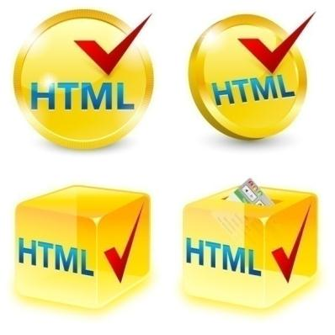
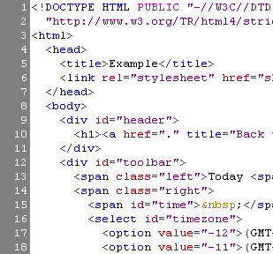

WEB SYSTEMS & TECHNOLOGIES
0. Internet and Web

Slide 2
Table of Contents
Introduction
  Introduction of web
  Evolution of web
  Types of Web application
Web Application architecture
  Web Application components
  Web Client side
  Web Server side
  Introduction to Web Services

Slide 3
Introduction of Web
The Internet is a vast, international network, made up of computers and the physical connections (wires, routers, etc.) allowing them to communicate.
The World Wide Web (WWW or just the Web) is a collection of software that spans the Internet and enables the interlinking of documents and resources.
Notes:
Provides a way of accessing information on the Internet.

Slide 4
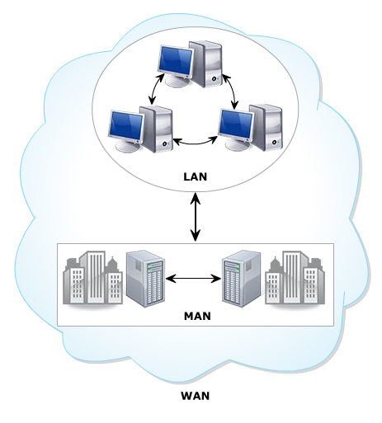
Evolution of web
The growth of computing expanded in multiple.
Organizations connect together to share data.
This makes the beginning of computer networks.

Slide 5
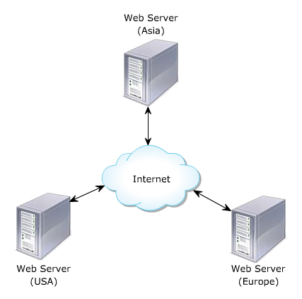
Web and Internet
WANs raised a strong need about global data sharing
This resulted referred as WWW.
Internet is known as the largest WAN.

Slide 6
Web can be classified
Web 1.0.
Web 2.0.
Semantic Web.

Slide 7
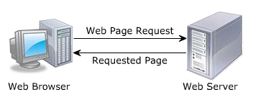
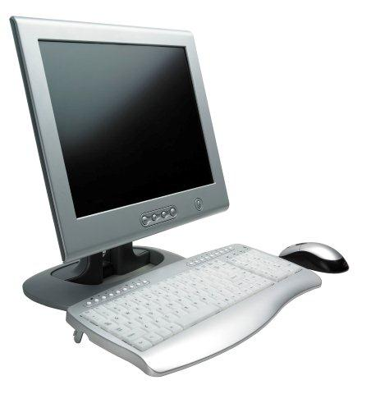
Web 1.0
To be Known as traditional web.
Authors write/publish content on the web.
The published content has read-only format.
Posing the problem of User interactivity.
write
read
Internet
Web Author
Web Reader

Slide 8
Web 2.0
Web 2.0 also called as the read-write web.
Readers can interact the authors by providing comments, blogs, queries, rating and so on.

Slide 9
Web 2.0
It’s great platform for the readers to share their viewpoints with the authors.
The Web space is limited in web 1.0 and 2.0.
read/write
Internet
read/write
Web Author
Web Reader

Slide 10
Semantic web
Concept to be expected as the future of web.
It is the read-write-request web.
The user can send the request for Web space.
Web
read/write/request
read/write/request
Semantic
Web space
Semantic
Web space
Web Author
Web Reader

Slide 11
Static web pages
Static web pages have a limitations.
Difficult to maintain.
Updated manually.
Inconsistency.
Don’t allow any user interaction.

Slide 12
Dynamic web pages
Include static as well as dynamic web pages.
Allows customizing the content and its appearance in the browser.
Geneates content “on-demand”.
Accepts the user inputs through web browser.
Serveral technologies envoled to make web sites more flexible and dynamic.
Variety device such as PDAs, Cell phones, and so on is used XHTML Documents

Slide 13
Types of Web Application
Static Web Application
Dynamic Web Application
Shop online or e-commerce
Portal Web Application
Animation Web Application
Web Application with CMS
Notes:
Static app: non flexible, little content, HTML,JS, CSS, …
Dynamic App: complex on technical level, use database, operates with an Administrative Panel call CMS (Asp, PHP, JSP,…)
Shop online or e-commerce: electronic payment, modify product information, fully responsive app, mobile version
Portal App: accesses content, various sections or categories through a home page, includes chats, forums, emails, latest content,…
Animated App: animated effects, Flash Tech, not suitable for web position purpose.
CMS App: (Content Management System): modify content on the website, Wordpress, Joomla, Drupal, commonly use for contents page, blogs, news pages, articles, media, …

Slide 14



Web Application architecture
WWW use classical client / server architecture
  HTTP is text-based request-response protocol
HTTP
Page request
HTTP
Server response
Server running Web Server Software (IIS, Apache, etc.)
Client running a Web Browser
Notes:
there are basically two programs running at the same time:
The code that lives on the server and responds to HTTP requests.
The code that lives in the browser and responds to user input.

Slide 15
Server-Side Code
Languages/frameworks include but are not limited to Ruby (Rails), Javascript (Node.js), Python (Django), PHP, C#, and Java; but the list of possibilities is infinite. Any code that can run on a computer and respond to HTTP requests can run a server.
Stores persistent data (user profiles, instatweets, mybook pages, etc.).

Slide 16
Server-Side Code
Cannot be seen by the user (unless something is terribly wrong).
Can only respond to HTTP requests for a particular URL, not any kind of user input.
Creates the page that the user finally sees (this is generally only true in web applications that choose to render most of their layouts on the server)

Slide 17
Client-Side Code
Languages used include: HTML, CSS, and JavaScript.
Parsed by the user’s browser.
Reacts to user input.
Can be seen and edited by the user in full.
Notes:
Languages used include: HTML, CSS, and JavaScript. Nothing else. But don’t worry, there’s a million frameworks and transpiles-to-[CSS|HTML|JS] languages to choose from (and keep yourself updated on) anyway.

Slide 18
Client-Side Code
Cannot store anything that lasts beyond a page refresh.
Cannot read files off of a server directly, must communicate via HTTP requests.
Creates the page that the user finally sees (this is generally only true in single page applications).

Slide 19
  Introduction to Web Services
A Web service is a software module that has a URL or an Internet address so they can be called upon to perform a operation via the Internet.
One Web service makes a request of another Web service to perform its task or tasks and pass back an answer creating a highly distributed system.
using XML based messages via internet-based protocols.
Web Services are latest distributed technology

Slide 20
  Introduction to Web Services
Benefits of Web Services:
  Loosely Coupled
  Ease of Integration
  Service Reuse
Notes:
Loosely Coupled: Each service exists independently of the other services that make up the application. Individual pieces of the application to be modified without impacting unrelated areas.
Ease of Integration: Data is isolated between applications creating ’silos’. Web Services act as glue between these and enable easier communications within and across organisations.
Service Reuse: Takes code reuse a step further. A specific function within the domain is only ever coded once and used over and over again by consuming applications.

Slide 21
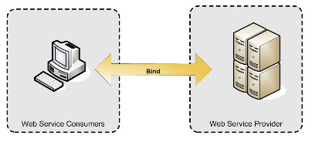
  Web Services Architectures
The simplest Web service system has two participants:
  A service producer (provider)
  A service consumer(requester).
The provider presents the interface and implementation of the service, and the requester uses the Web service.

Slide 22
  Web Services Architectures
Service-Oriented Architecture
  A broker, acts as a broker for Web services.
  A provider, can publish services to the registry
  A consumer, can then discover services in the registry
Notes:
Service Provider
A service is a function or a facility.
A Service provider makes such services available for service consumers to use.
Service Broker
Acts as a common point to publish all service-related information.
Stored information about the organizations and the services they provide.
Stores information about how to access and use the service.
Service Consumer
Is another application or service within the organization or external to the organization.
Uses the service broker to locate one more services. Once a service located, the consumer binds itself to the service provider in order to use the service.

Slide 23
  Web Services Architectures
Service
Provider
Publish
Bind/ Communication
Service
Broker
Service
Requestor
Service
Registry
(UDDI)
Find/Look up
Notes:
Provider creates WS and host to server (service broker or service Registry in practical)
Service Requestor find the service on Registry/ Broker. If found, the requestor binding with Provider to consume WS
UDDI:Universal Description, Discovery, and Integration

Slide 24
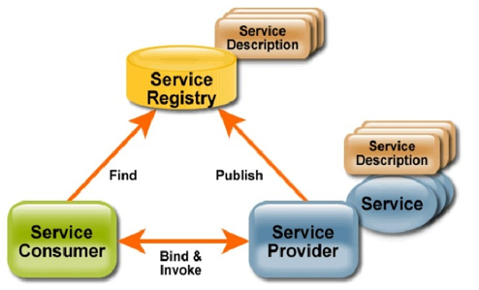
Web Services Conceptual Model

Slide 25
Life cycle of Web Service
Create Web Service
Define Service Interface & Invocation Methods
Unpublish Web Service if not needed
Publish Web Service on Internet or Intranet
Invoke Web Service to be used by web users
Web users should find Web Service to use

Slide 26
Web Service Standard

Slide 27
Web Service standard
Web services are a set of specifications formulated and accepted by the leading enterprises that provide or avail Web services.
Various Web services standards are:
  XML: Represents data in a standard format
  SOAP: Common, extensible, message format
  WSDL: Common, extensible, service description language
  UDDI: Maintains registries storing information about service providers and their services

Slide 28
XML – eXtensible Markup Language
Extensible Markup Language (XML) is a markup language that defines a set of rules for encoding documents in a format that is both human-readable and machine-readable.
The design goals of XML emphasize simplicity, generality, and usability over the Internet.
Many application programming interfaces (APIs) have been developed to aid software developers with processing XML data, and several schema systems exist to aid in the definition of XML-based languages.
Notes:
It is defined in the XML 1.0 Specification produced by the W3C, and several other related specifications, all gratis open standards.
It is a textual data format with strong support via Unicode for the languages of the world. Although the design of XML focuses on documents, it is widely used for the representation of arbitrary data structures, for example in web services.

Slide 29
SOAP - Simple Object Access Protocol
Is an text-based standard protocol of WS.
Enables communication between Web services and Web service clients.
Allows different enterprises to communicate and exchange information as SOAP messages
Notes:
Features
Programming is language-independent
Platform-independent
Object-oriented
Elements of a SOAP message:
SOAP Envelope element
SOAP Header element
SOAP Body element

Slide 30
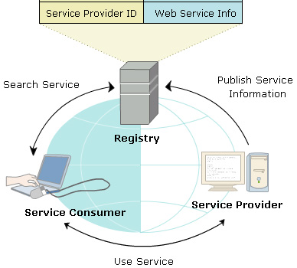
Web Services Registry

Slide 31
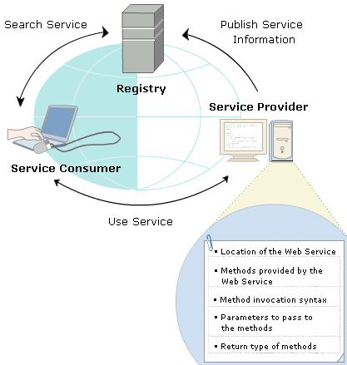
WSDL - Web Services Description Language

Slide 32
?
?
?
?
?
Questions?
?
?
?
?
?
?

