Slide 1

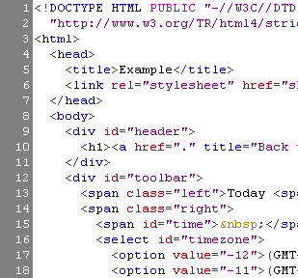

WEB SYSTEMS & TECHNOLOGIES
6. Web Security

Slide 2
Table of Content
Web Security Facts
Web Communication Fundamentals
Popular Web Application Attacks
How to Secure Web Applications

Slide 3
Web Security Facts
White Security Statistics Report 2015
  86% of all websites tested by Whitehat Sentinen had at least one serious vulnerability, and most of the time, far more than one.
  90,9 % of the explointed vulnerabilities were compromised more than a year after the Common Vulnerability and Exposures (CVE) record was published.
  500 million dollars – the damages Ashley Madison was already facing via lawsuits filed only one week after their massive data breach.

Slide 4
Web Communication Fundamentals
HTTP
GET vs. POST Security
Web Sites vs. Web Application
Web Applications Breach the Perimeter

Slide 5
Hypertext Transfer Protocol - HTTP
Hypertext Transfer Protocol (HTTP) is a communications protocol for the transfer of information on intranets and the World Wide Web. Its original purpose was to provide a way to publish and retrieve hypertext pages over the Internet.”
http://en.wikipedia.org/wiki/HTTP
Server
www.mybank.com
(64.58.76.230)
Port: 80
Client PC
(10.1.0.123)
Request
Response
Notes:
HTTP is called a stateless protocol because each request is processed independently, without any knowledge of the requests that came before it.

Slide 6
HTTP Request - GET
Form data encoded in the URL
Most common HTTP method used on the web
Should be used to retrieve information, not for actions that have side-effects
Notes:
REST is a term coined by Roy Fielding in his Ph.D. dissertation [1] to describe an architecture style of networked systems. REST is an acronym standing for Representational State Transfer. http://www.xfront.com/REST-Web-Services.html

Slide 7

HTTP Request - GET
GET http://www.mysite.com/kgsearch/search.php?catid=1 HTTP/1.1
Host: www.mysite.com
User-Agent: Mozilla/5.0 (Windows; U; Windows NT 5.1; en-US; rv:1.8.1.13) Gecko/20080311 Firefox/2.0.0.13
Accept: text/xml,application/xml,application/xhtml+xml,text/html;q=0.9,text/plain;q=0.8,image/png,*/*;q=0.5
Accept-Language: en-us,en;q=0.5
Accept-Encoding: gzip,deflate
Accept-Charset: ISO-8859-1,utf-8;q=0.7,*;q=0.7
Keep-Alive: 300
Connection: keep-alive
Referer: http://www.mysite.com/

Slide 8
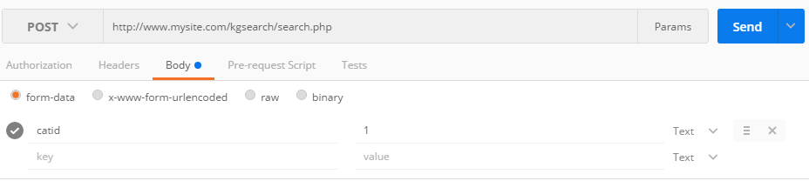
HTTP Requests - POST
Data is included in the body of the request.
Should be used for any action that has side-effects
  Storing/updating data, ordering a product, etc…
Tool: Chrome Add-in Postman:
  Demo: Change GET http://www.mysite.com/kgsearch/search.php?catid=1 to POST Request using Postman

Slide 9
GET v. POST Security
There information contained in parameters can tell a user a lot about how your application works
GET parameters are easily visible in the address bar
POST parameters are hidden from the average user
  Users can still view source code
  Users can still view the packets
  Users can still intercept & modify web requests

Slide 10
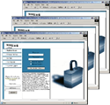
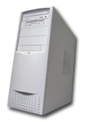
Web Sites
No applications
Static pages
Hard coded links
Browser
Web Server

Slide 11
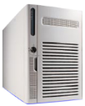

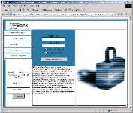
Web Applications
Very complex architectures, multiple platforms, multiple protocols
Web Application
Web Services
HTTP
Network
Web Servers
Presentation Layer
Media Store
Application Server
Business Logic
Content Services
Database Server
Customer Identification
Access Controls
Transaction Information
Core Business Data
Wireless
Browser
Notes:
Main speaking points:
- Now we no longer have websites, we have web applications
- Web applications reside on multiple systems in distributed architectures
- Three tiers (presentation, logic, data)
- Use sophisticated programming languages and architectures
- Corporate and customer data moved to the computing edge
- Edge extended to cellphones, pda’s, mobile sales force solutions, inventory management systems, etc.

Slide 12

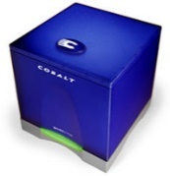

Web Applications Breach the Perimeter
Internet
DMZ
Trusted Inside
IIS
SunOne
Apache
ASP
.NET
WebSphere
Java
SQL
Oracle
DB2
HTTP(S)
Corporate Inside
Browser
Firewall only allows applications
on the web server to talk to
application server.
Firewall only allows application server to talk to database server.
Allows HTTP port 80
Allows HTTPS port 443

Slide 13
Popular Web Attacks
Why Web Application Vulnerabilities Occur
Web Application Vulnerabilities
OWASP – 10 Most Critical Web Application Security Risks

Slide 14
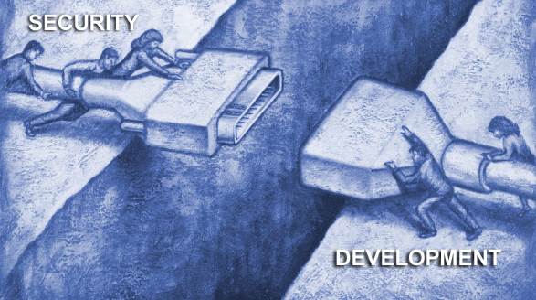
Why Web Application Vulnerabilities Occur
The Web Application
Security Gap
Security Professionals Don’t Know The Applications
Application Developers and QA Professionals Don’t Know Security
  “As a Network Security Professional, I don’t know how my companies web applications are supposed to work so I deploy a protective solution…but don’t know if it’s protecting what it’s supposed to.”
  “As an Application Developer, I can build great features and functions while meeting deadlines, but I don’t know how to develop my web application with security as a feature.”
Notes:
Main Speaking Points:
There is a lack of awareness of application vulnerabilities in security departments.
Security Departments scrutinize the desktop, the network, and even the web servers, but the web application escapes their measures.
Even in departments that want to audit for web application vulnerabilities, the lack of effective tools has made it impractical
As a result, Certification and Accreditation programs rarely examine the web application
In fact, the entire development cycle is usually missing from security procedures and controls
This illustrates the fundamental gap between security and development, which creates these web application vulnerabilities
Many traditional information security practitioners are ill-equipped to
mitigate application security issues
– Little to no experience coding
– No experience coding in “modern” enterprise environments like .NET and J2EE
– Understand that there are risks, but not in a position to address them

Slide 15
Web Application Vulnerabilities
Web application vulnerabilities occur in multiple areas.
Application
Application Mapping
Cookie Manipulation
Custom Application Scripting
Parameter Manipulation
Reverse Directory Transversal
Brute Force
Application Mapping
Cookie Poisoning/Theft
Buffer Overflow
SQL Injection
Cross-site scripting
Administration
Extension Checking
Common File Checks
Data Extension Checking
Backup Checking
Directory Enumeration
Path Truncation
Hidden Web Paths
Forceful Browsing
Platform
Known Vulnerabilities
Notes:
Main Speaking Points:
-Web Application vulnerabilities occur in different areas of the web application.
[Note: Start at bottom of the screen]
-The web server itself is subject to a variety of known vulnerabilities, all of which must be readily patched for.
The actual administration and management of the server and contents is very important
A misconfigured server or poorly managed content can permit system file and source code disclosure
The application itself is of the utmost importance.
It too can inadvertently reveal source code and system files, and even allow full system access.
It can mistakenly allow replay attacks against your customers.
It could allow a hacker to impersonate your customers.
In addition it is the web application that interacts with the database to manage and tracks customer information and store business and transaction information .
One slip-up in the web application can expose the entire system and database, right through a web browser, right over port 80.

Slide 16
Application Area Weaknesses
Common coding techniques do not necessarily include security
Input is assumed to be valid, but not tested
Unexamined input from a browser can inject scripts into page for replay against later visitors
Unhandled error messages reveal application and database structures
Unchecked database calls can be ‘piggybacked’ with a hacker’s own database call, giving direct access to business data through a web browser
Notes:
Main Speaking Points:
The application logic itself must be careful constructed and must include security mechanisms
Don’t assume that the input you received is what you expected. It must be tested, validated, and filtered. Test before you ingest
Be extremely careful how you call up files, especially if you pull files directly from the file system. You could expose your pages’ source code, or worse yet, expose system files.
Be particularly careful to remove anything that even resembles javascript or vbscript. Inadvertently storing scripts entered from a hacker will allow them to be replayed against your customers, resulting in your website attacking your customers or divulging session information to the hacker.
Handle all error messages. Unhandled (raw) error messages are a roadmap through the application and database.
Structure your database calls carefully, and scrutinize any user-input that will become used in the query. Carefully constructed input could allow a hacker to piggy-back your queries with their own, letting them access the database through the web application.

Slide 17
OWASP – 10 Most Critical Web Application Security Risks
https://www.owasp.org/index.php/Top_10_2013-Top_10
A1 Injection.
A2 Broken Authentication and Session Management.
A3 Cross-Site Scripting (XSS)
A4 Insecure Direct Object References.
A5 Security Misconfiguration.
A6 Sensitive Data Exposure.
A7 Missing Function Level Access Control.
A8 Cross-Site Request Forgery (CSRF)
A9 Using Components with Known Vulnerabilities
A10 Unvalidated Redirects and Forwards

Slide 18
DEMO

Slide 19
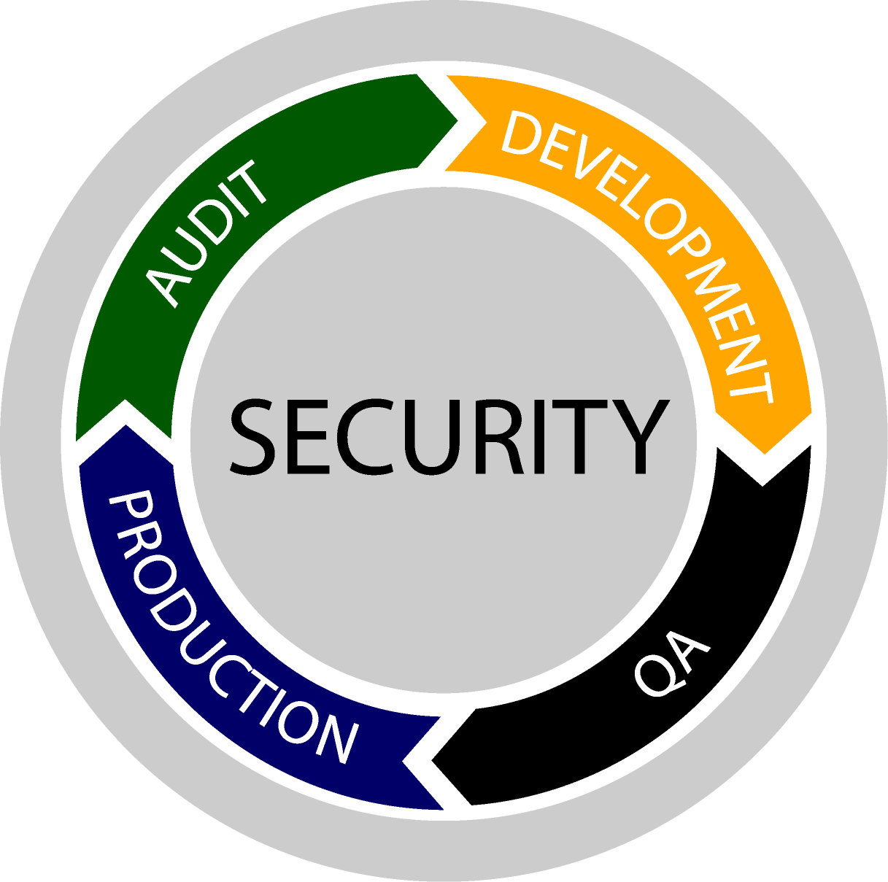
How to Secure Web Applications
Incorporating security into lifecycle
  Integrate security into application requirements
  Including information security professionals in software architecture/design review
  Security APIs & libraries (e.g. ESAPI, Validator, etc.) when possible
  Threat modeling
  Web application vulnerability assessment tools
Notes:
Where to begin?

Slide 20
How to Secure Web Applications
Educate
  Developers – Software security best practices
  Testers – Methods for identifying vulnerabilities
  Security Professionals – Software development, Software coding best practices
  Executives, System Owners, etc. – Understanding the risk and why they should be concerned
Notes:
Where to begin?

Slide 21
?
?
?
?
?
Questions?
?
?
?
?
?
?

