Slide 1

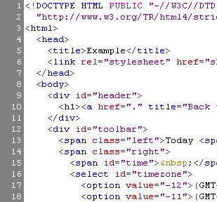

WEB SYSTEMS & TECHNOLOGIES
1. HTML Basics

Slide 2
Table of Contents
  What is a Web Page?
  My First HTML Page
  Basic Tags: Hyperlinks, Images, Formatting
  Headings and Paragraphs
HTML in Details
  The <!DOCTYPE> Declaration
  The <head> Section: Title, Meta, Script, Style

Slide 3
Table of Contents (2)
HTML in Details
  The <body> Section
  Text Styling and Formatting Tags
  Hyperlinks: <a>, Hyperlinks and Sections
  Images: <img>
  Lists: <ol>, <ul> and <dl>
The <div> and <span> elements
HTML Tables
HTML Forms

Slide 4
HTML – Past, Present, Future
1991 – HTML first mentioned – Tim Berners-Lee
1993 – HTML (first public version, published at IETF)
1993 – HTML 2 draft
1995 – HTML 2 – W3C
1995 – HTML 3 draft
1997 – HTML 3.2 – “Wilbur”
1997 – HTML 4 – ”Cougar” – CSS
1999 – HTML 4.01 (final)
2000 – XHTML draft
2001 – XHTML (final)
2008 – HTML5 / XHTML5 draft
2011 – feature complete HTML5

Slide 5
What is a Web Page?
Web pages are text files containing HTML
HTML – Hyper Text Markup Language
  A notation for describing
    document structure (semantic markup)
    formatting (presentation markup)
  Looks (looked?) like:
    A Microsoft Word document
The markup tags provide information about the page content structure

Slide 6
Creating HTML Pages
An HTML file must have an .htm or .html file extension
HTML files can be created with text editors:
  NotePad, NotePad ++, PSPad
Or HTML editors (WYSIWYG Editors):
  Microsoft FrontPage
  Macromedia Dreamweaver
  Netscape Composer
  Microsoft Word
  Visual Studio

Slide 7



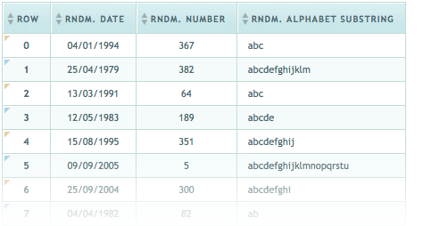

HTML Basics
Text, Images, Tables, Forms

Slide 8
Concepts in HTML
Tags
  Opening tag and closing tag
  The smallest piece in HTML
Attributes
  Properties of the tag
  Size, color, etc…
Elements
  Combination of opening, closing tag and attributes

Slide 9
HTML Structure
HTML is comprised of “elements” and “tags”
  Begins with <html> and ends with </html>
Elements (tags) are nested one inside another:
Tags have attributes:
HTML describes structure using two main sections: <head> and <body>
<html> <head></head> <body></body> </html>
<img src="logo.jpg" alt="logo" />

Slide 10
HTML Code Formatting
The HTML source code should be formatted to increase readability and facilitate debugging.
  Every block element should start on a new line.
  Every nested (block) element should be indented.
  Browsers ignore multiple whitespaces in the page source, so formatting is harmless.
For performance reasons, formatting can be sacrificed

Slide 11
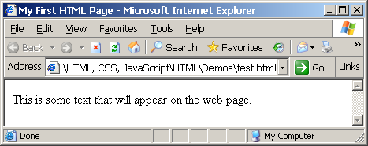
First HTML Page
test.html
<!DOCTYPE HTML>
<html>
<head>
<title>My First HTML Page</title>
</head>
<body>
<p>This is some text...</p>
</body>
</html>

Slide 12
First HTML Page: Tags
<!DOCTYPE HTML>
<html>
<head>
<title>My First HTML Page</title>
</head>
<body>
<p>This is some text...</p>
</body>
</html>
Opening tag
Closing tag
An HTML element consists of an opening tag, a closing tag and the content inside.

Slide 13
First HTML Page: Header
HTML header
<!DOCTYPE HTML>
<html>
<head>
<title>My First HTML Page</title>
</head>
<body>
<p>This is some text...</p>
</body>
</html>

Slide 14
First HTML Page: Body
<!DOCTYPE HTML>
<html>
<head>
<title>My First HTML Page</title>
</head>
<body>
<p>This is some text...</p>
</body>
</html>
HTML body

Slide 15
Tags Attributes
Tags can have attributes
  Attributes specify properties and behavior
  Example:
  Few attributes can apply to every element:
    id, style, class, title
    The id is unique in the document
    Content of title attribute is displayed as hint when the element is hovered with the mouse
    Some elements have obligatory attributes
Attribute alt with value "logo"
<img src="logo.gif" alt="logo" />

Slide 16
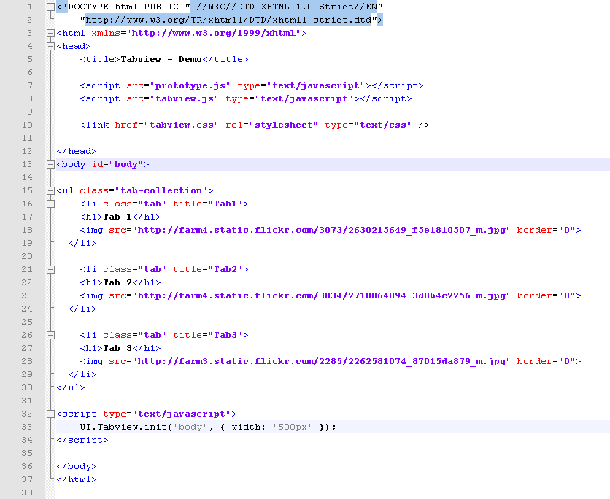
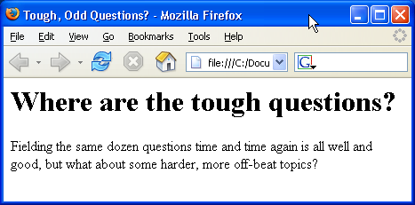
Introduction to HTML
HTML Document Structure in Depth

Slide 17
Preface
It is important to have the correct vision and attitude towards HTML
  HTML is only about structure, not appearance
  Browsers tolerate invalid HTML code and parse errors – you should not.

Slide 18
The <!DOCTYPE> Declaration
HTML documents must start with a document type definition (DTD)
  It tells web browsers what type is the served code
  Possible versions: HTML 4.01, XHTML 1.0 (Transitional or Strict), XHTML 1.1, HTML 5
Example:
  See http://w3.org/QA/2002/04/valid-dtd-list.html for a list of possible doctypes
<!DOCTYPE html PUBLIC "-//W3C//DTD XHTML 1.0 Transitional//EN" "http://www.w3.org/TR/xhtml1/DTD/xhtml1-transitional.dtd">

Slide 19
The <head> Section
Contains information that doesn’t show directly on the viewable page
Starts after the <!doctype> declaration
Begins with <head> and ends with </head>
Contains mandatory single <title> tag
Can contain some other tags, e.g.
  <meta>
  <script>
  <style>
  <!–- comments -->

Slide 20
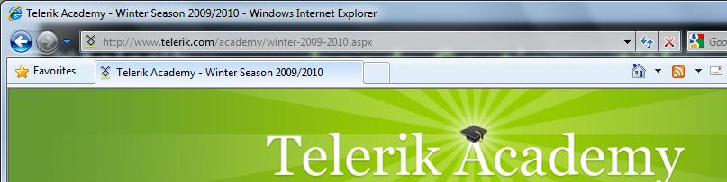
<head> Section: <title> tag
Title should be placed between <head> and </head> tags
Used to specify a title in the window title bar
Search engines and people rely on titles
<title>Telerik Academy – Winter Season 2009/2010 </title>

Slide 21
<head> Section: <meta>
Meta tags additionally describe the content contained within the page
<meta name="description" content="HTML tutorial" />
<meta name="keywords" content="html, web design, styles" />
<meta name="author" content="Chris Brewer" />
<meta http-equiv="refresh" content="5; url=http://www.telerik.com" />

Slide 22
<head> Section: <script>
The <script> element is used to embed scripts into an HTML document
  Script are executed in the client's Web browser
  Scripts can live in the <head> and in the <body> sections
Supported client-side scripting languages:
  JavaScript (it is not Java!)
  VBScript
  JScript

Slide 23
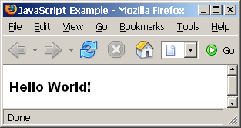
The <script> Tag – Example
scripts-example.html
<!DOCTYPE HTML>
<html>
<head>
<title>JavaScript Example</title>
<script type="text/javascript">
function sayHello() {
document.write("<p>Hello World!<\/p>");
}
</script>
</head>
<body>
<script type=
"text/javascript">
sayHello();
</script>
</body>
</html>

Slide 24
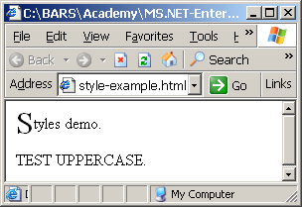
<head> Section: <style>
The <style> element embeds formatting information (CSS styles) into an HTML page
style-example.html
<html>
<head>
<style type="text/css">
p { font-size: 12pt; line-height: 12pt; }
p:first-letter { font-size: 200%; }
span { text-transform: uppercase; }
</style>
</head>
<body>
<p>Styles demo.<br />
<span>Test uppercase</span>.
</p>
</body>
</html>

Slide 25
Comments: <!-- --> Tag
Comments can exist anywhere between the <html></html> tags
Comments start with <!-- and end with -->
<!–- Telerik Logo (a JPG file) -->
<img src="logo.jpg" alt=“Telerik Logo">
<!–- Hyperlink to the web site -->
<a href="http://telerik.com/">Telerik</a>
<!–- Show the news table -->
<table class="newstable">
...

Slide 26
<body> Section: Introduction
The <body> section describes the viewable portion of the page
Starts after the <head> </head> section
Begins with <body> and ends with </body>
<html>
<head><title>Test page</title></head>
<body>
<!-- This is the Web page body -->
</body>
</html>

Slide 27
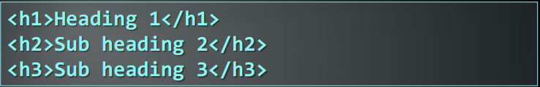

Headings and Paragraphs
Heading Tags (h1 – h6)
Paragraph Tags
<br />new line<br />

Slide 28
Text Formatting
Text formatting tags modify the text between the opening tag and the closing tag
  Ex. <b>Hello</b> makes “Hello” bold
<b></b> | bold
<i></i> | italicized
<u></u> | underlined
<sup></sup> | Sample^{superscript}
<sub></sub> | Sample_{subscript}
<strong></strong> | strong
<em></em> | emphasized
<pre></pre> | Preformatted text
<blockquote></blockquote> | Quoted text block
<del></del> | Deleted text – strike through
28

Slide 29
Text Formatting – Example
text-formatting.html
<!DOCTYPE html PUBLIC "-//W3C//DTD XHTML 1.0 Transitional//EN"
"http://www.w3.org/TR/xhtml1/DTD/xhtml1-transitional.dtd">
<html>
<head>
<title>Page Title</title>
</head>
<body>
<h1>Notice</h1>
<p>This is a <em>sample</em> Web page.</p>
<p><pre>Next paragraph:
preformatted.</pre></p>
<h2>More Info</h2>
<p>Specifically, we’re using XHMTL 1.0 transitional.<br />
Next line.</p>
</body>
</html>

Slide 30
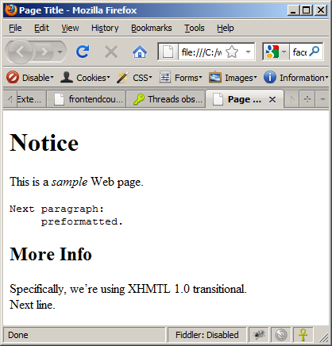
Text Formatting – Example (2)
text-formatting.html
<!DOCTYPE html PUBLIC "-//W3C//DTD XHTML 1.0 Transitional//EN"
"http://www.w3.org/TR/xhtml1/DTD/xhtml1-transitional.dtd">
<html>
<head>
<title>Page Title</title>
</head>
<body>
<h1>Notice</h1>
<p>This is a <em>sample</em> Web page.</p>
<p><pre>Next paragraph:
preformatted.</pre></p>
<h2>More Info</h2>
<p>Specifically, we’re using XHMTL 1.0 transitional.<br />
Next line.</p>
</body>
</html>

Slide 31
Hyperlinks: <a> Tag
Link to a document called form.html on the same server in the same directory:
Link to a document called parent.html on the same server in the parent directory:
Link to a document called cat.html on the same server in the subdirectory stuff:
<a href="form.html">Fill Our Form</a>
<a href="../parent.html">Parent</a>
<a href="stuff/cat.html">Catalog</a>

Slide 32
Hyperlinks: <a> Tag (2)
Link to an external Web site:
  Always use a full URL, including "http://", not just "www.somesite.com"
  Using the target="_blank" attribute opens the link in a new window
Link to an e-mail address:
<a href="http://www.devbg.org" target="_blank">BASD</a>
<a href="mailto:bugs@example.com?subject=Bug+Report">
Please report bugs here (by e-mail only)</a>

Slide 33
Hyperlinks: <a> Tag (3)
Link to a document called apply-now.html
  On the same server, in same directory
  Using an image as a link button:
Link to a document called index.html
  On the same server, in the subdirectory english of the parent directory:
<a href="apply-now.html"><img
src="apply-now-button.jpg" /></a>
<a href="../english/index.html">Switch to English version</a>

Slide 34
Hyperlinks and Sections
Link to another location in the same document:
Link to a specific location in another document:
<a href="#section1">Go to Introduction</a>
...
<h2 id="section1">Introduction</h2>
<a href="chapter3.html#section3.1.1">Go to Section 3.1.1</a>
<!–- In chapter3.html -->
...
<div id="section3.1.1">
<h3>3.1.1. Technical Background</h3>
</div>

Slide 35
Hyperlinks – Example
hyperlinks.html
<a href="form.html">Fill Our Form</a> <br />
<a href="../parent.html">Parent</a> <br />
<a href="stuff/cat.html">Catalog</a> <br />
<a href="http://www.devbg.org" target="_blank">BASD</a> <br />
<a href="mailto:bugs@example.com?subject=Bug Report">Please report bugs here (by e-mail only)</a>
<br />
<a href="apply-now.html"><img src="apply-now-button.jpg” /></a> <br />
<a href="../english/index.html">Switch to English version</a> <br />

Slide 36
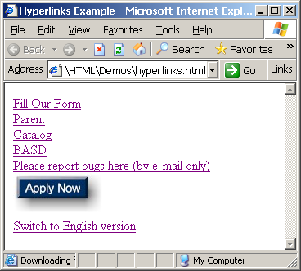
Hyperlinks – Example (2)
hyperlinks.html
<a href="form.html">Fill Our Form</a> <br />
<a href="../parent.html">Parent</a> <br />
<a href="stuff/cat.html">Catalog</a> <br />
<a href="http://www.devbg.org" target="_blank">BASD</a> <br />
<a href="mailto:bugs@example.com?subject=Bug Report">Please report bugs here (by e-mail only)</a>
<br />
<a href="apply-now.html"><img src="apply-now-button.jpg” /></a> <br />
<a href="../english/index.html">Switch to English version</a> <br />

Slide 37
Links to the Same Document – Example
links-to-same-document.html
<h1>Table of Contents</h1>
<p><a href="#section1">Introduction</a><br />
<a href="#section2">Some background</A><br />
<a href="#section2.1">Project History</a><br />
...the rest of the table of contents...
<!-- The document text follows here -->
<h2 id="section1">Introduction</h2>
... Section 1 follows here ...
<h2 id="section2">Some background</h2>
... Section 2 follows here ...
<h3 id="section2.1">Project History</h3>
... Section 2.1 follows here ...

Slide 38
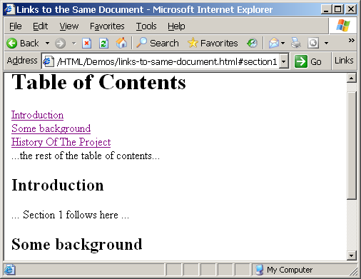
Links to the Same Document – Example (2)
links-to-same-document.html
<h1>Table of Contents</h1>
<p><a href="#section1">Introduction</a><br />
<a href="#section2">Some background</A><br />
<a href="#section2.1">Project History</a><br />
...the rest of the table of contents...
<!-- The document text follows here -->
<h2 id="section1">Introduction</h2>
... Section 1 follows here ...
<h2 id="section2">Some background</h2>
... Section 2 follows here ...
<h3 id="section2.1">Project History</h3>
... Section 2.1 follows here ...

Slide 39
Images: <img> tag
Inserting an image with <img> tag:
Image attributes:
Example:
<img src="/img/basd-logo.png">
src | Location of image file (relative or absolute)
alt | Substitute text for display (e.g. in text mode)
height | Number of pixels of the height
width | Number of pixels of the width
border | Size of border, 0 for no border
<img src="./php.png" alt="PHP Logo" />
39

Slide 40
Image maps
There are diferrent areas that act as links in an image.
  Map element
  AREA element

Slide 41
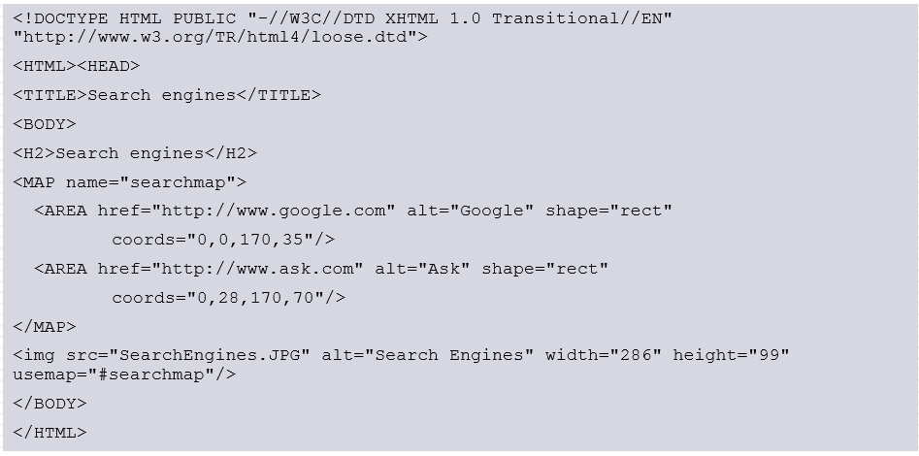
Image maps
Notes:
<!DOCTYPE HTML PUBLIC "-//W3C//DTD XHTML 1.0 Transitional//EN" "http://www.w3.org/TR/html4/loose.dtd">
<HTML><HEAD>
<TITLE>Search engines</TITLE>
<BODY>
<H2>Search engines</H2>
<MAP name="searchmap">
<AREA href="http://www.google.com" alt="Google" shape="rect"
coords="0,0,170,35"/>
<AREA href="http://www.ask.com" alt="Ask" shape="rect"
coords="0,28,170,70"/>
</MAP>
<img src="SearchEngines.JPG" alt="Search Engines" width="286" height="99" usemap="#searchmap"/>
</BODY>
</HTML>

Slide 42
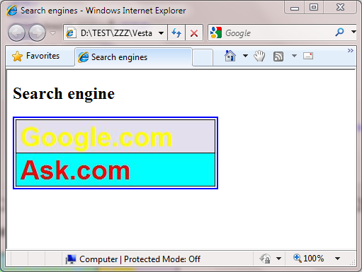

Image maps

Slide 43
OBJECT element
DATA: url of the resource
WIDTH
HEGHT
NAME
TYPE: media type

Slide 44
Audio & Video
Media Tags
  <audio>
    Attributes: autoplay, controls, loop, src
  <video>
    Attributes: autoplay, controls, loop, height, width, src
<audio width="360" height="240" controls= "controls" >
<source src="someSong.mp3" type="audio/mp3">
</source>
Audio tag is not supported
</audio>

Slide 45
Embed Tag – New Syntax
<embed>
  Defines embedded content, such as a plug-in
Attributes
  src="url", type="type"
<embed src="helloworld.swf" />

Slide 46
Miscellaneous Tags
<hr />: Draws a horizontal rule (line):
<center></center>: Deprecated!
<font></font>: Deprecated!
<hr size="5" width="70%" />
<center>Hello World!</center>
<font size="3" color="blue">Font3</font>
<font size="+4" color="blue">Font+4</font>

Slide 47
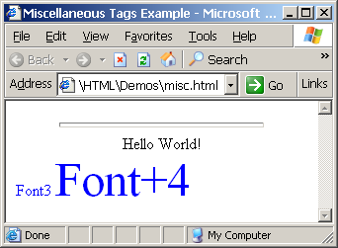
Miscellaneous Tags – Example
misc.html
<html>
<head>
<title>Miscellaneous Tags Example</title>
</head>
<body>
<hr size="5" width="70%" />
<center>Hello World!</center>
<font size="3" color="blue">Font3</font>
<font size="+4" color="blue">Font+4</font>
</body>
</html>

Slide 48
Ordered Lists: <ol> Tag
Create an Ordered List using <ol></ol>:
Attribute values for type are 1, A, a, I, or i
<ol type="1">
<li>Apple</li>
<li>Orange</li>
<li>Grapefruit</li>
</ol>
Apple
Orange
Grapefruit
Apple
Orange
Grapefruit
Apple
Orange
Grapefruit
Apple
Orange
Grapefruit
Apple
Orange
Grapefruit

Slide 49
Unordered Lists: <ul> Tag
Create an Unordered List using <ul></ul>:
Attribute values for type are:
  disc, circle or square
<ul type="disk">
<li>Apple</li>
<li>Orange</li>
<li>Grapefruit</li>
</ul>
Apple
Orange
Pear
Apple
Orange
Pear
Apple
Orange
Pear

Slide 50
Definition lists: <dl> tag
Create definition lists using <dl>
  Pairs of text and associated definition; text is in <dt> tag, definition in <dd> tag
  Renders without bullets
  Definition is indented
<dl>
  <dt>HTML</dt>
  <dd>A markup language …</dd>
  <dt>CSS</dt>
  <dd>Language used to …</dd>
</dl>

Slide 51
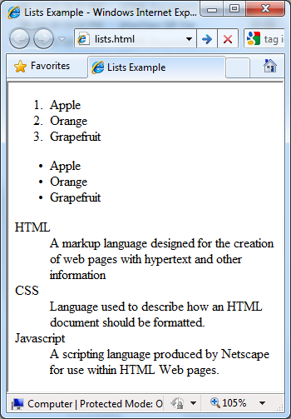
Lists – Example
lists.html
<ol type="1">
<li>Apple</li>
<li>Orange</li>
<li>Grapefruit</li>
</ol>
<ul type="disc">
<li>Apple</li>
<li>Orange</li>
<li>Grapefruit</li>
</ul>
<dl>
<dt>HTML</dt>
<dd>A markup lang…</dd>
</dl>

Slide 52
HTML Special Characters
Symbol Name
HTML Entity
Symbol
Copyright Sign
&copy;
©
Registered Trademark Sign
&reg;
®
Trademark Sign
&trade;
™
Less Than
&lt;
<
Greater Than
&gt;
>
Ampersand
&amp;
&
Non-breaking Space
&nbsp;
Em Dash
&mdash;
—
Quotation Mark
&quot;
"
Euro
&#8364;
€
British Pound
&pound;
£
Japanese Yen
&yen;
¥
52

Slide 53
Special Characters – Example
special-chars.html
<p>[&gt;&gt;&nbsp;&nbsp;Welcome
&nbsp;&nbsp;&lt;&lt;]</p>
<p>&#9658;I have following cards:
A&#9827;, K&#9830; and 9&#9829;.</p>
<p>&#9658;I prefer hard rock &#9835;
music &#9835;</p>
<p>&copy; 2006 by Svetlin Nakov &amp; his team</p>
<p>Telerik Academy™</p>

Slide 54
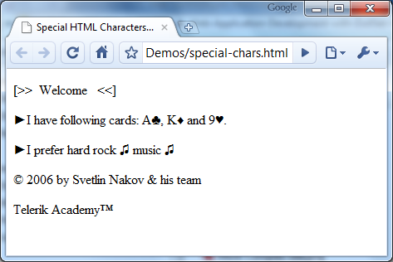
Special Chars – Example (2)
special-chars.html
<p>[&gt;&gt;&nbsp;&nbsp;Welcome
&nbsp;&nbsp;&lt;&lt;]</p>
<p>&#9658;I have following cards:
A&#9827;, K&#9830; and 9&#9829;.</p>
<p>&#9658;I prefer hard rock &#9835;
music &#9835;</p>
<p>&copy; 2006 by Svetlin Nakov &amp; his team</p>
<p>Telerik Academy™</p>

Slide 55
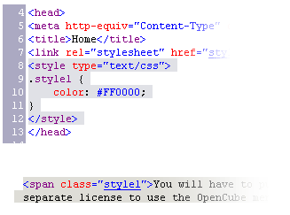

Using <DIV> and <SPAN> Block and Inline Elements

Slide 56
Block and Inline Elements
Block elements add a line break before and after them
  <div> is a block element
  Other block elements are <table>, <hr>, headings, lists, <p> and etc.
Inline elements don’t break the text before and after them
  <span> is an inline element
  Most HTML elements are inline, e.g. <a>

Slide 57
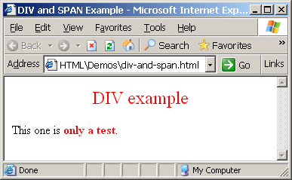
The <div> Tag
<div> creates logical divisions within a page
Block style element
Used with CSS
Example:
div-and-span.html
<div style="font-size:24px; color:red">DIV example</div>
<p>This one is <span style="color:red; font-weight:bold">only a test</span>.</p>

Slide 58
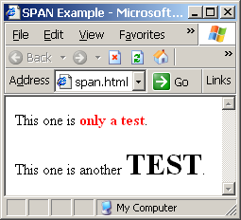
The <span> Tag
Inline style element
Useful for modifying a specific portion of text
  Don't create a separate area (paragraph) in the document
Very useful with CSS
span.html
<p>This one is <span style="color:red; font-weight:bold">only a test</span>.</p>
<p>This one is another <span style="font-size:32px; font-weight:bold">TEST</span>.</p>

Slide 59
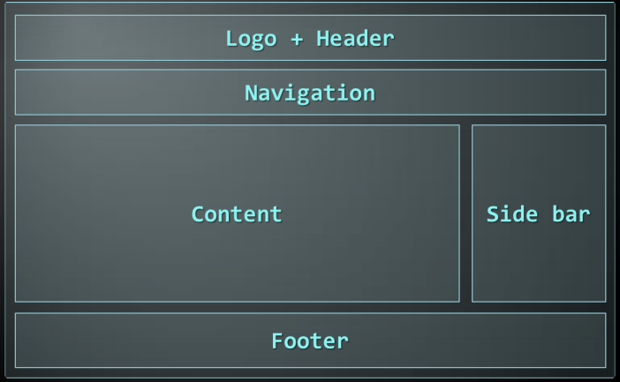
DIV with The Structure of a Web Page
A sample layout structure of a Web Page

Slide 60
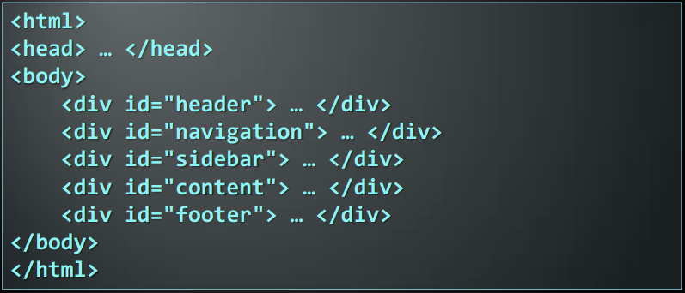
The "HTML 4 and Before" Way
Using divs with IDs
  The IDs are needed for styling
Notes:
<html>
<head> … </head>
<body>
<div id="header"> … </div>
<div id="navigation"> … </div>
<div id="sidebar"> … </div>
<div id="content"> … </div>
<div id="footer"> … </div>
</body>
</html>

Slide 61
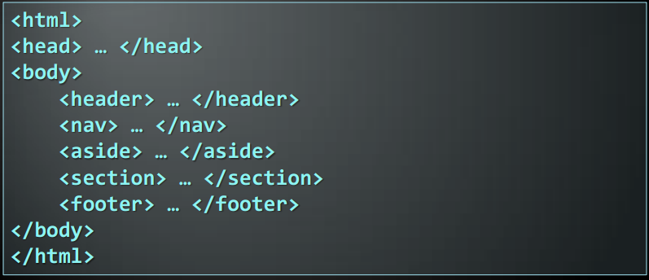
The HTML 5 Way
In HTML 5 there are semantic tags for layout
  <nav>, <header>, <footer>, <section>
Notes:
<html>
<head> … </head>
<body>
<header> … </header>
<nav> … </nav>
<aside> … </aside>
<section> … </section>
<footer> … </footer>
</body>
</html>

Slide 62
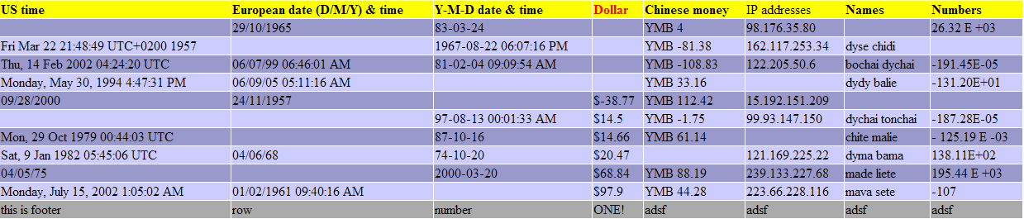
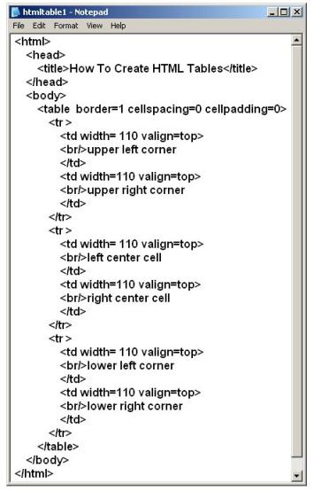
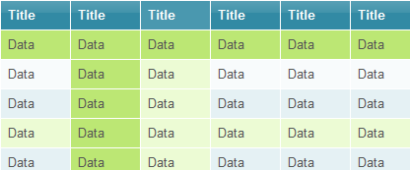
HTML Tables

Slide 63
HTML Tables
Tables represent tabular data
  A table consists of one or several rows
  Each row has one or more columns
Tables comprised of several core tags: <table></table>: begin / end the table
<tr></tr>: create a table row
<td></td>: create tabular data (cell)
Tables should not be used for layout. Use CSS floats and positioning styles instead

Slide 64
HTML Tables (2)
Start and end of a table
Start and end of a row
Start and end of a cell in a row
<table> ... </table>
<tr> ... </tr>
<td> ... </td>

Slide 65
Simple HTML Tables – Example
<table cellspacing="0" cellpadding="5">
<tr>
<td><img src="ppt.gif"></td>
<td><a href="lecture1.ppt">Lecture 1</a></td>
</tr>
<tr>
<td><img src="ppt.gif"></td>
<td><a href="lecture2.ppt">Lecture 2</a></td>
</tr>
<tr>
<td><img src="zip.gif"></td>
<td><a href="lecture2-demos.zip">
Lecture 2 - Demos</a></td>
</tr>
</table>

Slide 66
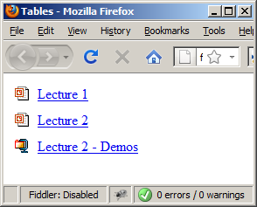
Simple HTML Tables – Example (2)
<table cellspacing="0" cellpadding="5">
<tr>
<td><img src="ppt.gif"></td>
<td><a href="lecture1.ppt">Lecture 1</a></td>
</tr>
<tr>
<td><img src="ppt.gif"></td>
<td><a href="lecture2.ppt">Lecture 2</a></td>
</tr>
<tr>
<td><img src="zip.gif"></td>
<td><a href="lecture2-demos.zip">
Lecture 2 - Demos</a></td>
</tr>
</table>

Slide 67
Complete HTML Tables
Table rows split into three semantic sections: header, body and footer
  <thead> denotes table header and contains <th> elements, instead of <td> elements
  <tbody> denotes collection of table rows that contain the very data
  <tfoot> denotes table footer but comes BEFORE the <tbody> tag
  <colgroup> and <col> define columns (most often used to set column widths)

Slide 68
Complete HTML Table: Example
<table>
<colgroup>
<col style="width:100px" /><col />
</colgroup>
<thead>
<tr><th>Column 1</th><th>Column 2</th></tr>
</thead>
<tfoot>
<tr><td>Footer 1</td><td>Footer 2</td></tr>
</tfoot>
<tbody>
<tr><td>Cell 1.1</td><td>Cell 1.2</td></tr>
<tr><td>Cell 2.1</td><td>Cell 2.2</td></tr>
</tbody>
</table>
columns
header
th
footer
Last comes the body (data)

Slide 69
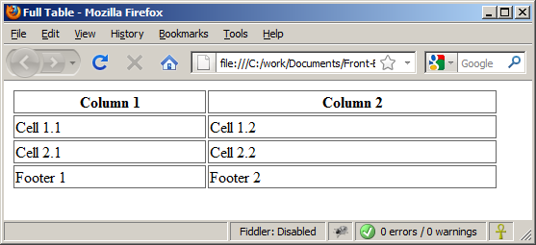
Complete HTML Table:
Example (2)
By default, header text is bold and centered.
table-full.html
<table>
<colgroup>
<col style="width:200px" /><col />
</colgroup>
<thead>
<tr><th>Column 1</th><th>Column 2</th></tr>
</thead>
<tfoot>
<tr><td>Footer 1</td><td>Footer 2</td></tr>
</tfoot>
<tbody>
<tr><td>Cell 1.1</td><td>Cell 1.2</td></tr>
<tr><td>Cell 2.1</td><td>Cell 2.2</td></tr>
</tbody>
</table>
Although the footer is before the data in the code, it is displayed last

Slide 70
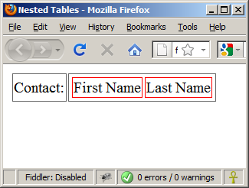
Nested Tables
Table data “cells” (<td>) can contain nested tables (tables within tables):
nested-tables.html
<table>
<tr>
<td>Contact:</td>
<td>
<table>
<tr>
<td>First Name</td>
<td>Last Name</td>
</tr>
</table>
</td>
</tr>
</table>

Slide 71
Cell Spacing and Padding
Tables have two important attributes:
cellspacing
Defines the empty space between cells
cellpadding
Defines the empty space around the cell content
cell
cell
cell
cell
cell
cell
cell
cell

Slide 72
Cell Spacing and Padding – Example
table-cells.html
<html>
<head><title>Table Cells</title></head>
<body>
<table cellspacing="15" cellpadding="0">
<tr><td>First</td>
<td>Second</td></tr>
</table>
<br/>
<table cellspacing="0" cellpadding="10">
<tr><td>First</td><td>Second</td></tr>
</table>
</body>
</html>

Slide 73
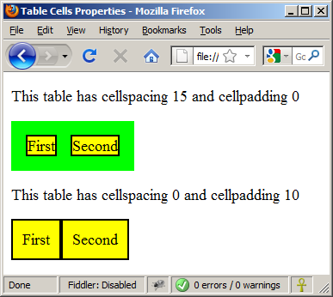
Cell Spacing and Padding – Example (2)
table-cells.html
<html>
<head><title>Table Cells</title></head>
<body>
<table cellspacing="15" cellpadding="0">
<tr><td>First</td>
<td>Second</td></tr>
</table>
<br/>
<table cellspacing="0" cellpadding="10">
<tr><td>First</td><td>Second</td></tr>
</table>
</body>
</html>

Slide 74
Column and Row Span
Table cells have two important attributes:
colspan
Defines how many columns the cell occupies
rowspan
Defines how many rows the cell occupies
colspan="1"
colspan="1"
rowspan="2"
rowspan="1"
cell[1,1]
cell[1,2]
cell[1,1]
cell[1,2]
cell[2,1]
cell[2,1]
colspan="2"
rowspan="1"

Slide 75
Column and Row Span – Example
table-colspan-rowspan.html
<table cellspacing="0">
<tr class="1"><td>Cell[1,1]</td>
<td colspan="2">Cell[2,1]</td></tr>
<tr class=“2"><td>Cell[1,2]</td>
<td rowspan="2">Cell[2,2]</td>
<td>Cell[3,2]</td></tr>
<tr class=“3"><td>Cell[1,3]</td>
<td>Cell[2,3]</td></tr>
</table>

Slide 76
Column and Row Span –
Example (2)
table-colspan-rowspan.html
<table cellspacing="0">
<tr class="1"><td>Cell[1,1]</td>
<td colspan="2">Cell[2,1]</td></tr>
<tr class=“2"><td>Cell[1,2]</td>
<td rowspan="2">Cell[2,2]</td>
<td>Cell[3,2]</td></tr>
<tr class=“3"><td>Cell[1,3]</td>
<td>Cell[2,3]</td></tr>
</table>
Cell[1,1]
Cell[2,1]
Cell[1,2]
Cell[2,2]
Cell[3,2]
Cell[1,3]
Cell[2,3]

Slide 77
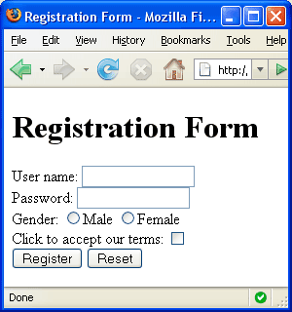


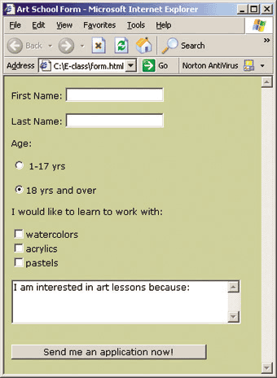
HTML Forms
Entering User Data from a Web Page

Slide 78
What are HTML Forms?
The primary method for gathering data from site visitors
HTML Forms can contain
  Text fields for the user to type
  Buttons for interactions like "Register", "Login", "Search"
  Menus, Sliders, etc…
Check Google, Yahoo, Facebook
  Google search field is a simple Text field

Slide 79
How to Create Forms?
Create a form block with
Example:
The "method" attribute tells how the form data should be sent – via GET or POST request
<form></form>
<form name="myForm" method="post" action="path/to/some-script.php">
...
</form>
The "action" attribute tells where the form data should be sent

Slide 80
Text Fields
Single-line text input fields:
Multi-line text input fields (textarea):
Password input – a text field which masks the entered text with * signs
<input type="text" name="FirstName" value="This is a text field" />
<textarea name="Comments">This is a multi-line text field</textarea>
<input type="password" name="pass" />

Slide 81
Buttons
Reset button – brings the form to its initial state
Submit button:
Image button – acts like submit but image is displayed and click coordinates are sent
Ordinary button – no default action, used with JS
<input type="reset" name="resetBtn" value="Reset the form" />
<input type="submit" value="Apply Now" />
<input type="image" src="submit.gif" name="submitBtn" alt="Submit" />
<input type="button" value="click me" />

Slide 82
Checkboxes and Radio Buttons
Checkboxes:
Radio buttons:
Radio buttons can be grouped, allowing only one to be selected from a group:
<input type="checkbox" name="fruit" value="apple" />
<input type="radio" name="title" value="Mr." />
<input type="radio" name="city" value="Lom" />
<input type="radio" name="city" value="Ruse" />

Slide 83
Select Fields
Dropdown menus:
Multiple-choice menus
<select name="gender">
<option value="Value 1"
selected="selected">Male</option>
<option value="Value 2">Female</option>
<option value="Value 3">Other</option>
</select>
<select name="products" multiple="multiple">
<option value="Value 1"
selected="selected">keyboard</option>
<option value="Value 2">mouse</option>
</select>

Slide 84
Hidden Fields
Hidden fields contain invisible data
  Not shown to the user
  Used by JavaScript and server-side code
    ViewState, SessionState, etc..
<input type="hidden" name="Account" value="This is a hidden text field" />

Slide 85
File input
File input – a field used for uploading files
  When used, it requires the form element to have a specific attribute:
<input type="file" name="photo" />
<form enctype="multipart/form-data">
...
<input type="file" name="photo" />
...
</form>

Slide 86
Labels
Labels are used to associate an explanatory text to a form field using the field's ID.
Clicking on a label focuses its associated field (checkboxes are toggled, radio buttons are checked)
Labels are both a usability and accessibility feature and are required in order to pass accessibility validation.
<label for="fn">First Name</label>
<input type="text" id="fn" />

Slide 87
Fieldsets
Fieldsets are used to enclose a group of related form fields:
The <legend> is the fieldset's title.
<form method="post" action="form.aspx">
<fieldset>
<legend>Client Details</legend>
<input type="text" id="Name" />
<input type="text" id="Phone" />
</fieldset>
<fieldset>
<legend>Order Details</legend>
<input type="text" id="Quantity" />
<textarea cols="40" rows="10"
id="Remarks"></textarea>
</fieldset>
</form>

Slide 88
HTML Forms – Example
form.html
<form method="post" action="apply-now.php">
<input name="subject" type="hidden" value="Class" />
<fieldset><legend>Academic information</legend>
<label for="degree">Degree</label>
<select name="degree" id="degree">
<option value="BA">Bachelor of Art</option>
<option value="BS">Bachelor of Science</option>
<option value="MBA" selected="selected">Master of
Business Administration</option>
</select>
<br />
<label for="studentid">Student ID</label>
<input type="password" name="studentid" />
</fieldset>
<fieldset><legend>Personal Details</legend>
<label for="fname">First Name</label>
<input type="text" name="fname" id="fname" />
<br />
<label for="lname">Last Name</label>
<input type="text" name="lname" id="lname" />

Slide 89
HTML Forms – Example (2)
form.html (continued)
<br />
Gender:
<input name="gender" type="radio" id="gm" value="m" />
<label for="gm">Male</label>
<input name="gender" type="radio" id="gf" value="f" />
<label for="gf">Female</label>
<br />
<label for="email">Email</label>
<input type="text" name="email" id="email" />
</fieldset>
<p>
<textarea name="terms" cols="30" rows="4"
readonly="readonly">TERMS AND CONDITIONS...</textarea>
</p>
<p>
<input type="submit" name="submit" value="Send Form" />
<input type="reset" value="Clear Form" />
</p>
</form>

Slide 90
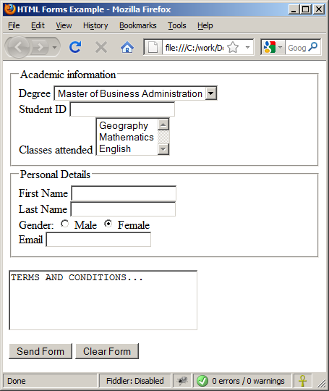
HTML Forms – Example (3)
form.html (continued)

Slide 91




HTML 5 Forms
Inputs Fields
Live Demo

Slide 92


Sliders and Spinboxes
Lets make it spin

Slide 93
Range and Spinbox
Restricts users to enter only numbers
  Additional attributes min, max and step and value
  Can become Spinbox or Slider, depending on the input type
  Have some differences on different browsers
  Sliders and Spinboxes do not work on Firefox
    Shown as regular textboxes
<input type="range" min="0" max="100" />
<input type="number" min="0" max="100" />

Slide 94

Sliders and Spinboxes
Live Demo

Slide 95
Attributes from HTML 5
Autocomplete
  The browser stores the previously typed values
  Brings them back on a later visit on the same page
Autofocus
  The field becomes on focus on page load
Required
  The field is required to be filled/selected

Slide 96
Input Fields with Validation
Email – provides a simple validation for email
  Can be passed a pattern for validation
  On a mobile device brings the email keyboard
URL – has validation for url
  On a mobile device brings the url keyboard
Telephone
  Brings the numbers keyboard
<input type="email" required="true"
pattern="[^ @]*@[^ @].[^ @]"/>
<input type="url" required="true" />
<input type="tel" required="true" />

Slide 97


HTML Forms Validation
Live Demo

Slide 98
TabIndex
The tabindex HTML attribute controls the order in which form fields and hyperlinks are focused when repeatedly pressing the TAB key
  tabindex="0" (zero) - "natural" order
  If X < Y, then elements with tabindex="X" are iterated before elements with tabindex="Y"
  Elements with negative tabindex are skipped, however, this is not defined in the standard
<input type="text" tabindex="10" />

Slide 99


Tab Index
Live Demo

Slide 100
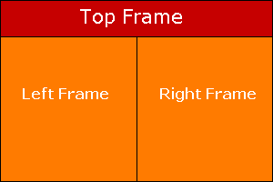
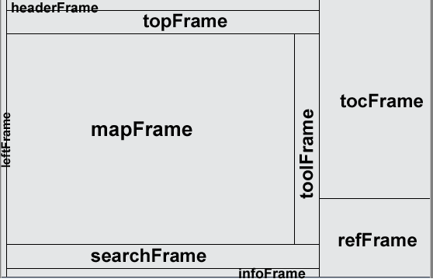
HTML Frames
<frameset>, <frame> and <iframe>

Slide 101
HTML Frames
Frames provide a way to show multiple HTML documents in a single Web page
The page can be split into separate views (frames) horizontally and vertically
Frames were popular in the early ages of HTML development, but now their usage is rejected
Frames are not supported by all user agents (browsers, search engines, etc.)
  A <noframes> element is used to provide content for non-compatible agents.

Slide 102
HTML Frames – Demo
frames.html
<html>
<head><title>Frames Example</title></head>
<frameset cols="180px,*,150px">
<frame src="left.html" />
<frame src="middle.html" />
<frame src="right.html" />
</frameset>
</html>
Note the target attribute applied to the <a> elements in the left frame.

Slide 103
Inline Frames: <iframe>
Inline frames provide a way to show one website inside another website:
iframe-demo.html
<iframe name="iframeGoogle" width="600" height="400" src="http://www.google.com" frameborder="yes" scrolling="yes"></iframe>

Slide 104

NORAME Element
One of the limitations of using frames is that the frames are not supported by all browser.
The “NOFRAME” element specifies the text to be displayed in the browser if the browser does not support frame
  <noframes>
  <body>
  <p>This browser does not support frames.</p>
  </body>
  </noframes>

Slide 105
HTML Basics
?
?
?
?
?
Questions?
?
?
?
?
?
?

Slide 106
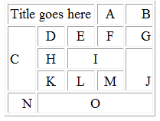
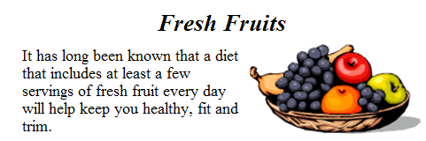
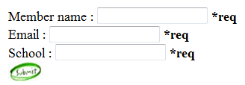
Homework
Create Web Pages like the following using tables:
Create a Web Page like the following using forms:

Slide 107
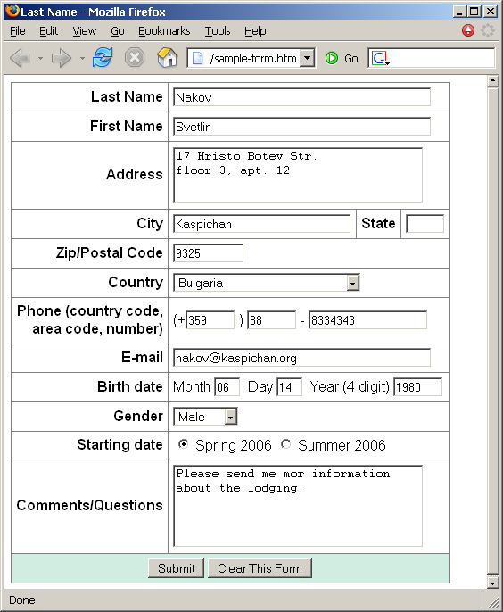
Homework (2)
Create a Web form that looks like this sample:

Slide 108
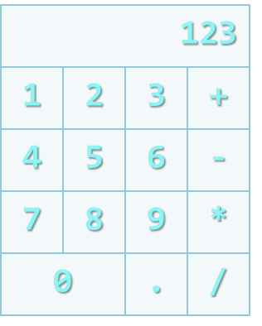
Homework (3)
Create a Calculator-like table.
You should use a HTML 5
form for the Calculator
  Buttons for all the numbers
  and operators (+, -, etc.)
  Textbox for the result
  Do not make the same styles
  as the example.

Slide 109
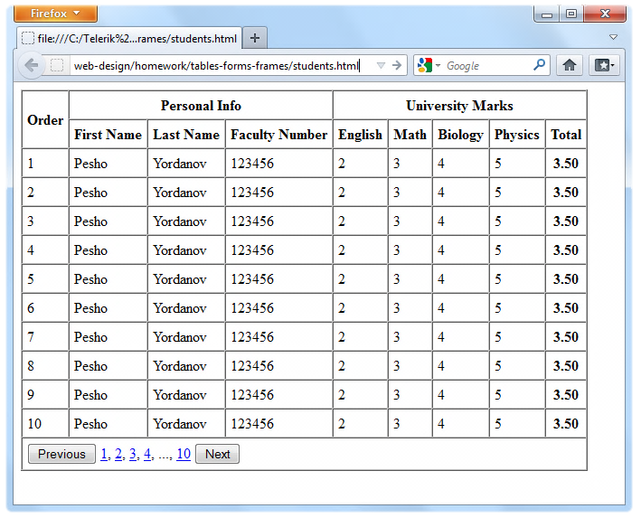
Homework (4)
Create the following using tables and forms:

Slide 110
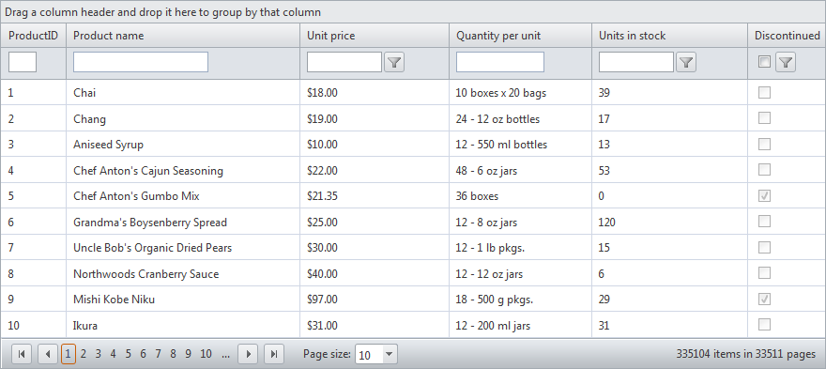
Homework (5)
Construct the following Grid component:
  Try to make a HTML page, that looks just like the example
  Not required to style for the homework

Slide 111
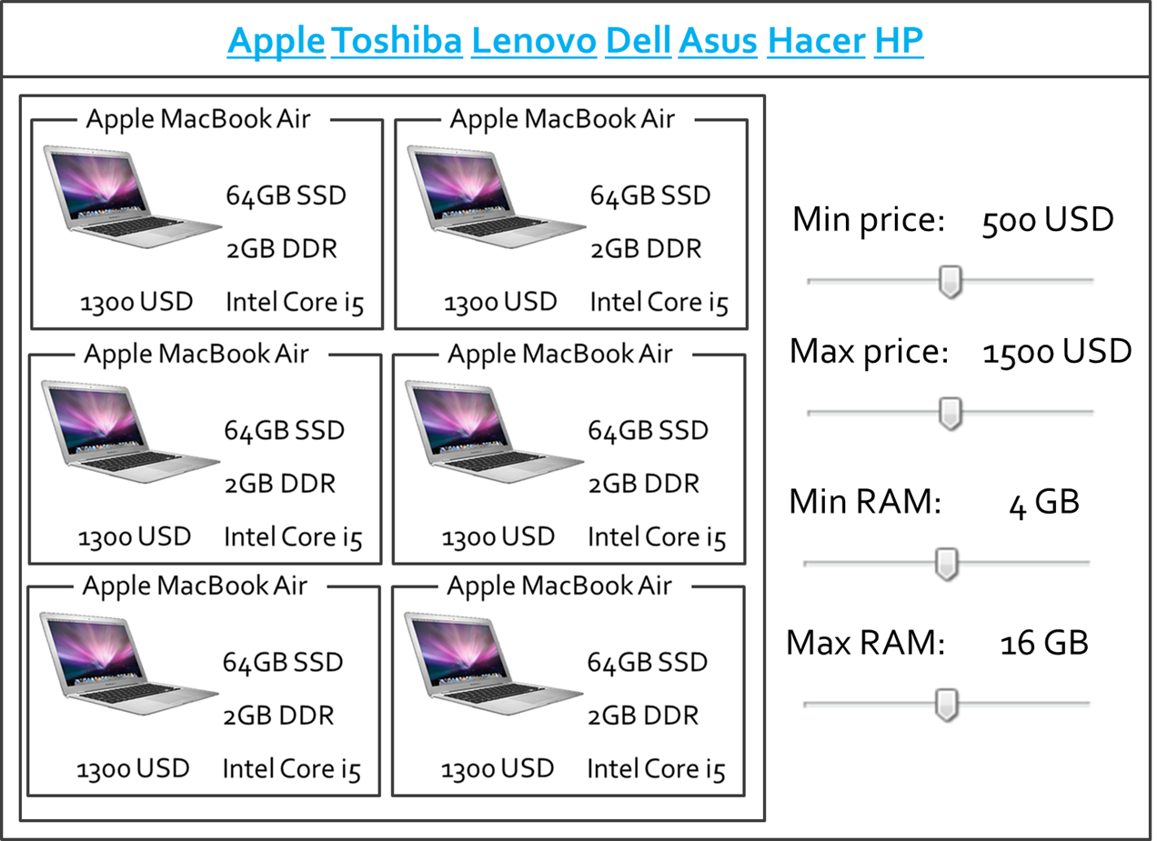
Homework (7)
Create the following HTML 5 Page
  Hint: Use Fieldsets and Nested tables

