Slide 1
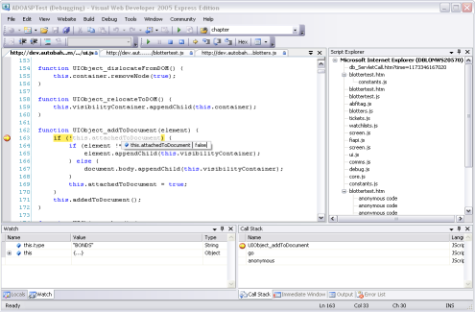
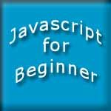

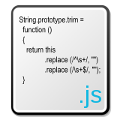

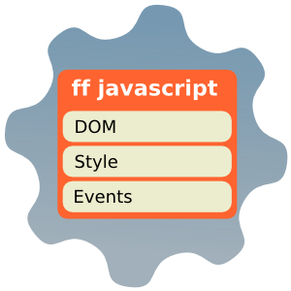

WEB SYSTEMS & TECHNOLOGIES
3. JavaScript

Slide 2

Table of Contents
What is DHTML?
DHTML Technologies
  XHTML, CSS, JavaScript, DOM

Slide 3

Table of Contents (2)
Introduction to JavaScript
  What is JavaScript
  Implementing JavaScript into Web pages
    In <head> part
    In <body> part
    In external .js file

Slide 4
Table of Contents (3)
JavaScript Syntax
  JavaScript operators
  JavaScript Data Types
  JavaScript Pop-up boxes
    alert, confirm and prompt
  Conditional and switch statements, loops and functions
Document Object Model
Debugging in JavaScript

Slide 5


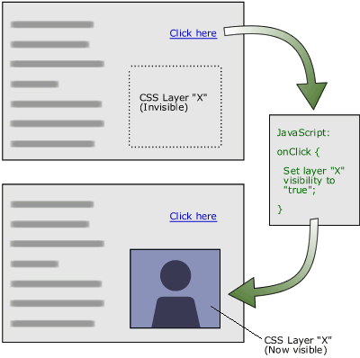
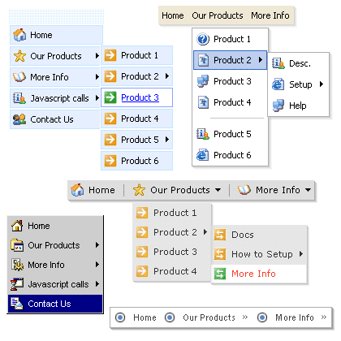
DHTML
Dynamic Behavior at the Client Side

Slide 6
What is DHTML?
Dynamic HTML (DHTML)
  Makes possible a Web page to react and change in response to the user’s actions
DHTML = HTML + CSS + JavaScript
DHTML
XHTML
CSS
JavaScript
DOM

Slide 7
DTHML = HTML + CSS + JavaScript
HTML defines Web sites content through semantic tags (headings, paragraphs, lists, …)
CSS defines 'rules' or 'styles' for presenting every aspect of an HTML document
  Font (family, size, color, weight, etc.)
  Background (color, image, position, repeat)
  Position and layout (of any object on the page)
JavaScript defines dynamic behavior
  Programming logic for interaction with the user, to handle events, etc.

Slide 8
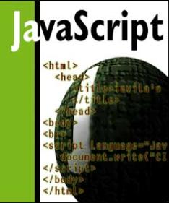


JavaScript
Dynamic Behavior in a Web Page

Slide 9
JavaScript
JavaScript is a front-end scripting language developed by Netscape for dynamic content
  Lightweight, but with limited capabilities
  Can be used as object-oriented language
Client-side technology
  Embedded in your HTML page
  Interpreted by the Web browser
Simple and flexible
Powerful to manipulate the DOM

Slide 10
JavaScript Advantages
JavaScript allows interactivity such as:
  Implementing form validation
  React to user actions, e.g. handle keys
  Changing an image on moving mouse over it
  Sections of a page appearing and disappearing
  Content loading and changing dynamically
  Performing complex calculations
  Custom HTML controls, e.g. scrollable table
  Implementing AJAX functionality

Slide 11
What Can JavaScript Do?
Can handle events
Can read and write HTML elements and modify the DOM tree
Can validate form data
Can access / modify browser cookies
Can detect the user’s browser and OS
Can be used as object-oriented language
Can handle exceptions
Can perform asynchronous server calls (AJAX)

Slide 12
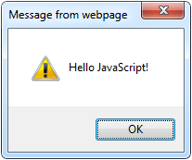
The First Script
first-script.html
<html>
<body>
<script type="text/javascript">
alert('Hello JavaScript!');
</script>
</body>
</html>

Slide 13
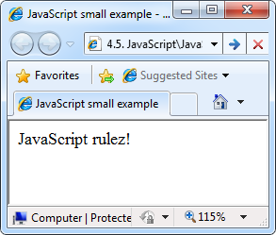
Another Small Example
small-example.html
<html>
<body>
<script type="text/javascript">
document.write('JavaScript rulez!');
</script>
</body>
</html>

Slide 14
Using JavaScript Code
The JavaScript code can be placed in:
  <script> tag in the head
  <script> tag in the body – not recommended
  External files, linked via <script> tag the head
    Files usually have .js extension
    Highly recommended
    The .js files get cached by the browser
<script src="scripts.js" type="text/javscript">
<!– code placed here will not be executed! -->
</script>

Slide 15
JavaScript – When is Executed?
JavaScript code is executed during the page loading or when the browser fires an event
  All statements are executed at page loading
  Some statements just define functions that can be called later
Function calls or code can be attached as "event handlers" via tag attributes
  Executed when the event is fired by the browser
<img src="logo.gif" onclick="alert('clicked!')" />

Slide 16
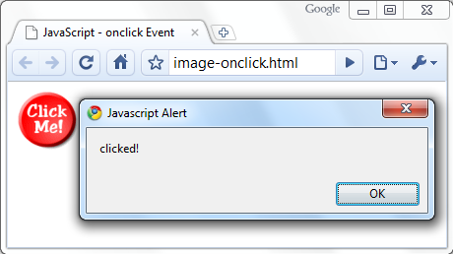
Calling a JavaScript Function from Event Handler – Example
<html>
<head>
<script type="text/javascript">
function test (message) {
alert(message);
}
</script>
</head>
<body>
<img src="logo.gif"
onclick="test('clicked!')" />
</body>
</html>
image-onclick.html

Slide 17
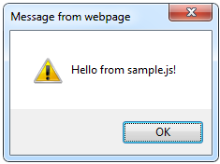
Using External Script Files
Using external script files:
External JavaScript file:
<html>
<head>
<script src="sample.js" type="text/javascript">
</script>
</head>
<body>
<button onclick="sample()" value="Call JavaScript
function from sample.js" />
</body>
</html>
external-JavaScript.html
The <script> tag is always empty.
function sample() {
alert('Hello from sample.js!')
}
sample.js

Slide 18
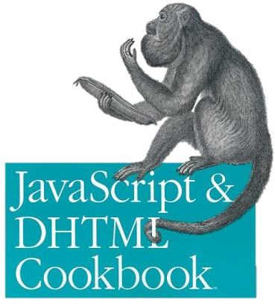
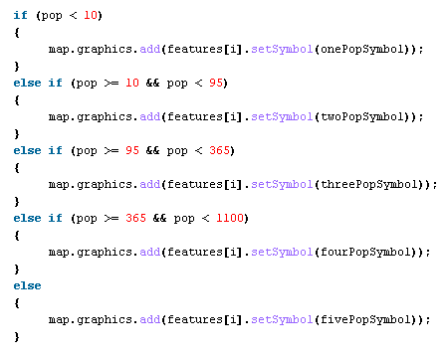

The JavaScript Syntax

Slide 19
JavaScript Syntax
The JavaScript syntax is similar to C# and Java
  Operators (+, *, =, !=, &&, ++, …)
  Variables (typeless)
  Conditional statements (if, else)
  Loops (for, while)
  Arrays (my_array[]) and associative arrays (my_array['abc'])
  Functions (can return value)
  Function variables (like the C# delegates)

Slide 20
Data Types
JavaScript data types:
  Numbers (integer, floating-point)
  Boolean (true / false)
String type – string of characters
Arrays
Associative arrays (hash tables)
var myName = "You can use both single or double quotes for strings";
var my_array = [1, 5.3, "aaa"];
var my_hash = {a:2, b:3, c:"text"};

Slide 21
Everything is Object
Every variable can be considered as object
  For example strings and arrays have member functions:
objects.html
var test = "some string";
alert(test[7]); // shows letter 'r'
alert(test.charAt(5)); // shows letter 's'
alert("test".charAt(1)); //shows letter 'e'
alert("test".substring(1,3)); //shows 'es'
var arr = [1,3,4];
alert (arr.length); // shows 3
arr.push(7); // appends 7 to end of array
alert (arr[3]); // shows 7

Slide 22
String Operations
The + operator joins strings
What is "9" + 9?
Converting string to number:
string1 = "fat ";
string2 = "cats";
alert(string1 + string2); // fat cats
alert("9" + 9); // 99
alert(parseInt("9") + 9); // 18

Slide 23
Arrays Operations and Properties
Declaring new empty array:
Declaring an array holding few elements:
Appending an element / getting the last element:
Reading the number of elements (array length):
Finding element's index in the array:
var arr = new Array();
var arr = [1, 2, 3, 4, 5];
arr.push(3);
var element = arr.pop();
arr.length;
arr.indexOf(1);

Slide 24
Standard Popup Boxes
Alert box with text and [OK] button
  Just a message shown in a dialog box:
Confirmation box
  Contains text, [OK] button and [Cancel] button:
Prompt box
  Contains text, input field with default value:
alert("Some text here");
confirm("Are you sure?");
prompt ("enter amount", 10);

Slide 25
Sum of Numbers – Example
  sum-of-numbers.html
<html>
<head>
<title>JavaScript Demo</title>
<script type="text/javascript">
function calcSum() {
value1 =
parseInt(document.mainForm.textBox1.value);
value2 =
parseInt(document.mainForm.textBox2.value);
sum = value1 + value2;
document.mainForm.textBoxSum.value = sum;
}
</script>
</head>

Slide 26
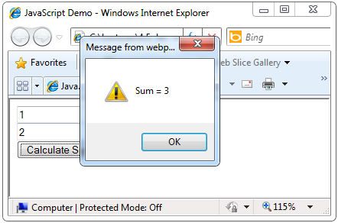
Sum of Numbers – Example (2)
  sum-of-numbers.html (cont.)
<body>
<form name="mainForm">
<input type="text" name="textBox1" /> <br/>
<input type="text" name="textBox2" /> <br/>
<input type="button" value="Process"
onclick="javascript: calcSum()" />
<input type="text" name="textBoxSum"
readonly="readonly"/>
</form>
</body>
</html>

Slide 27
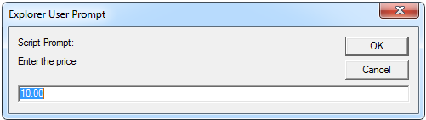
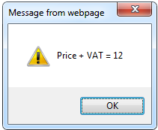
JavaScript Prompt – Example
prompt.html
price = prompt("Enter the price", "10.00");
alert('Price + VAT = ' + price * 1.2);

Slide 28
Conditional Statement (if)
unitPrice = 1.30;
if (quantity > 100) {
unitPrice = 1.20;
}
Symbol
Meaning
>
Greater than
<
Less than
>=
Greater than or equal to
<=
Less than or equal to
==
Equal
!=
Not equal

Slide 29

Conditional Statement (if) (2)
The condition may be of Boolean or integer type:
conditional-statements.html
var a = 0;
var b = true;
if (typeof(a)=="undefined" || typeof(b)=="undefined") {
document.write("Variable a or b is undefined.");
}
else if (!a && b) {
document.write("a==0; b==true;");
} else {
document.write("a==" + a + "; b==" + b + ";");
}

Slide 30
Switch Statement
The switch statement works like in C#:
switch (variable) {
case 1:
// do something
break;
case 'a':
// do something else
break;
case 3.14:
// another code
break;
default:
// something completely different
}
switch-statements.html

Slide 31
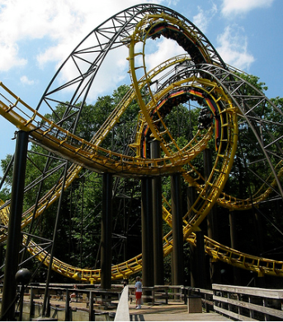

Loops
Like in C#
    for loop
    while loop
    do … while loop
var counter;
for (counter=0; counter<4; counter++) {
alert(counter);
}
while (counter < 5) {
alert(++counter);
}
loops.html

Slide 32
Functions
Code structure – splitting code into parts
Data comes in, processed, result returned
Parameters come in here.
function average(a, b, c)
{
var total;
total = a+b+c;
return total/3;
}
Declaring variables is optional. Type is never declared.
Value returned here.

Slide 33
Function Arguments and Return Value
Functions are not required to return a value
When calling function it is not obligatory to specify all of its arguments
  The function has access to all the arguments passed via arguments array
function sum() {
var sum = 0;
for (var i = 0; i < arguments.length; i ++)
sum += parseInt(arguments[i]);
return sum;
}
alert(sum(1, 2, 4));
functions-demo.html

Slide 34
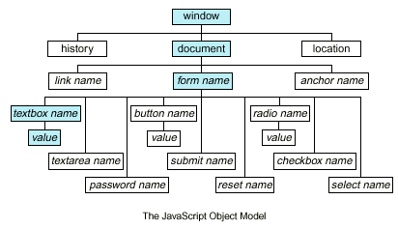
Document Object Model (DOM)

Slide 35
Document Object Model (DOM)
Every HTML element is accessible via the JavaScript DOM API
Most DOM objects can be manipulated by the programmer
The event model lets a document to react when the user does something on the page
Advantages
  Create interactive pages
  Updates the objects of a page without reloading it

Slide 36
Accessing Elements
Access elements via their ID attribute
Via the name attribute
Via tag name
  Returns array of descendant <img> elements of the element "el"
var elem = document.getElementById("some_id")
var arr = document.getElementsByName("some_name")
var imgTags = el.getElementsByTagName("img")

Slide 37
DOM Manipulation
Once we access an element, we can read and write its attributes
DOM-manipulation.html
function change(state) {
var lampImg = document.getElementById("lamp");
lampImg.src = "lamp_" + state + ".png";
var statusDiv =
document.getElementById("statusDiv");
statusDiv.innerHTML = "The lamp is " + state";
}
…
<img src="test_on.gif" onmouseover="change('off')"
onmouseout="change('on')" />

Slide 38
Common Element Properties
Most of the properties are derived from the HTML attributes of the tag
  E.g. id, name, href, alt, title, src, etc…
style property – allows modifying the CSS styles of the element
  Corresponds to the inline style of the element
    Not the properties derived from embedded or external CSS rules
  Example: style.width, style.marginTop, style.backgroundImage

Slide 39
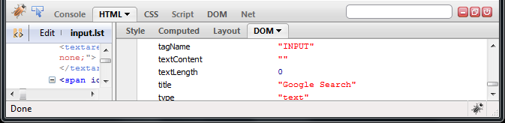
Common Element Properties (2)
className – the class attribute of the tag
innerHTML – holds all the entire HTML code inside the element
Read-only properties with information for the current element and its state
  tagName, offsetWidth, offsetHeight, scrollHeight, scrollTop, nodeType, etc…

Slide 40
Accessing Elements through the DOM Tree Structure
We can access elements in the DOM through some tree manipulation properties:
  element.childNodes
  element.parentNode
  element.nextSibling
  element.previousSibling
  element.firstChild
  element.lastChild

Slide 41
Accessing Elements through the DOM Tree – Example
var el = document.getElementById('div_tag');
alert (el.childNodes[0].value);
alert (el.childNodes[1].
getElementsByTagName('span').id);
…
<div id="div_tag">
<input type="text" value="test text" />
<div>
<span id="test">test span</span>
</div>
</div>
  accessing-elements-demo.html
  Warning: may not return what you expected due to Browser differences

Slide 42
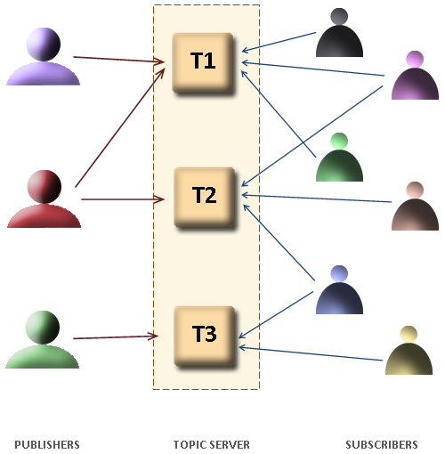
The HTML DOM Event Model

Slide 43
The HTML DOM Event Model
JavaScript can register event handlers
  Events are fired by the Browser and are sent to the specified JavaScript event handler function
  Can be set with HTML attributes:
  Can be accessed through the DOM:
<img src="test.gif" onclick="imageClicked()" />
var img = document.getElementById("myImage");
img.onclick = imageClicked;

Slide 44
The HTML DOM Event Model (2)
All event handlers receive one parameter
  It brings information about the event
  Contains the type of the event (mouse click, key press, etc.)
  Data about the location where the event has been fired (e.g. mouse coordinates)
  Holds a reference to the event sender
    E.g. the button that was clicked

Slide 45


The HTML DOM Event Model (3)
  Holds information about the state of [Alt], [Ctrl] and [Shift] keys
  Some browsers do not send this object, but place it in the document.event
  Some of the names of the event’s object properties are browser-specific

Slide 46
Common DOM Events
Mouse events:
  onclick, onmousedown, onmouseup
  onmouseover, onmouseout, onmousemove
Key events:
  onkeypress, onkeydown, onkeyup
  Only for input fields
Interface events:
  onblur, onfocus
  onscroll

Slide 47
Common DOM Events (2)
Form events
  onchange – for input fields
  onsubmit
    Allows you to cancel a form submission
    Useful for form validation
Miscellaneous events
  onload, onunload
    Allowed only for the <body> element
    Fires when all content on the page was loaded / unloaded

Slide 48
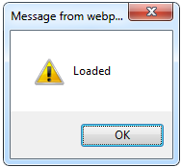
onload Event – Example
onload event
  onload.html
<html>
<head>
<script type="text/javascript">
function greet() {
alert("Loaded.");
}
</script>
</head>
<body onload="greet()" >
</body>
</html>

Slide 49

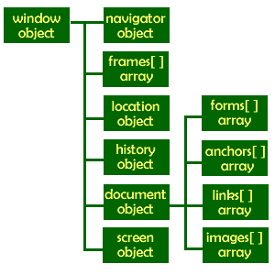
The Built-In Browser Objects

Slide 50
Built-in Browser Objects
The browser provides some read-only data via:
  window
    The top node of the DOM tree
    Represents the browser's window
  document
    holds information the current loaded document
  screen
    Holds the user’s display properties
  browser
    Holds information about the browser

Slide 51
DOM Hierarchy – Example
window
navigator
screen
document
history
location
form
form
button
form

Slide 52
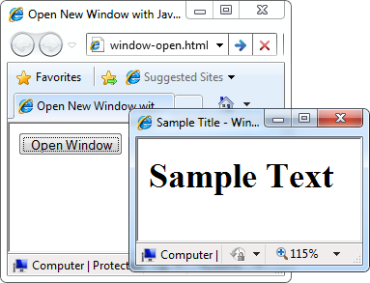
Opening New Window – Example
window.open()
  window-open.html
var newWindow = window.open("", "sampleWindow",
"width=300, height=100, menubar=yes,
status=yes, resizable=yes");
newWindow.document.write(
"<html><head><title>
Sample Title</title>
</head><body><h1>Sample
Text</h1></body>");
newWindow.status =
"Hello folks";

Slide 53
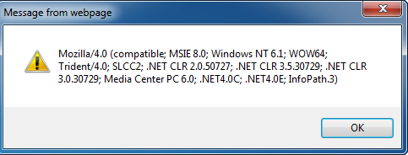
The Navigator Object
alert(window.navigator.userAgent);
The browser window
The navigator in the browser window
The userAgent (browser ID)

Slide 54

The Screen Object
The screen object contains information about the display
window.moveTo(0, 0);
x = screen.availWidth;
y = screen.availHeight;
window.resizeTo(x, y);

Slide 55
Document and Location
document object
  Provides some built-in arrays of specific objects on the currently loaded Web page
document.location
  Used to access the currently open URL or redirect the browser
document.links[0].href = "yahoo.com";
document.write(
"This is some <b>bold text</b>");
document.location = "http://www.yahoo.com/";

Slide 56
Form Validation – Example
  form-validation.html
function checkForm()
{
var valid = true;
if (document.mainForm.firstName.value == "") {
alert("Please type in your first name!");
document.getElementById("firstNameError").
style.display = "inline";
valid = false;
}
return valid;
}
…
<form name="mainForm" onsubmit="return checkForm()">
<input type="text" name="firstName" />
…
</form>

Slide 57
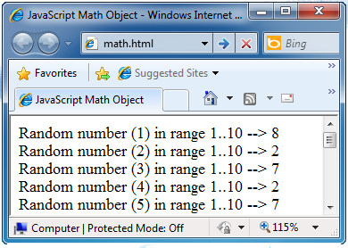
The Math Object
The Math object provides some mathematical functions
  math.html
for (i=1; i<=20; i++) {
var x = Math.random();
x = 10*x + 1;
x = Math.floor(x);
document.write(
"Random number (" +
i + ") in range " +
"1..10 --> " + x +
"<br/>");
}

Slide 58
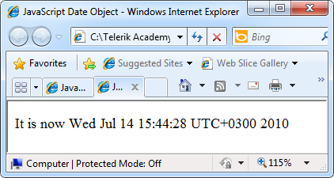
The Date Object
The Date object provides date / calendar functions
  dates.html
var now = new Date();
var result = "It is now " + now;
document.getElementById("timeField")
.innerText = result;
...
<p id="timeField"></p>

Slide 59
Timers: setTimeout()
Make something happen (once) after a fixed delay
var timer = setTimeout('bang()', 5000);
5 seconds after this statement executes, this function is called
clearTimeout(timer);
Cancels the timer

Slide 60
Timers: setInterval()
Make something happen repeatedly at fixed intervals
var timer = setInterval('clock()', 1000);
This function is called continuously per 1 second.
clearInterval(timer);
Stop the timer.

Slide 61
Timer – Example
  timer-demo.html
<script type="text/javascript">
function timerFunc() {
var now = new Date();
var hour = now.getHours();
var min = now.getMinutes();
var sec = now.getSeconds();
document.getElementById("clock").value =
"" + hour + ":" + min + ":" + sec;
}
setInterval('timerFunc()', 1000);
</script>
<input type="text" id="clock" />

Slide 62
HTML, CSS and JavaScript Basics
?
?
?
?
?
Questions?
?
?
?
?
?
?

