Slide 1
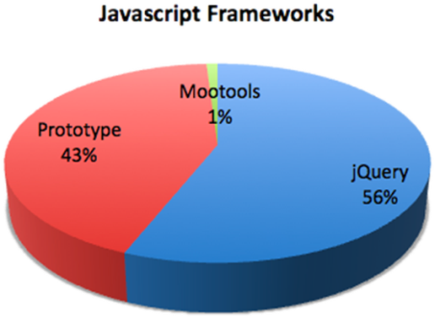


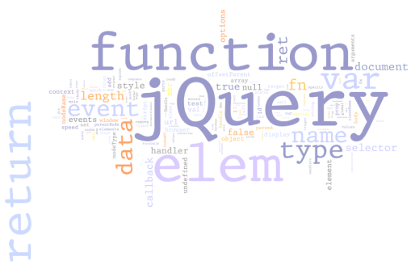

WEB SYSTEMS & TECHNOLOGIES
4. jQuery Overview

Slide 2

Table of Contents
What is jQuery?
jQuery Fundamentals
  Selectors
  DOM Manipulation
  DOM Altering
  jQuery DOM elements
AJAX
  jQuery AJAX Methods
  Executing AJAX Requests

Slide 3
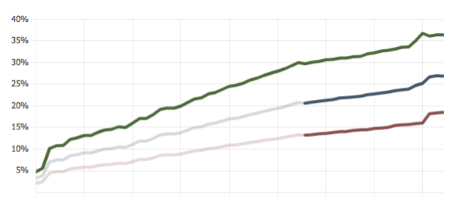
What is jQuery?
The world’s most popular JavaScript library

Slide 4
What is jQuery?
jQuery is a cross-browser JavaScript library
  Designed to simplify the client-side scripting of HTML
  The most popular JavaScript library in use today
  Free, open source software
jQuery's syntax is designed to make it easier to
  Navigate a document and select DOM elements
  Create animations
  Handle events

Slide 5
What is jQuery? (2)
jQuery also provides capabilities for developers to create plugins for
  Low-level interaction and animation
  Advanced effects and high-level, theme-able widgets
  Creation of powerful and dynamic web pages
Microsoft adopted jQuery within Visual Studio
  Uses in Microsoft's ASP.NET AJAX Framework and ASP.NET MVC Framework
Notes:
Widget: tiện ích
Adopted: nhận đề nghị

Slide 6
Why jQuery is So Popular?
Easy to learn
  Fluent programming style
Easy to extend
  You create new jQuery plugins by creating new JavaScript functions
Powerful DOM Selection
  Powered by CSS 3.0
Lightweight
Community Support
  Large community of developers and geeks
Notes:
Community: cộng đồng
Geek: đam mê.

Slide 7
How to Add jQuery to a Web Site?
Download jQuery files from
  http://www.jquery.com
Self hosted
  You can choose to self host the .js file
  E.g. jquery-2.1.1.js or .min.js file
Use it from CDN (content delivery network)
  Microsoft, jQuery, Google CDNs
  e.g. http://code.jquery.com/jquery-2.1.1.min.js,
  http://ajax.microsoft.com/ajax/jquery/jquery-2.1.1.min.js
Notes:
Talking Points:
You can choose to self host files - this is including jQuery in the scripts folder in Visual Studio.
Can also just include jQuery from a CDN - simply change the script reference to point to jQuery on the CDN
Can be faster loading and client browser may already have jQuery file cached
Be careful! If the CDN goes down your site may also go down.
Source version is human readable.
Always include the minified version for your production code.

Slide 8




Selectors and DOM Manipulation

Slide 9
Selectors
Selection of DOM elements in jQuery is much like as in pure JavaScript
  Selection of elements using CSS selectors
  Like querySelectorAll
$(selector)
//by tag
$("div") //document.querySelectorAll("div");
//by class
$(".menu-item")
//document.querySelectorAll(".menu-item");
//by id
$("#navigation")
//by combination of selectors
$("ul.menu li")

Slide 10
Selection with jQuery
Selecting items with jQuery
  Almost always returns a collection of the items
    Even if there is only one item
  Can be stored in a variable or used right away
  The usage of the elements is always the same, no matter whether a single or many elements
More at: http://learn.jquery.com/using-jquery-core/selecting-elements/
// select the item
$("#something").hide();
$(".widgets").fade(1);

Slide 11
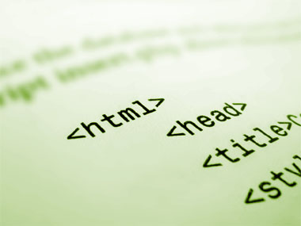
Selection with jQuery
Live Demo

Slide 12
DOM Traversal
Traversing the nodes of the DOM

Slide 13
DOM Traversal
As with plain JavaScript, the DOM can be traversed with jQuery
  Properties for:
    Next and previous siblings
    Parents and children

Slide 14
DOM Traversal:
Next and Previous
jQuery.next(), jQuery.prev()
  Returns the next/prev sibling
  Returns an HTML element
    Not a [text] node
<ul>
<li>Item 1</li>
<li>Item 2</li>
<li>Item 3</li>
</ul>
var $first = $("li").first();
log($first);
//logs "Item 1"
log($first.next());
//logs "Item 2"

Slide 15
Next/Prev Siblings
Live Demo

Slide 16
DOM Traversal:
Parent
jQuery.parent()
  Returns the parent of the element
jQuery.parents(selector)
  Returns the first parent that matches the selector
<div id="wrapper">
<ul id="items-list">
<li>Item 1</li>
<li>Item 2</li>
<li class="special">Item 3</li>
<li>Item 4</li>
</ul>
</div>
var $node = $(".special");
$node.parent().attr("id");
//logs "items-list"
$node.parents("div").attr("id");
//logs "wrapper"
$node.parents("#wrapper")
.attr("id");
/logs "wrapper"

Slide 17
Parent Element
Live Demo

Slide 18
Altering the DOM
Adding and removing DOM elements

Slide 19

Adding Elements
Adding elements can
  be done on the fly
  jQuery.appendTo()/prependTo()
  jQuery.append()/prepend()
$('<ul><li>Hello</li></ul>').appendTo('body');
$("body").prepend("<h1>header</h1>");

Slide 20
Creating elements
Creating new elements is also easy
var $divElement = $('<div>');
var $anotherDivElement = $('<div />');

Slide 21
Adding Elements to the DOM
Live Demo

Slide 22
Removing Elements
You can also remove elements from the DOM
  Just as easy
// Before
<div>
<p>Red</p>
<p>Green</p>
</div>
// Removing elements
$('p').remove();
// After
<div>
</div>

Slide 23

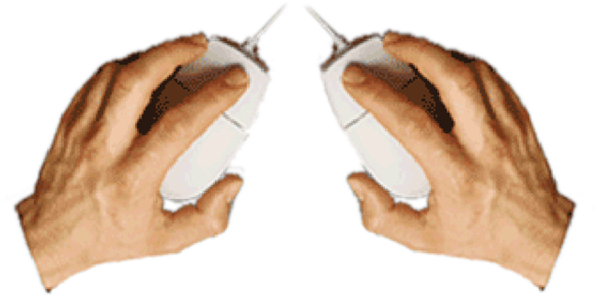

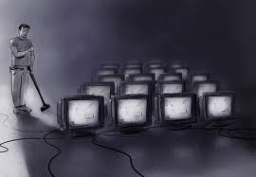
Removing Elements
Live Demo

Slide 24
jQuery Extended DOM Elements

Slide 25
jQuery Objects
Selected with jQuery DOM elements are NOT pure DOM elements
  They are extended
  Have additional properties and methods
    addClass(), removeClass(), toogleClass()
    on(event, callback) for attaching events
    animate(), fade(), etc…
//Parsing a regular DOM element to jQuery Element
var content = document.createElement("div");
var $content = $(content);

Slide 26
Properties of jQuery Elements
jQuery elements extend regular DOM elements
Methods for altering the elements
  jQuery.css("color", "#f3f")
  jQuery.html() returns the innerHTML
    jQuery.html(content) sets the innerHTML
  jQuery.text(content) sets the innerText, by escaping the content

Slide 27
Properties of jQuery Elements
Live Demo

Slide 28
jQuery Events
Cross-browser events

Slide 29
jQuery Events
jQuery has a convenient way for attaching and detaching events
  Works cross-browser
  Using methods on() and off()
function onButtonClick(){
$(".selected").removeClass("selected");
$(this).addClass("selected");
}
$("a.button").on("click", onButtonClick);

Slide 30
jQuery Events
Optimize the event
  Add it on the parent element
  A bit different syntax
function onListItemClick(){
$(".selected").removeClass("selected");
$(this).addClass("selected");
}
$("ul").on("click", "li", onListItemClick);

Slide 31

jQuery Event Handlers
Live Demo

Slide 32
jQuery Chaining
Call after call, after call…

Slide 33
jQuery Chaining
The chaining paradigm is as follows:
  If a method should return result -> Ok, return it
  If a method should NOT return a result
  -> return this
jQuery implements this paradigm, so methods can be chained to one another:
$('<button />')
.addClass('btn-success')
.html('Click me for success')
.on('click', onSuccessButtonClick)
.appendTo(document.body);
Notes:
Paradigm: mô hình

Slide 34
jQuery Chaining
Live Demo

Slide 35
jQuery AJAX
Creating HTTP requests with jQuery

Slide 36
jQuery AJAX
AJAX stands for Asynchronous JavaScript and XML
  Meaning asynchronously get data from a remote place and render it dynamically
jQuery provides some methods for AJAX
  jQuery.ajax(options) – HTTP request with full control (headers, data, method, etc…)
  jQuery.get(url) – HTTP GET request
  jQuery.post(url) – HTTP POST request
  jQuery(selector).load(url) – loads the contents from the url inside the selected node

Slide 37
jQuery AJAX
Live Demo

Slide 38
jQuery Overview
?
?
?
?
?
Questions?
?
?
?
?
?
?

Slide 39
Homework
Create a slider control using jQuery
  The slider can have many slides
  Only one slide is visible at a time
  Each slide contains HTML code
    i.e. it can contain images, forms, divs, headers, links, etc…
  Implement functionality for changing the visible slide after 5 seconds
  Create buttons for next and previous slide

Slide 40
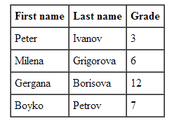
Homework (2)
Using jQuery implement functionality to insert a DOM element before or after another element
By given an array of students, generate a table that represents these students
  Each student has first name,
  last name and grade
  Use jQuery
Implement functionality to change the background color of a web page
  i.e. select a color from a color picker and set this color as the background color of the page

Slide 41
Homework (3)
*Implement a GridView control
  Rows can be added dynamically
  A header row can be added dynamically
    Each GridView can have at most one header row
  Each row can have a nested GridView
    Each GridView can have at most one nested GridView

