Slide 1
Chapter 2 Data of Macroeconomics
Mentor Pham Xuan Truong
truongpx@ftu.edu.vn

Slide 2
Content
I National income - Gross domestic products (GDP)
1 Definition
2 Methods of computing GDP
3 Other measurements of national income
4 Nominal GDP, real GDP and GDP deflator
5 GDP and net economic welfare
II Cost of living - Consumer price index (CPI)
1 Definition
2 Method of computing CPI
3 Problems in measuring CPI
4 CPI versus GDP deflator
5 Apply CPI in practice

Slide 3
I Gross domestic products (GDP)
1 Definition
Gross Domestic Product (GDP) is the market value of all final goods and services produced within an economy in a given period of time.
Concepts must be noticed
Market value: reflect the value of the goods
of all: all items produced in the economy and sold legally in markets excluding most items produced and sold illicitly or produced and consumed at home
  Final goods and services: Value of intermediate goods is already included in the prices of the final goods
  Produced within an economy: Goods and services produced domestically, regardless of the nationality of the producer
  a given period of time: A year or a quarter

Slide 4
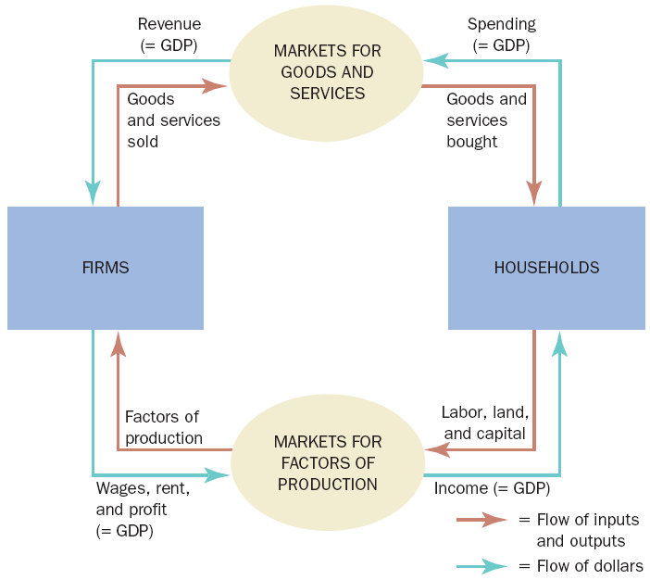
I Gross domestic products (GDP)
2 Methods of computing GDP
Let’s examine Circular-flow diagram with two assumptions:
+ All goods and services – bought by households (economy includes only firms and households
+ Households - -spend all of their income (no saving)
Households buy goods and services from firms, and firms use their revenue from sales to pay wages to workers, rent to landowners, and profit to firm owners. GDP equals the total amount spent by households in the market for goods and services. It also equals the total wages, rent, and profit paid by firms in the markets for the factors of production.

Slide 5
I Gross domestic products (GDP)
2 Methods of computing GDP
For the economy as a whole, income must equal expenditure.
There are 2 ways
of viewing GDP
Total income of everyone in the economy
Total expenditure on the economy’s
output of goods and services

Slide 6
I Gross domestic products (GDP)
2 Method of computing GDP
+ Expenditure approach – GDP as aggregate expenditure
Component of aggregate expenditure
C: consumption spending by households except purchases of new houses
I: investment spending by business (capitals, inventories) and households (houses)
G: government purchases of goods and services except transfer payment
NX (X –M): net export or net foreign demand for domestic goods. X is spending on domestically produced goods by foreigners (export), M is spending on foreign goods by domestic residents (import)
GDP = C + I + G + (X-M)
= C + I + G + NX

Slide 7
I Gross domestic products (GDP)
2 Method of computing GDP
+ Income approach - GDP as aggregate income
Component of aggregate expenditure
w: wage paying for workers who contribute labor for production
R: rent paying for capital owners who contribute capital including land for production
i: interest paying for lender who contribute finance for production
∏: profit paying for stockholder who contribute finance for production
D: depreciation of old machines
Te: net indirect tax paying for government who contribute business environment for production
GDP = w + R + i + ∏ + D + Te

Slide 8
I Gross domestic products (GDP)
2 Method of computing GDP
+ Production approach - GDP as aggregate/total output
Total value added = total revenue – total cost
GDP = ∑ Value added in all industries
Example
Total output (GDP)= 700 = value added by steel mill + value added by car producer = 100 + 600
Steel mill– steel products | 100
Car producer - cars | 100 | 600

Slide 9
I Gross domestic products (GDP)
3 Other measurements of national income
GNP (gross national products) is the market value of all the products and services produced in one year by labour and property supplied by the citizens of a country.
or the equivalent measurement
GNP (gross national products) or GNI (gross national income) is the total factor income owned by domestic residents from selling final goods and services
GNP (GDP) = GDP + NFA
NFA: net factor income from abroad
NNP (net national product): GNP excludes Depreciation
NI (national income): NNP excludes tax
DPI (disposable personal income): NI excludes income tax and adds transfer payment and other payment items from government.

Slide 10
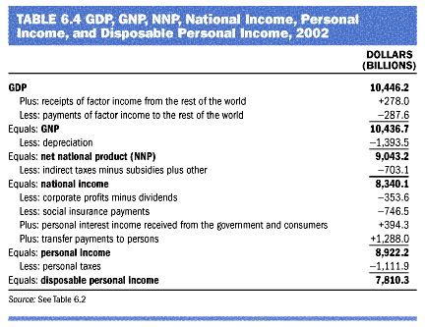
I Gross domestic products (GDP)
3 Other measurements of national income

Slide 11
I Gross domestic products (GDP)
4 Nominal GDP, real GDP and GDP deflator
Total spending rises from one year to the next
+ Economy - producing a larger output of goods and services
+ And/or goods and services are being sold at higher prices
Nominal GDP reflects both changes of output and price, whereas real GDP only reflect change of output

Slide 12
I Gross domestic products (GDP)
4 Nominal GDP, real GDP and GDP deflator
Nominal GDP
  Production of goods and services
  Valued at current prices
Real GDP
  Production of goods and services
  Valued at constant prices
  Designate one year as base year
  Not affected by changes in prices
Notice: For the base year Nominal GDP = Real GDP

Slide 13
I Gross domestic products (GDP)
4 Nominal GDP, real GDP and GDP deflator
The GDP deflator
  Measure of the price level
  Ratio of nominal GDP to real GDP times 100
  =100 for the base year
  Measures the current level of prices relative to the level of prices in the base year
Inflation
  Economy’s overall price level is rising
  Inflation rate: Percentage change in some measure of the price level from one period to the next

Slide 14
Example: Real and Nominal GDP
Prices and Quantities
Year | Price of hot dogs | Quantity of hot dogs | Price of hamburgers |  | Quantity of hamburgers
2008 2009 2010 | $1 $2 $3 | 100 150 200 | $2 $3 $4 |  | 50 100 150
Calculating Nominal GDP
2008 2009 2010 | ($1 per hot dog × 100 hot dogs) + ($2 per hamburger × 50 hamburgers) = $200 ($2 per hot dog × 150 hot dogs) + ($3 per hamburger × 100 hamburgers) = $600 ($3 per hot dog × 200 hot dogs) + ($4 per hamburger × 150 hamburgers) = $1,200
Calculating Real GDP (base year 2008)
2008 2009 2010 | ($1 per hot dog × 100 hot dogs) + ($2 per hamburger × 50 hamburgers) = $200 ($1 per hot dog × 150 hot dogs) + ($2 per hamburger × 100 hamburgers) = $350 ($1 per hot dog × 200 hot dogs) + ($2 per hamburger × 150 hamburgers) = $500
Calculating the GDP Deflator
2008 2009 2010 | ($200 / $200) × 100 = 100 ($600 / $350) × 100 = 171 ($1,200 / $500) × 100 = 240 |  |  | This table shows how to calculate real GDP, nominal GDP, and the GDP deflator for a hypothetical economy that produces only hot dogs and hamburgers.

Slide 15
I Gross domestic products (GDP)
5 GDP and net economic welfare
GDP – good measure of economic well - being
GDP – “single measure of the economic well-being of a society”
  Economy’s total income
  Economy’s total expenditure
  Larger GDP
    Good life
    Better healthcare
    Better educational systems
  Measure - ability to obtain many of the inputs into a worthwhile life

Slide 16
I Gross domestic products (GDP)
5 GDP and net economic welfare
But GDP – not a perfect measure of well-being
  Doesn’t include
    Leisure
    Value of almost all activity that takes place outside markets
    Quality of the environment
  No distribution of income
Net economic welfare (NEW)
NEW = GDP(or GNP) + V1 – V2
V1: value of rest, value of goods and services which are not sold, revenue from transactions in black market…
V2: negative externality for natural resource, environment such as noise, traffic jam, air pollution…
NEW reflects welfare better than GNP but it is very difficult to have enough data to compute NEW. Therefore, economists still use GDP and GNP
Notes:
Underground economy accounts for 8% of the US’ GDP, 9% of Swiss GDP, 11% of Japan’s GDP, 54% of Thais GDP

Slide 17
GDP and the quality of life
Country | Real GDP per person (2005) | Life expectancy | Adult literacy (% of population) | Internet usage (% of population)
United States Japan Germany Russia Mexico Brazil China Indonesia India Pakistan Bangladesh Nigeria | $41,890 31,267 29,461 10,845 10,751 8,402 6,757 3,843 3,452 2,370 2,053 1,128 | 78 years 82 79 65 76 72 72 70 64 65 63 47 | 99% 99 99 99 92 89 91 90 61 50 47 69 | 63 % 67 45 15 18 19 9 7 3 7 0.3 4
The table shows GDP per person and three other measures of the quality of life for twelve major countries.

Slide 18
II Consumer price index
1 Definition
The consumer price index (CPI) is a measure of the overall cost of the goods and services bought by a typical consumer. Each month, the General Statistic Office (GSO), which is part of the Ministry of Finance, computes and reports the consumer price index.
Concepts must be noticed
Overall cost
Typical consumer

Slide 19
II Consumer price index
2 Method of computing of CPI
How the consumer price index is calculated
1. Fix the basket
2. Find the prices
3. Compute the basket’s cost
4. Chose a base year and compute the CPI
Price of basket of goods & services in current year
Divided by price of basket in base year
Times 100
5. Compute the inflation rate
Percentage change in the price index from the preceding period

Slide 20
Calculating the CPI and the inflation rate: an example
Step 1: Survey consumers to determine a fixed basket of goods
Basket = 4 hot dogs, 2 hamburgers
Step 2: Find the price of each good in each year
Year | Price of hot dogs | Price of hamburgers
2008 2009 2010 | $1 2 3 | $2 3 4
Step 3: Compute the cost of the basket of goods in each year
2008 2009 2010 | ($1 per hot dog × 4 hot dogs) + ($2 per hamburger × 2 hamburgers) = $8 per basket ($2 per hot dog × 4 hot dogs) + ($3 per hamburger × 2 hamburgers) = $14 per basket ($3 per hot dog × 4 hot dogs) + ($4 per hamburger × 2 hamburgers) = $20 per basket
Step 4: Choose one year as a base year (2008) and compute the CPI in each year
2008 2009 2010 | ($8 / $8) × 100 = 100 ($14 / $8) × 100 = 175 ($20 / $8) × 100 = 250
Step 5: Use the consumer price index to compute the inflation rate from previous year
2009 2010 | (175 – 100) / 100 × 100 = 75% (250 – 175) / 175 × 100 = 43%

Slide 21
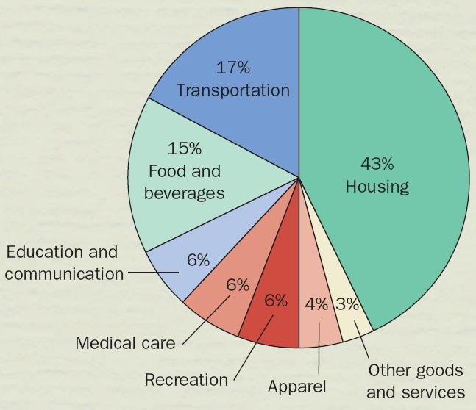
Typical basket of goods and services

Slide 22
II Consumer price index
3 Problems in measuring CPI
Substitution bias: overstate cost of living by fixing goods baskets as consumers change consumption behavior from buying high price goods to low price substitute goods
Introduction of new goods: overstate cost of living by ignoring new introduced goods with lower price
Unmeasured quality change: increase cost of living does not mean we are more miserable

Slide 23
II Consumer price index
4 CPI versus GDP deflator
GDP deflator
  Ratio of nominal GDP to real GDP
  Reflects prices of all goods & services produced domestically
CPI
  Reflects prices of goods & services bought by consumers
GDP deflator
  Compares the price of currently produced goods and services
  To the price of the same goods and services in the base year
CPI
  Compares price of a fixed basket of goods and services
  To the price of the basket in the base year

Slide 24
II Consumer price index
5 Apply CPI in practice
Correcting Economic Variable for the effects of Inflation
Money value figures from different times
Rank | Title | Studio | Adjusted Gross | Unadjusted Gross | Year^
1 | Gone with the Wind | MGM | $1,594,132,100 | $198,676,459 | 1939^
2 | Star Wars | Fox | $1,405,363,600 | $460,998,007 | 1977^
3 | The Sound of Music | Fox | $1,123,657,300 | $158,671,368 | 1965
4 | E.T.: The Extra-Terrestrial | Uni. | $1,119,230,700 | $435,110,554 | 1982^
5 | The Ten Commandments | Par. | $1,033,590,000 | $65,500,000 | 1956
6 | Titanic | Par. | $1,012,649,000 | $600,788,188 | 1997
7 | Jaws | Uni. | $1,010,541,900 | $260,000,000 | 1975
8 | Doctor Zhivago | MGM | $979,428,700 | $111,721,910 | 1965
9 | The Exorcist | WB | $872,386,800 | $232,671,011 | 1973^
10 | Snow White and the Seven Dwarfs | Dis. | $860,010,000 | $184,925,486 | 1937^

Slide 25
II Consumer price index
5 Apply CPI in practice
Nominal and real interest rate
Nominal interest rate
  Interest rate as usually reported
  Without a correction for the effects of inflation
  Implies the growth of money value of an amount of money over time
Real interest rate
  Interest rate corrected for the effects of inflation
  = Nominal interest rate – Inflation rate
  Implies the growing of purchasing power of an amount of money over time

Slide 26
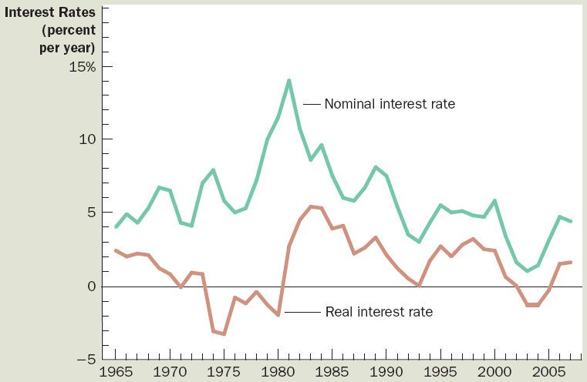
Nominal and real interest rate of the US from 1965 to 2005

Slide 27
Key concepts
Gross domestic products (GDP)
Gross national products (GNP)
Nominal GDP, real GDP, GDP deflator
Consumer price index (CPI)
Inflation rate
Nominal interest rate, real interest rate

