Slide 1
Chapter 3 Economic growth
Mentor Pham Xuan Truong
truongpx@ftu.edu.vn

Slide 2
Content
1 Definition, computing method and implications of economic growth
2 Factors decide economic growth in the long run
3 Theories of economic growth
4 Policies to promote economic growth

Slide 3
1 Definition, computing method and implications of economic growth
Definition
Economic growth is the increase in the market value of the goods and services produced by an economy over time. It is conventionally measured as the percent rate of increase in real gross domestic product, or real GDP
To reflect more accurately about living standard of each person in country, economists use the growth of the ratio of GDP to population (GDP per capita), which is also called income per capita
An increase in per capita income is referred to as intensive growth. GDP growth caused only by increases in population or territory is called extensive growth

Slide 4
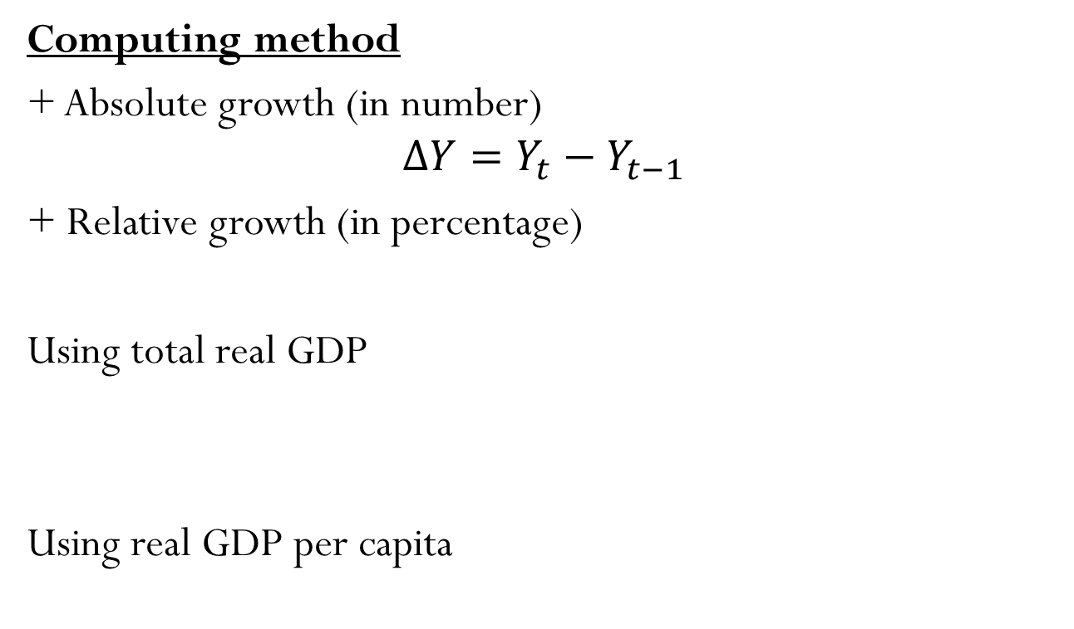
1 Definition, computing method and implications of economic growth
Computing method
+ Absolute growth (in number)
$$∆Y=Y_{t}−Y_{t−1}$$
+ Relative growth (in percentage)
Using total real GDP
Using real GDP per capita

Slide 5
1 Definition, computing method and implications of economic growth
+ Average growth
yn GDP at the end of period
y0 GDP in the beginning of period
ga average growth in period
n number of year (month) in period

Slide 6
Rule of thumb: rule of 70
A way to estimate the number of years it takes for a certain variable to double. The rule of 70 states that in order to estimate the number of years for a variable to double, take the number 70 and divide it by the growth rate of the variable (70/g). This rule is commonly used with an annual compound interest rate to quickly determine how long it would take to double your money.
If the growth rate is greater than 4% we use 72 for dividing (rule of 72)
Similarly, we have rule of 110 for triple growth and rule of 140 for quadruple growth

Slide 7
1 Definition, computing method and implications of economic growth
Implications
Enhance people’s income, thereby improving living standard
Create jobs, mitigate unemployment (Okun’s law)
Provide finance to strengthen national security, political credibility
With low income countries, high economic growth rate helps these country to catch up high income ones

Slide 8
The variety of growth experiences
Country | Period | Real GDP per person at beginning of period | Real GDP per person at end of period | Growth rate (per year)
Japan Brazil China Mexico Germany Canada Argentina United States India United Kingdom Indonesia Bangladesh Pakistan | 1890–2006 1900–2006 1900–2006 1900–2006 1870–2006 1870–2006 1900–2006 1870–2006 1900–2006 1870–2006 1900–2006 1900–2006 1900–2006 | $1,408 729 670 1,085 2,045 2,224 2,147 3,752 632 4,502 834 583 690 | $33,150 8,880 7,740 11,410 31,830 34,610 15,390 44,260 3,800 35,580 3,950 2,340 2,500 | 2.76% 2.39 2.34 2.24 2.04 2.04 1.88 1.83 1.71 1.53 1.48 1.32 1.22

Slide 9
2 Factors decides economic growth in the long run
Economic growth in long run means the increase of productivity (quantity of goods and services produced from each unit of labor input).
Productivity is so important because it is the key determinant of living standards (an economy’s income is the economy’s output)
The question is how productivity is determined

Slide 10
2 Factors decides economic growth in the long run
  How productivity is determined
  Physical capital (K)
    Stock of equipment and structures
    Used to produce goods and services
  Human capital (H)
    Knowledge and skills that workers acquire through education, training, and experience
  Natural resources (R)
    Inputs into the production of goods and services
    Provided by nature, such as land, rivers, and mineral deposits
  Technological knowledge (T)
    Society’s understanding of the best ways to produce goods and services

Slide 11
3 Theories of economic growth
Classical theory
Production expansion depends on savings of capitalist
Savings of capitalist depends on profit
Profit depends on production cost
Production cost depends on labor cost
Labor cost depends on food price
Food price depends on land area
Land plays an important role for economic growth

Slide 12
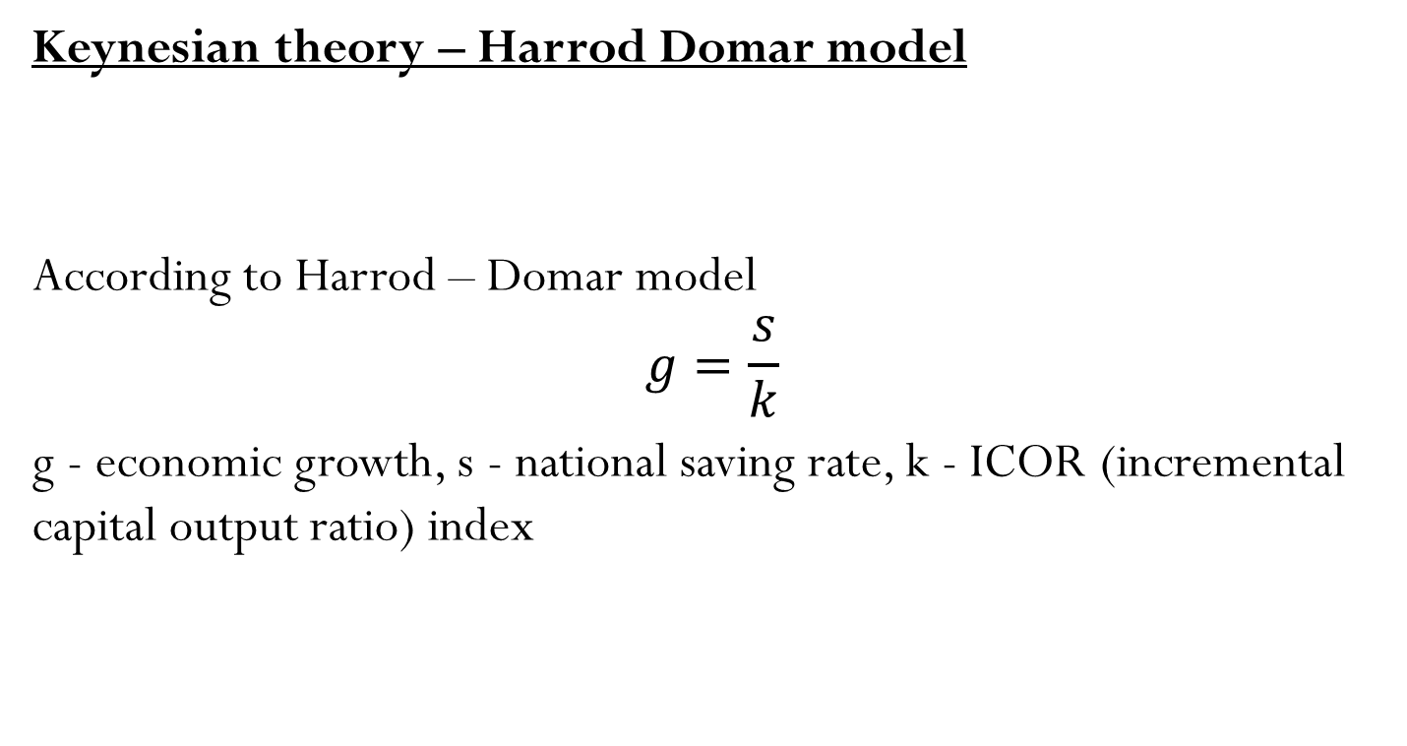
3 Theories of economic growth
Keynesian theory – Harrod Domar model
According to Harrod – Domar model
$$g=\frac{s}{k}$$
g - economic growth, s - national saving rate, k - ICOR (incremental capital output ratio) index
Capital accumulation plays an important role for economic growth

Slide 13
3 Theories of economic growth
Keynesian theory – Harrod Domar model
Conclusions drawn by Harrod - Domar model:
Economic growth rate (g) has positive relationship with saving rate (s) and negative relationship with ICOR index (k)
Due to constant k in short run, s is the most determinant of g
There is a trade off between current consumption and future consumption

Slide 14
3 Theories of economic growth
Neoclassical theory – Solow model
We build Solow model from constant return production function Y = f (K,L)
We transform the function:
y – products per capita or income per capita
k – capital per capita

Slide 15
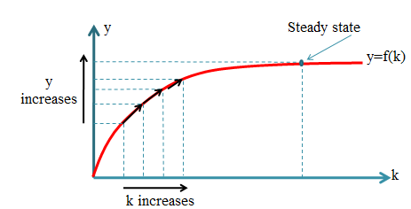
3 Theories of economic growth
Neoclassical theory – Solow model
Graph illustrating the relationship between k and y

Slide 16
3 Theories of economic growth
Neoclassical theory – Solow model
Two key questions from the graph
Why pace of output increase becomes slow (slop of production curve)?
How economy overcomes steady state?
Answer two questions
Slow pace of output increase due to diminishing marginal return of capital
To overcome steady state, it requires technological advances

Slide 17
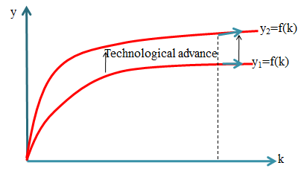
3 Theories of economic growth
Neoclassical theory – Solow model
However technological advance in Solow model is given variable (exogenous variable). Therefore, Solow model is also called exogenous growth model.

Slide 18
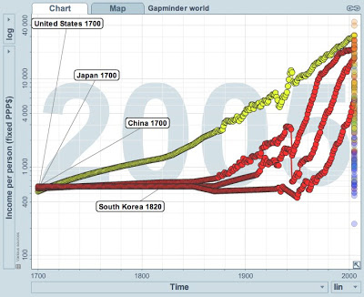
3 Theories of economic growth
Neoclassical theory – Solow model
Catch – up effect (convergence)

Slide 19
3 Theories of economic growth
Neoclassical theory – Solow model
Conclusions drawn by Solow model:
The role of savings for economic growth
Capital accumulation is good for short run economic growth
Technology is the determinant of long run economic growth

Slide 20
3 Theories of economic growth
Modern theory – endogenous model
Later economist (Paul Romer, Grossman, Mankiw…) proposed economic growth model in which technological advances are determined by R&D investment, government spending for education, number of workers in knowledge producing area…
Because now technological advances are internally decided then modern theory is also called as endogenous growth model

Slide 21
4 Policy to promote economic growth
Saving and investment: Raise future productivity
  Invest more current resources in the production of capital
  Trade-off: Devote fewer resources to produce goods and services for current consumption
Investment from abroad: Another way for a country to invest in new capital
  Foreign direct investment: Capital investment that is owned and operated by a foreign entity
  Foreign portfolio investment: Investment financed with foreign money but operated by domestic residents

Slide 22
4 Policy to promote economic growth
Education: Investment in human capital
  Gap between wages of educated and uneducated workers
  Opportunity cost: wages forgone
  Conveys positive externality
  Brain drain (problem for poor countries)
Health and nutrition: Healthier workers – more productive
  The right investments in the health of the population: One way for a nation to increase productivity and raise living standards
  Historical trends of long-run economic growth: Improved health - from better nutrition and Taller workers – higher wages – better productivity

Slide 23
4 Policy to promote economic growth
Property rights and political stability: Create favorable institutions
  Protect property rights: Ability of people to exercise authority over the resources they own
  Promote political stability
  Free trade: Utilize national advantages
  Inward-oriented policies: avoid interaction with the rest of the world
  Outward-oriented policies: integrate into the world economy

Slide 24
4 Policy to promote economic growth
Research and development : Knowledge – public good that enhances technology
  Research Institutes or other science programs funded by government
  Research grants
  Tax breaks
  Patent system
Population growth: Large population create both advantages and disadvantages
  Stretching natural resources
  Diluting the capital stock
  Reduces GDP per worker
  But
  Promoting technological progress
  Large labor force
  More consumers

Slide 25
Key concepts
Economic growth
Income per capita
Living standard
Rule of 70
Human capital, Physical capital, Natural resources, Technology advance
Classical theory
Keynesian theory, Harrod – Domar model
Neo-classical theory, Solow model
Steady state
Endogenous model
R&D

