Slide 1
Chapter 7 Aggregate expenditure and fiscal policy
Mentor Pham Xuan Truong
truongpx@ftu.edu.vn

Slide 2
Content
I Aggregate expenditure model (Keynesian cross point model)
1 Introduction to aggregate expenditure model
2 Mathematical form of aggregate expenditure model
3 Aggregate expenditure model and aggregate demand
II Fiscal policy
1 What is fiscal policy
2 Effects of fiscal policy on the economy
3 Fiscal policy and government budget

Slide 3
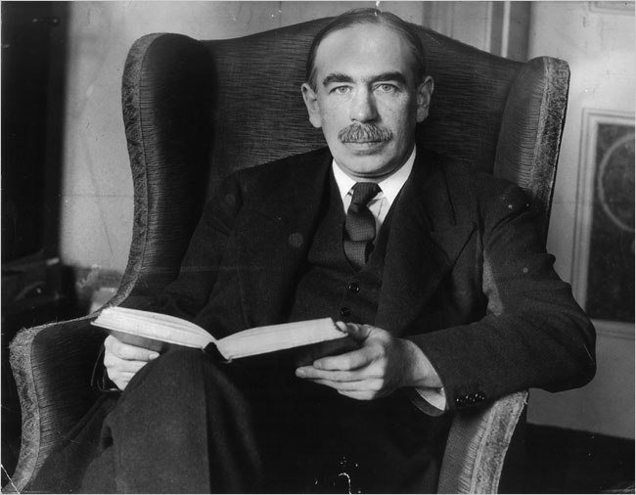

Slide 4
Personal and marital life of Keynes
Born at 6 Harvey Road, Cambridge, John Maynard Keynes was the son of John Neville Keynes, an economics lecturer at Cambridge University, and Florence Ada Brown, a successful author and a social reformist. His younger brother Geoffrey Keynes (1887–1982) was a surgeon and bibliophile and his younger sister Margaret (1890–1974) married the Nobel-prize-winning physiologist Archibald Hill. Keynes was very tall at 1.98 m (6 ft 6 in).
In 1918, Keynes met Lydia Lopokova, a well-known Russian ballerina, and they married in 1925. By most accounts, the marriage was a happy one. Before meeting Lopokova, Keynes's love interests had been men, including a relationship with the artist Duncan Grant and with the writer Lytton Strachey. For medical reasons, Keynes and Lopokova were unable to have children, though both his siblings had children of note

Slide 5
I Aggregate expenditure model (Keynesian cross point model)
1 Introduction to aggregate expenditure model
Main idea
The Great Depression caused many economists to question the validity of classical economic theory They believed they needed a new model to explain such a pervasive economic downturn and to suggest that government policies might ease some of the economic hardship that society was experiencing.
In 1936, John Maynard Keynes wrote The General Theory of Employment, Interest and Money. In it, he proposed a new way to analyze the economy, which he presented as an alternative to the classical theory. Keynes proposed that low aggregate demand is responsible for the low income and high unemployment that characterize economic downturns. He criticized the notion that aggregate supply alone determines national income.

Slide 6
I Aggregate expenditure model (Keynesian cross point model)
1 Introduction to aggregate expenditure model
Main idea
In the General Theory of Money, Interest and Employment, Keynes proposed that an economy’s total income was, in the short run, determined largely by the desire to spend by households, firms and the government (i.e. aggregate demand). The more people want to spend, the more goods and services firms can sell. The more firms can sell, the more output they will choose to produce and the more workers they will choose to hire. Thus, the problem during recessions and depressions, according to Keynes, was inadequate spending. The Keynesian cross is an attempt to model this insight.

Slide 7
I Aggregate expenditure model (Keynesian cross point model)
1 Introduction to aggregate expenditure model
Other assumptions
+ Prices, Wages and Interest Rate are Constant: this implies the rigidity of specific market due to objective reasons
+ The Economy Operates at less than full Employment: this implies that firms are willing to supply any amount of the good at a given price P. In other words, assume that the supply of goods is completely elastic at price P. This assumption is generally valid only in the short run

Slide 8
I Aggregate expenditure model (Keynesian cross point model)
1 Introduction to aggregate expenditure model
Main idea illustrated by AD – AS model
Compare to the idea of classical economists (2 special cases of AD – AS which imply behavior of the economy in (very) short run and long run)
Price Level, P
SRAS
AD''
AD'
AD
Y*
Y*'
Y*''
Income, Output, Y

Slide 9
I Aggregate expenditure model (Keynesian cross point model)
1 Introduction to aggregate expenditure model
Building model
The aggregate expenditure model which is illustrated by vertical axis of expenditure variable and horizontal axis of income (i.e. output) variable has two lines
+ Actual expenditure: is the amount households, firms , the government and foreigner spend on goods and services (GDP).
+ Planned expenditure (or APE – aggregate planned expenditure) is the amount households, firms, the government and the foreigner would like to spend on goods and services

Slide 10
I Aggregate expenditure model (Keynesian cross point model)
1 Introduction to aggregate expenditure model
Building model
The economy is in equilibrium when: Actual Expenditure = Planned Expenditure (Y=APE) or total income = planned expenditure
Planned expenditure, APE
Actual Expenditure, Y=APE
Planned Expenditure,
APE = C + I + G + NX
Y₂
Y*
Y₁
Income, Output, Y

Slide 11
I Aggregate expenditure model (Keynesian cross point model)
1 Introduction to aggregate expenditure model
Building model
+ Actual expenditure is the 45 degree line, which implies the most important identity in the macroeconomics Total income = Total expenditure (this is also indicated by computing GDP in two ways but having the same result)
+ Planned expenditure has 3 properties
* Upward sloping: expenditure is planned to increase as income increase
* Positive intercept with vertical axis: when income is zero, the economy still plans to expenditure for necessaries. This level of expenditure is called autonomous expenditure (the lowest expenditure of the economy, the part of expenditure does not change as income rises)
* Angular coefficient: has value between 0 and 1. It indicate normal behavior of economic entity. When you have additional income, you will save more and consume more from it

Slide 12
I Aggregate expenditure model (Keynesian cross point model)
1 Introduction to aggregate expenditure model
Building model
How does the economy get to this equilibrium? Inventories play an important role in the adjustment process. Whenever the economy is not in equilibrium, firms experience unplanned changes in inventories, and this induces them to change production levels. Changes in production in turn influence total income and expenditure, moving the economy toward equilibrium.
+ if actual expenditure > planned expenditure: unplanned inventory increases → firms decrease production
+ if actual expenditure < planned expenditure: unplanned inventory decreases → firms increase production

Slide 13
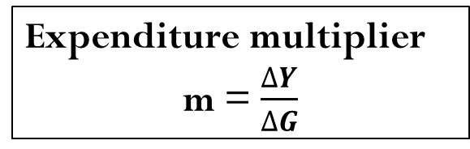
I Aggregate expenditure model
(Keynesian cross point model)
1 Introduction to aggregate expenditure model
Expenditure multiplier (by graph)
Consider how changes in government purchases affect the economy. Because government purchases are one component of expenditure, higher government purchases result in higher planned expenditure, for any given level of income.
An increase in government purchases of ΔG raises planned expenditure by that amount for any given level of income. The equilibrium moves from A to B and income rises. Note that the increase in income Y exceeds the increase in government purchases ΔG. Thus, fiscal policy in particular and total expenditure change in general has a multiplied effect on income.
Planned expenditure, APE
Actual Expenditure, Y=APE
B
Planned Expenditure,
APE = C + I + G+ NX
A
ΔG
Expenditure multiplier
m = $\frac{∆Y}{∆G}$
ΔY
Y*
Y₁
Income, Output, Y

Slide 14
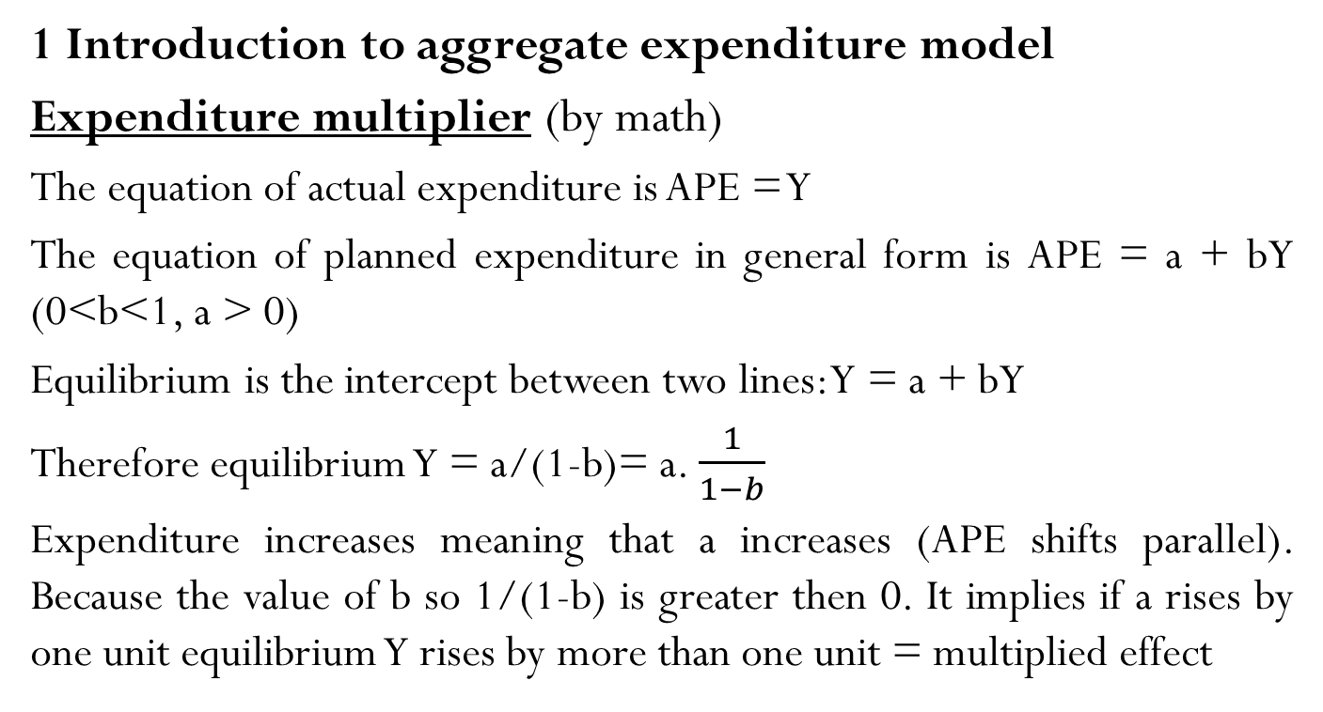
I Aggregate expenditure model
(Keynesian cross point model)
1 Introduction to aggregate expenditure model
Expenditure multiplier (by math)
The equation of actual expenditure is APE = Y
The equation of planned expenditure in general form is APE = a + bY (0<b<1, a > 0)
Equilibrium is the intercept between two lines: Y = a + bY
Therefore equilibrium Y = a/(1-b)= a. $\frac{1}{1−b}$
Expenditure increases meaning that a increases (APE shifts parallel). Because the value of b so 1/(1-b) is greater then 0. It implies if a rises by one unit equilibrium Y rises by more than one unit = multiplied effect

Slide 15
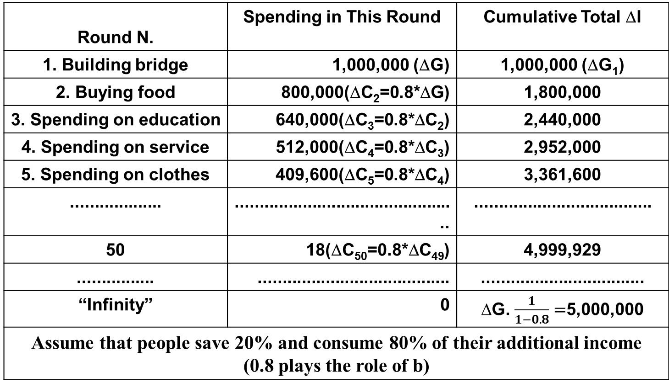
I Aggregate expenditure model
(Keynesian cross point model)
1 Introduction to aggregate expenditure model
Expenditure multiplier (by logical sequences)
Round N. | Spending in This Round | Cumulative Total ΔI
1. Building bridge | 1,000,000 (ΔG) | 1,000,000 (ΔG₁)
2. Buying food | 800,000(ΔC₂=0.8*ΔG) | 1,800,000
3. Spending on education | 640,000(ΔC₃=0.8*ΔC₂) | 2,440,000
4. Spending on service | 512,000(ΔC₄=0.8*ΔC₃) | 2,952,000
5. Spending on clothes | 409,600(ΔC₅=0.8*ΔC₄) | 3,361,600
................... | ............................................... | .....................................
50 | 18(ΔC₅₀=0.8*ΔC₄₉) | 4,999,929
................ | ........................................ | ..................................
“Infinity” | 0 | ∆G. $\frac{1}{1−0.8}=$5,000,000
Assume that people save 20% and consume 80% of their additional income (0.8 plays the role of b)

Slide 16
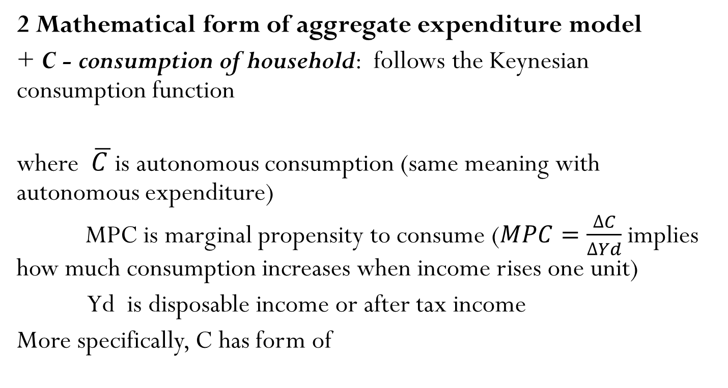
I Aggregate expenditure model (Keynesian cross point model)
2 Mathematical form of aggregate expenditure model
+ C - consumption of household: follows the Keynesian consumption function
where $\overline{C }$is autonomous consumption (same meaning with autonomous expenditure)
MPC is marginal propensity to consume ($MPC=\frac{∆C}{∆Yd}$implies how much consumption increases when income rises one unit)
Yd is disposable income or after tax income
More specifically, C has form of

Slide 17
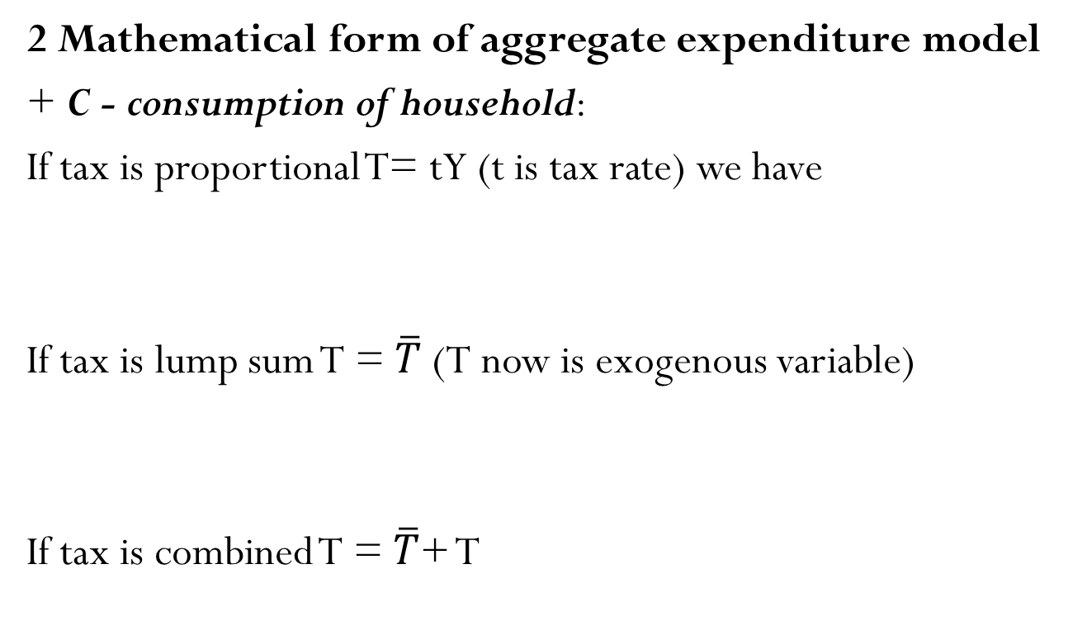
I Aggregate expenditure model (Keynesian cross point model)
2 Mathematical form of aggregate expenditure model
+ C - consumption of household:
If tax is proportional T= tY (t is tax rate) we have
If tax is lump sum T = $\overline{T}$ (T now is exogenous variable)
If tax is combined T = $\overline{T}$+ T
Notes:
a bar over a variables indicates that the variable is regarded as an exogenous variable. In other words, the variable does not depend on income Y

Slide 18
I Aggregate expenditure model (Keynesian cross point model)
2 Mathematical form of aggregate expenditure model
+ I - investment: in this model we will take investment as given or, in other words, we will regard it as an exogenous variable. The main reason for taking investment as given is to keep our model simple and follow the concept proposed by Keynes animal spirit. This concept implies current investment depends on expectation on future (e.g. future profit)rather than current income Y. Therefore

Slide 19
I Aggregate expenditure model (Keynesian cross point model)
2 Mathematical form of aggregate expenditure model
+ G – government spending: in this model, government spending also is given as an exogenous variable. The reason is that government spending depends on various factors such as social welfare, national security and of course economic situation. To a certain extent, we can consider government spending does not depend on current income Y

Slide 20
I Aggregate expenditure model (Keynesian cross point model)
2 Mathematical form of aggregate expenditure model
+ NX – net export (X – M): in this model, export also is given as an exogenous variable. The reason is understandable as export of a country does not depend on income of person in the country (however opposite way could be true). Import, on the other hand, is treated as endogenous variable due to import’s dependence on income
where MPM is marginal propensity to import, which indicate how much import increases as income rise one unit

Slide 21
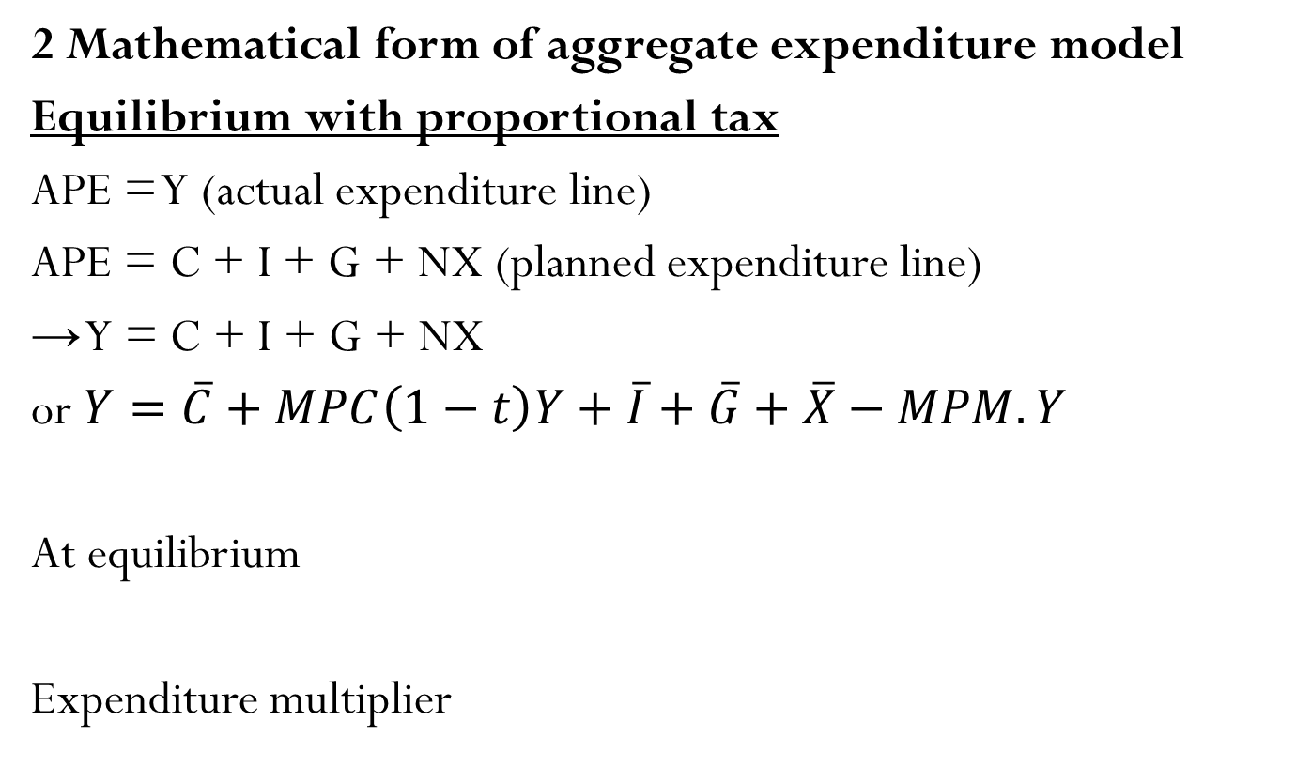
I Aggregate expenditure model (Keynesian cross point model)
2 Mathematical form of aggregate expenditure model
Equilibrium with proportional tax
APE = Y (actual expenditure line)
APE = C + I + G + NX (planned expenditure line)
→ Y = C + I + G + NX
or $Y=\overline{C}+MPC\left(1−t\right)Y+\overline{I}+\overline{G}+\overline{X}−MPM.Y$
At equilibrium
Expenditure multiplier

Slide 22
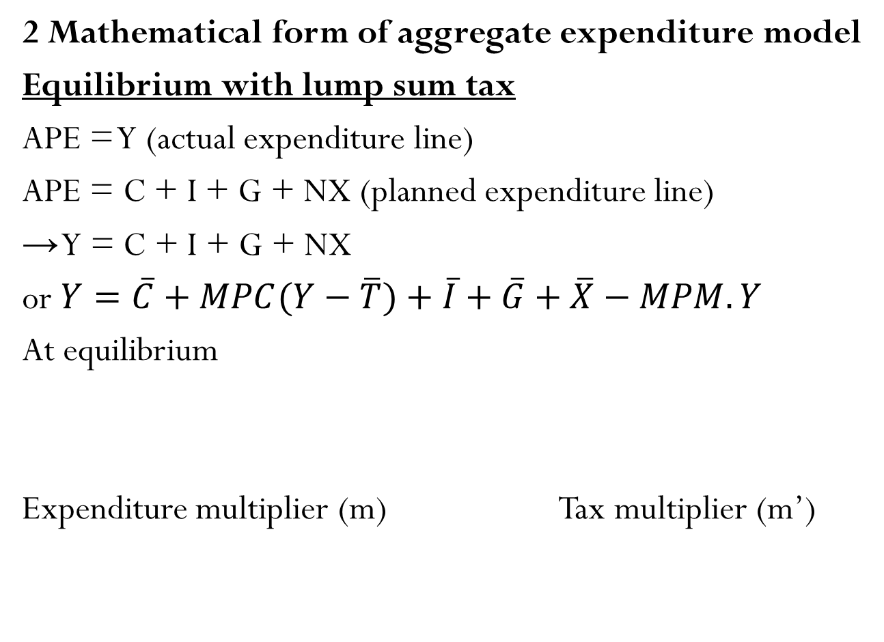
I Aggregate expenditure model (Keynesian cross point model)
2 Mathematical form of aggregate expenditure model
Equilibrium with lump sum tax
APE = Y (actual expenditure line)
APE = C + I + G + NX (planned expenditure line)
→ Y = C + I + G + NX
or $Y=\overline{C}+MPC(Y−\overline{T})+\overline{I}+\overline{G}+\overline{X}−MPM.Y$
At equilibrium
Expenditure multiplier (m) Tax multiplier (m’)

Slide 23
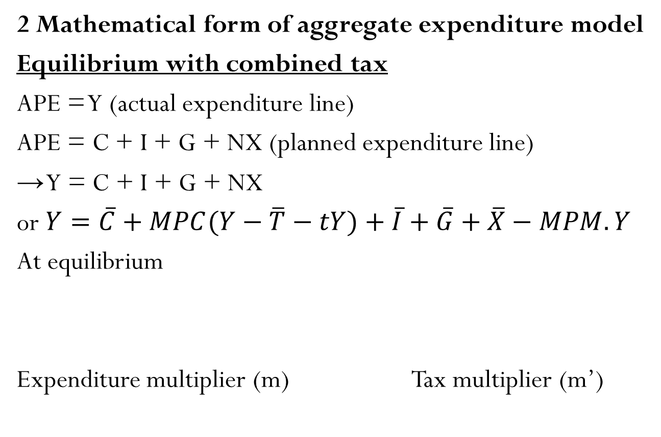
I Aggregate expenditure model (Keynesian cross point model)
2 Mathematical form of aggregate expenditure model
Equilibrium with combined tax
APE = Y (actual expenditure line)
APE = C + I + G + NX (planned expenditure line)
→ Y = C + I + G + NX
or $Y=\overline{C}+MPC(Y−\overline{T}−tY)+\overline{I}+\overline{G}+\overline{X}−MPM.Y$
At equilibrium
Expenditure multiplier (m) Tax multiplier (m’)

Slide 24
Economy | Tax | Expenditure multiplier | Tax multiplier
Simple (no government no international trade) | No tax |  | na
Close (government) | Lump sum tax
 | Proportional tax |  | na
 | Combined tax
Open (government) | Lump sum tax
 | Proportional tax |  | na
 | Combined tax
expenditure multiplier without tax is greater then with tax expenditure multiplier in close economy is greater than open economy
Notes:
Notion: function of I, M could be changed but they are still function of Y. Therefore, we apply the same method to find Y at equilibrium

Slide 25
Math problems
1. Close economy with government has following data
= 300 MPC = 0,8 = 200 = 300 t = 0,25 (25%)
a Find consumption function of household, planned expenditure function of the economy, autonomous expenditure
b Find output at equilibrium
c If government spending increases by 200, find the new equilibrium output
d If government would like to have output at 2500. Find the value of G

Slide 26

Math problems
2. Open economy with government has following data
a Find consumption function of household, planned expenditure function of the economy, autonomous expenditure
b Find output at equilibrium
c If government spending increases by 20 and investment increases by 5, find the new equilibrium output
d If government would like to have budget balance. Find the value of G

Slide 27

Math problems
3. Open economy with government has following data
a Find consumption function of household, planned expenditure function of the economy, autonomous expenditure
b Find output at equilibrium
c If government spending increases by 100 and tax increases by 200, find the new equilibrium output
d If government would like to have trade balance (NX = 0). Find the value of G

Slide 28
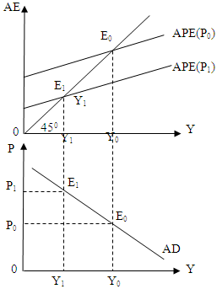
I Aggregate expenditure model (Keynesian cross point model)
3 Aggregate expenditure model and aggregate demand
Change in price level
Change in price level will affect C, I, NX by wealth effect, interest rate effect and international trade effect (see aggregate demand curve)→ shift of planned
expenditure curve → move along a AD curve

Slide 29
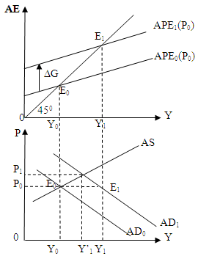
I Aggregate expenditure model (Keynesian cross point model)
3 Aggregate expenditure model and aggregate demand
Change in other factors
Change in other factors not price level → shift of planned expenditure curve → shift of AD curve
+) APE shifts upward (C, I, G, NX increase not by Y) = AD shifts rightward
+) APE shifts downward (C, I, G, NX increase not by Y) = AD shift leftward

Slide 30
II Fiscal policy
1 What is fiscal policy
Fiscal policy is the policy of government to use taxation and government spending to regulate aggregate demand
There are two types of fiscal policy
+ Expansionary fiscal policy: government raises spending or/and reduces tax
+ Contractionary fiscal policy: government reduces spending or/and raises tax
In economy, there is mechanism to automatically change government spending and taxation in accordance with the situation of the economy. It is called as automatic stabilizer. Two pillars of automatic stabilizer are unemployment subsidy and income tax system

Slide 31
II Fiscal policy
2 Effects of fiscal policy on the economy
Expansionary fiscal policy
AE
P
SRAS
APE’
APE
AD’
AD
Y
Y
Effects: output increases (unemployment rate decreases), price level rises (inflation rate increases)
Apply: when economy is in crisis, output declines and unemployment rises

Slide 32
II Fiscal policy
2 Effects of fiscal policy on the economy
Contractionary fiscal policy
AE
P
Short run AS
APE
APE’
AD
AD’
Y
Y
Effects: output decreases (unemployment rate increases), price level declines (inflation rate decreases)
Apply: when economy is in boom, output sharply increases and inflation rate rises

Slide 33
II Fiscal policy
2 Effects of fiscal policy on the economy
Automatic stabilizer
When economy is in crisis, government spending increases and tax collection decreases automatically (government has to pay more for unemployment subsidy automatically by labor law and incurs automatic reduction in income tax collection by income tax law) = expansionary fiscal policy
When economy is in boom, government spending decreases and tax collection increases automatically (government has to pay less for unemployment subsidy automatically by labor law and enjoys automatic increase in income tax collection by income tax law) = contractionary fiscal policy

Slide 34
II Fiscal policy
3 Fiscal policy and government budget
Government budget total sum of revenues and consumption of government in given time (one year)
BB= T – G
Fiscal policy can reach following objectives
+ Budget balance but Y can fluctuate (budget prioritized fiscal policy)
+ Potential output Y* but budget deficit can happen seriously (in time of crisis) (output prioritized fiscal policy)
    + BB= 0: Budget balance
    + BB> 0: Budget surplus
    + BB < 0: Budget deficit

Slide 35
II Fiscal policy
3 Fiscal policy and government budget
How to reduce budget deficit
- Increasing tax revenues and decreasing government spending
- Issuing Government bond
- Borrowings from foreign countries or international organizations
- Printing money or using reserve from foreign currency

Slide 36
Key concepts
Aggregate planned expenditure
Keynesian cross point model
Consumption function
Autonomous consumption, autonomous expenditure
Proportional tax, lump sum tax, combined tax
Endogenous variable, exogenous variable
Expenditure multiplier, multiplied effect
Marginal propensity to consume, marginal propensity to import
Expansionary fiscal policy, contractionary fiscal policy
Automatic stabilizer

