Slide 1
Chapter 8 Money and Monetary policy
Mentor Pham Xuan Truong
truongpx@ftu.edu.vn

Slide 2
Content
I Overview of money
II Banking system and money supply
III Central bank and tools to control money supply
IV The theory of liquidity preference and monetary policy

Slide 3
I Overview of money
Definition
Money is any object or record that is generally accepted as payment for goods and services and repayment of debts in a given socio-economic context or country.
In other words, money is a set of assets in an economy that people regularly use to buy goods and services from other people
The functions of money
Medium of exchange: Item that buyers give to sellers when they want to purchase goods and services
  Unit of account: Yardstick people use to post prices and record debt
  Store of value: Item that people can use to transfer purchasing power from the present to the future

Slide 4
I Overview of money
The kind of money
  - Commodity money: money that takes the form of a commodity with intrinsic value (Item would have value even if it were not used as money)
- Fiat money: money without intrinsic value used as money because of government decree
  Measuring money volume
M0: Currency - Paper bills and coins in the hands of the public
M1: M0 and demand deposit (depositors can access on demand by writing a check)
M2: M1 and timely deposit (depositors in principle can access to the money as maturity elapses)
  The differentiation in measuring money volume bases on the gradual decrease of liquidity (liquidity is the ease with which an asset can be converted into the economy’s medium of exchange)
Notes:
Barter activities: use a commodity to exchange another commodity

Slide 5
II Banking system and money supply
Money creation: fractional reserve banking
After receiving money from clients, banks have to lend or invest the money to make profit so that it can primarily pay back interest rate. However to secure liquidity and system stability, banks have to reserve money from clients’ deposit. Banks hold only a fraction of deposits as reserves
Desired reserve rate/ratio (rr) is the fraction of deposits that banks hold as reserves. It has two components
+ Required reserve rate (rrr): Bank must hold at the Minimum level set by country’s central bank
+ Excess reserve rate (err): Bank may hold additional excess reserves
→ rr = rrr + err

Slide 6
II Banking system and money supply
Money creation: fractional reserve banking
We examine an example to see how banking system create more money (money as definition) for the economy
The example has two assumption:
+ People don’t hold money in hand but deposit all to the banks
+ Desired reserve rate of each bank is similar (rr%)
The evolution: there is 1 unit value of money deposited in bank1. Bank 1 reserves rr and lends (1- rr) to people. People as assumed don’t hold money and deposit to bank 2. Bank 2 reserves (1-rr).rr and lends (1-rr)^2 to people. Then the process continues. The total deposits’ value of the economy increase from the action of depositing 1 unit value of money at the beginning is magnificent.

Slide 7
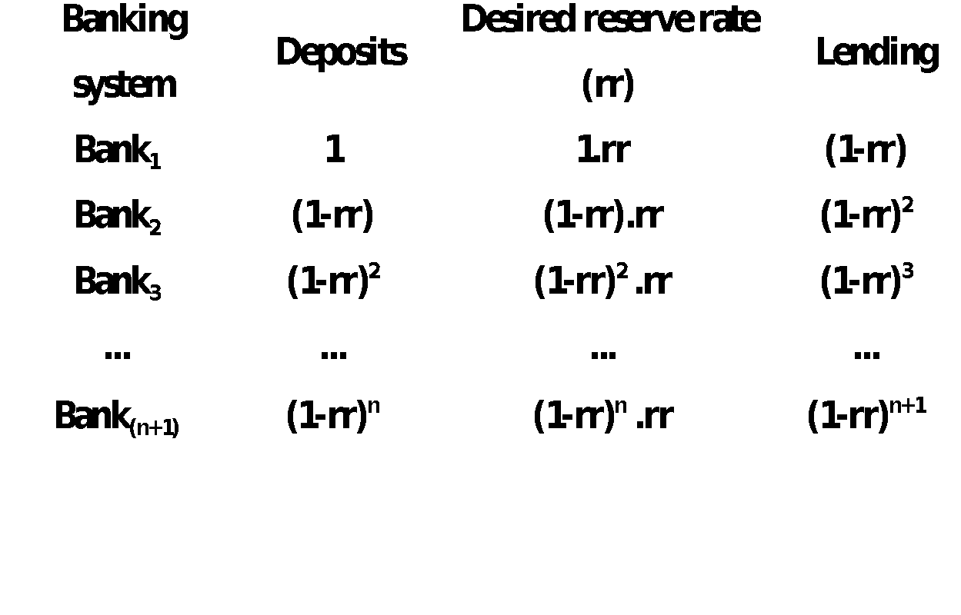
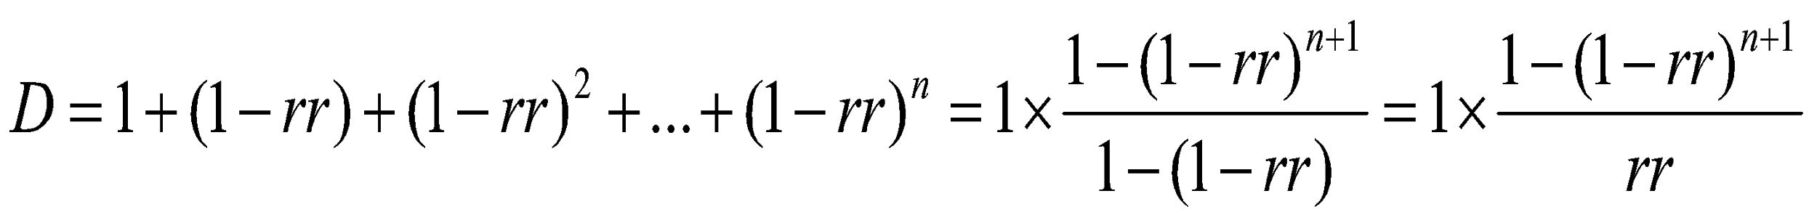
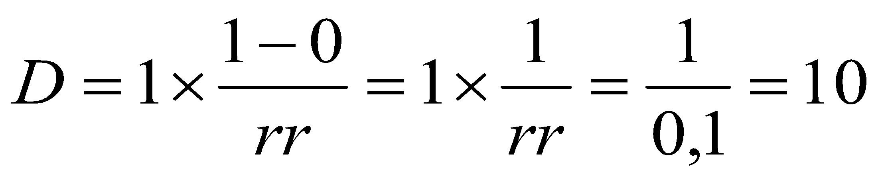
II Banking system and money supply
Money creation: fractional reserve banking
0 < rr < 1 =>

Slide 8
II Banking system and money supply
Money supply model
+) Money supply: money as the most wide scope of understanding (M2)
MS(M) = Cu + D
where Cu currency circulated outside banks and D deposits in bank
+) Monetary base (basic money, high powered money): money as cash printed by central bank (M0)
B (Ho) = Cu + R
where Cu currency circulated outside banks and R currency reserved by banks

Slide 9
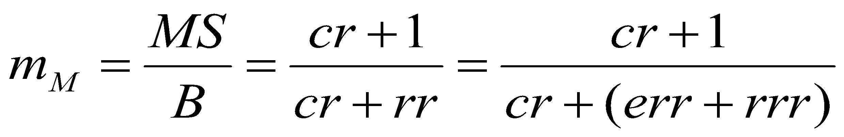

II Banking system and money supply
Money supply model
Monetary multiplier (m_{M}) is the fraction between MS and B
Denote Cu/D = cr (currency over deposit ratio)
R/D = rr (reserve ratio) (see the example)
→

Slide 10
II Banking system and money supply
Money supply model
Conclusions
Central bank cannot control entirely money supply due to cr (decided by payment behavior of people) and err (decided by each bank)
Monetary multiplier has negative relationship with both rr (rrr) and cr
Period | 1996-1997 | 2000-2001 | 2006-2007 | 2009-2010
m_{M} of Vietnam | 1,6-1,7 | 2,3-2,5 | 3-3,5 | 5-5,2

Slide 11
Math problems
1) Data have given as follows cr = 20% rr = 10% MS = 2000. Find B ?
2) Data have given as follows rr = 15%, MS = 3000, B = 500. Find cr ?
3) Data have given as follows cr/rr = 4, MS = 2000, B = 200. Find cr, rr ?
4) Data have given as follows cr + rr = 40%, MS = 1500, B = 500. Find cr, rr ?
5) A person deposited cash of 200 in a bank, given that cr = 20% rr = 20%. How much money supply increase ?
6) State bank of Vietnam (SBV) printed more cash of 1000, given that cr = 0% rr = 10%. How much money supply increase ?

Slide 12
III Central bank and tools to control money supply
Central bank
Central bank is the institution designed to oversee the banking system and regulate the quantity of money in the economy by monopolistic ability of printing money (monetary policy). Central bank also regulates foreign reserve of a country and represents the country in international monetary organization or monetary agreement
Central bank could be a body of government but it could be independent from government. Each type of organizational structure has advantage and disadvantage

Slide 13
III Central bank and tools to control money supply
Tools to control money supply
1. Open-market operations: Purchase and sale of government bonds by central bank
  To increase the money supply: central bank buys government bonds
  To reduce the money supply: central bank sells government bonds
2. Reserve requirements: Regulations on minimum amount of reserves that banks must hold against deposits
  An increase in reserve requirement: Decrease the money supply
  A decrease in reserve requirement: Increase the money supply
3. The discount rate: Interest rate on the loans that central bank makes to commercial banks
  Higher discount rate: Reduce the money supply
  Smaller discount rate: Increase the money supply

Slide 14
IV The theory of liquidity preference and monetary policy
The theory of liquidity preference (money market)
This is Keynes’s theory which indicates that interest rate will adjust to bring money supply and money demand into balance (we see nominal interest rate instead of real interest rate; moreover in short run due to fixed price nominal and real interest rate are not different)
Money supply Controlled by central bank Quantity of money supplied fixed by central bank therefore doesn’t vary with interest rate Money supply curve - vertical MS = mM . B | Money demand Money – most liquid asset (liquidity preference) Interest rate (i) – opportunity cost of holding money. Income (Y) is the most determinant of money demand Money demand curve – downward sloping MD = f(Y, i)

Slide 15
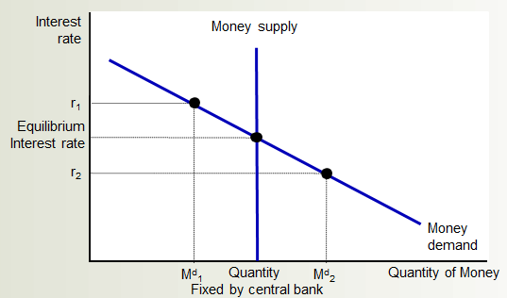
IV The theory of liquidity preference and monetary policy
The theory of liquidity preference (money market)
Equilibrium in the money market: Equilibrium interest rate will bring Quantity of money demanded = quantity of money supplied

Slide 16
IV The theory of liquidity preference and monetary policy
The theory of liquidity preference (money market)
If interest rate > equilibrium: Quantity of money people want to hold less than quantity supplied → People holding the surplus buy interest-bearing assets → Lowers the interest rate → People - more willing to hold money until equilibrium
If interest rate < equilibrium: Quantity of money people want to hold more than quantity supplied → People - increase their holdings of money by selling interest-bearing assets → Increase interest rates until equilibrium

Slide 17
IV The theory of liquidity preference and monetary policy
The theory of liquidity preference (money market)
Change in money supply derived from
+ monetary policy of central bank: increase or decrease money supply
+ change in price level (with real money supply)
Change in money demand derived from
+ change in national income
+ change in price level (with nominal money demand)
+ financial market stability
+ payment technology
…

Slide 18
IV The theory of liquidity preference and monetary policy
(a) The Money Market
(b) The Aggregate-Demand Curve
Interest
rate
2. . . . the increase in
spending increases
money demand . . .
Price
level
Money
supply
1. When an increase in government purchases
increases aggregate demand . . .
4. . . which in turn
partly offsets the
initial increase in
aggregate demand.
r₂
3. . . . which increases
the equilibrium interest
rate . . .
$20 billion
r₁
MD₂
AD₂
AD₃
Money demand, MD₁
Aggregate demand, AD₁
0
Quantity fixed
by the Fed
Quantity
of money
0
Quantity
of output
Panel (a) shows the money market. When the government increases its purchases of goods and services, the resulting increase in income raises the demand for money from MD₁ to MD₂, and this causes the equilibrium interest rate to rise from r₁ to r₂. Panel (b) shows the effects on aggregate demand. The initial impact of the increase in government purchases shifts the aggregate-demand curve from AD₁ to AD₂. Yet because the interest rate is the cost of borrowing, the increase in the interest rate tends to reduce the quantity of goods and services demanded, particularly for investment goods. This crowding out of investment partially offsets the impact of the fiscal expansion on aggregate demand. In the end, the aggregate-demand curve shifts only to AD₃.

Slide 19
IV The theory of liquidity preference and monetary policy
Monetary policy
+ Expansionary monetary policy: central bank increases the money supply → Money-supply curve shifts right → Interest rate falls → At any given price level increase in quantity demanded of goods and services → Aggregate-demand curve shifts right → output rises (unemployment rate decreases), price increases
Using expansionary monetary policy when economy is in crisis
+ Contractionary monetary policy: central bank decreases the money supply → Money-supply curve shifts left → Interest rate increases → At any given price level decrease in quantity demanded of goods and services → Aggregate-demand curve shifts left → output falls (unemployment rate increases), price decreases (inflation rate falls)
Using contractionary monetary policy when economy is in boom

Slide 20
Expansionary monetary policy
(a) The Money Market
(b) The Aggregate-Demand Curve
Interest
rate
Price
level
Money supply,
MS₁
MS₂
1. When the Fed
increases the
money supply . . .
r₁
P
r₂
AD₂
Money demand
at price level P
Aggregate
demand, AD₁
0
Quantity
of money
0
Y₁
Y₂
Quantity of output
2. . . . the equilibrium
interest rate falls . . .
3. . . . which increases the quantity of goods and
services demanded at a given price level.
In panel (a), an increase in the money supply from MS₁ to MS₂ reduces the equilibrium interest rate from r₁ to r₂. Because the interest rate is the cost of borrowing, the fall in the interest rate raises the quantity of goods and services demanded at a given price level from Y₁ to Y₂. Thus, in panel (b), the aggregate-demand curve shifts to the right from AD₁ to AD₂.

Slide 21
Monetary policy vs fiscal policy
Monetary policy focuses on investment (I) in GDP, fiscal policy focuses on government spending (G) in GDP
More open the economy is, more influence monetary policy is. More severe economic downturn is, more influence fiscal policy is
Inside lag of monetary policy is smaller than fiscal policy but outside lag of monetary policy is larger than fiscal policy

Slide 22
Key concepts
Money, fiat money, commodity money
Liquidity
Monetary multiplier
Required reserve rate, excess reserve rate, desired reserve rate
Money supply
Money demand
The theory of liquidity preference
Central bank
Open market operation, reserve rate requirement, discount rate
Expansionary monetary policy, contractionary monetary policy

