Slide 1
Chapter 5 Unemployment
Mentor Pham Xuan Truong
truongpx@ftu.edu.vn

Slide 2
Content
I Definitions and computing method
II Unemployment classification
III Impacts of unemployment on the economy
IV Solutions to reduce unemployment

Slide 3
I Definitions and computing method
Definitions
Employed is the People who work
Unemployed is the People who are Not employed but Want to work and are Looking for a job
Labor force = Number of employed + Number of unemployed
Not in the labor force (non-labor force): Not employed Not unemployed. It includes children, elders, students, disable…
Adult population is the proportion of population that is within working – age (includes labor force and a part of non – labor force)

Slide 4
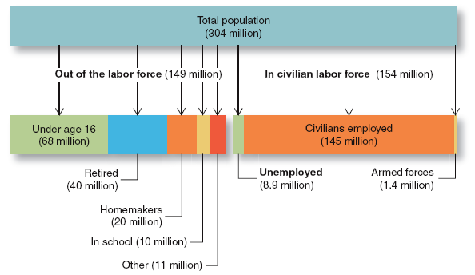
I Definitions and computing method

Slide 5
I Definitions and computing method
Computing method
Unemployment rate: Percentage of labor force that is unemployed
Labor-force participation rate: Percentage of adult population that is in the labor force

Slide 6
I Definitions and computing method
Computing method
Math problems
Population of Vietnam is 90 million people. The employed is 43 million people, the unemployed is 1.5 million people. There are 4.5 million people in working – age but out of labor force. Calculate unemployment rate, labor participation rate?
FTU city has adult population of 100 thousand people. Labor force participation is 90% and the employed are 70 thousand people. Calculate unemployment rate?
The employed is greater than the unemployed 70 million people. Adult population is 90 million people. Labor participation rate is 25 time higher than unemployment rate. Calculate unemployment rate?

Slide 7
II Unemployment classification
There are two fundamental types of unemployment
Natural rate of unemployment
  Normal rate of unemployment that exists even at the equilibrium of labor market by objective reasons
  Around which the unemployment rate fluctuates
  Existence in the long run
Cyclical unemployment
  Deviation of actual unemployment from its natural rate
  Non-existence in the long run when the economy adjusts itself

Slide 8
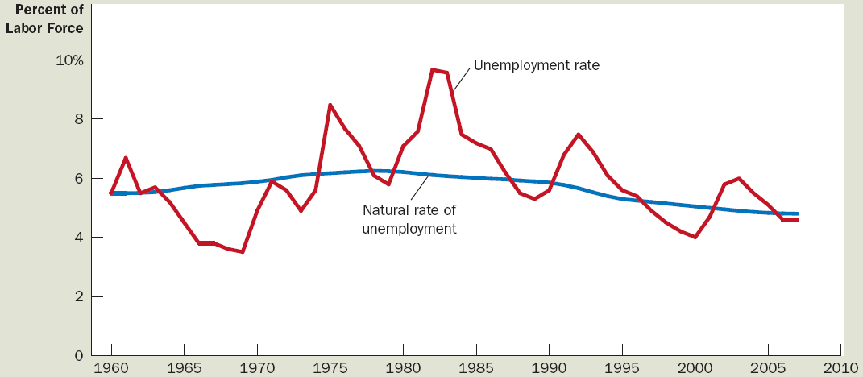
Unemployment rate of the US since 1960
This graph uses annual data on the U.S. unemployment rate to show the percentage of the labor force without a job. The natural rate of unemployment is the normal level of unemployment around which the unemployment rate fluctuates

Slide 9
II Unemployment classification
1 Natural rate of unemployment
There are four categories of natural unemployment
+ Frictional unemployment: Results because it takes time for workers to search for the jobs that best suit their tastes and skills
E.g. The graduate who just leave university is finding a job
+ Structural unemployment: occurs when a labor market is unable to provide jobs for everyone who wants one because there is a mismatch between the skills of the unemployed workers and the skills needed for the available jobs
E.g. Farmers who were reclaimed land try to be workers
+ Seasonal unemployment: occurs at seasonal jobs which require working in certain moments of a year
E.g. Employee in water park in winter

Slide 10
II Unemployment classification
1 Natural rate of unemployment
+ Classical unemployment: occurs when real wages for a job are set above the market-clearing level, causing the number of job-seekers to exceed the number of vacancies.
E.g. Unskilled worker who only graduates from high school
Reasons for classical unemployment
Minimum wage law
Efficiency wages
Labor unions

Slide 11
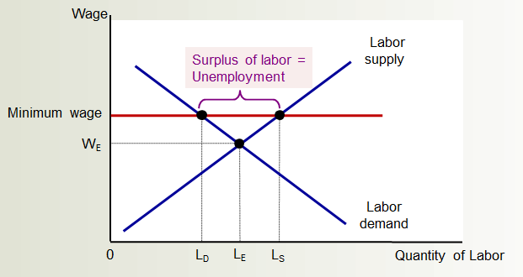
II Unemployment classification
1 Natural rate of unemployment
+ Classical unemployment

Slide 12
II Unemployment classification
2 Cyclical rate of unemployment
Cyclical, deficient-demand, or Keynesian unemployment, occurs when there is not enough aggregate demand in the economy to provide jobs for everyone who wants to work. Demand for most goods and services falls, less production is needed and consequently fewer workers are needed, wages are sticky and do not fall to meet the equilibrium level, and mass unemployment results

Slide 13
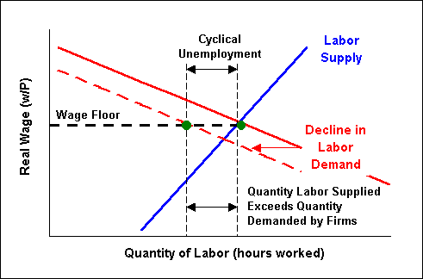
II Unemployment classification
2 Cyclical rate of unemployment
Sticky wage

Slide 14
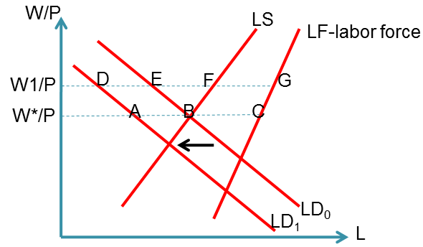
II Unemployment classification
All types of unemployment illustrated in labor market model
At W*/P: AB cyclical unemployment, BC natural unemployment (without classical unemployment)
At W1/P: DE cyclical unemployment, EG natural unemployment includes EF classical unemployment and FG frictional, structural, seasonal unemployment

Slide 15
III Impacts of unemployment on the economy
1 Negative impacts
Waste of labors not used to produce goods and services → output decline – supply side (Okun’s law)
Demand for goods and services declines → production decrease – demand side
Burden of society in supporting unemployed → ineffective resource allocation
Unemployment time mitigates labor’s skill → productivity decrease
Unstable mentality of individuals who can not find a job and related person → unstable for the whole society

Slide 16
III Impacts of unemployment on the economy
2 Positive impact
Job seekers have enough time to find appropriate job
Labors who just lost their jobs have time to relax
Someone has time to acquire necessary skills to do a new job

Slide 17
IV Solutions to reduce unemployment
1Government – run employment agencies: reduce time for unemployed to find jobs
2 Public training programs: equip quickly necessary skill for unemployed to find jobs
3 Labor movement facilitation: reduce frictional unemployment
4 Income tax reduction: incentivize more economic activities
5 Unemployment insurance cut: encourage unemployed to find jobs quickly
6 Demand side stimulus: promote manufacture, thereby creating more jobs

Slide 18
Key concepts
Unemployment
Labor force
Unemployment rate, labor-force participation rate
Natural rate of unemployment
Cyclical unemployment
Frictional unemployment, structural unemployment, seasonal unemployment, classical unemployment

