Slide 1
Chapter 6 Aggregate demand and aggregate supply
Mentor Pham Xuan Truong
truongpx@ftu.edu.vn

Slide 2
Content
I Fluctuation of the economy in the short run and its trend in the long run
II Aggregate demand and Aggregate supply model (AD – AS model)
III Explain behaviors of the economy via AD – AS model

Slide 3
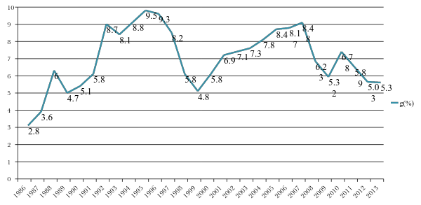
I Fluctuation of the economy in the short run and its trend in the long run
The fact from Vietnam (short run)
Economic growth from 1986 to 2013

Slide 4
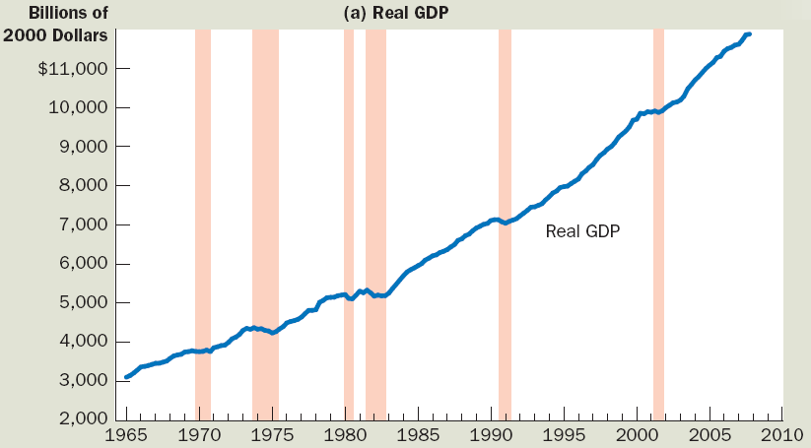
I Fluctuation of the economy in the short run and its trend in the long run
The fact from the US (long run)
Economic growth from 1965 to 2010

Slide 5
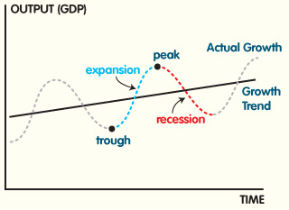
I Fluctuation of the economy in the short run and its trend in the long run
Economic activity: fluctuates from year to year however keep upward trend in long run. Economists call economic fluctuation in short run as Business cycle
Recession: economic contraction = period of declining real incomes and rising unemployment (especially, depression = severe recession), the lowest point is trough or bottom
Expansion: economic expansion = period of rising real incomes and declining unemployment (especially, boom = severe expansion), the highest point is peak

Slide 6
I Fluctuation of the economy in the short run and its trend in the long run
3 key facts about economic fluctuations
Economic fluctuations are irregular and unpredictable
Most macroeconomic quantities fluctuate together
As output falls, unemployment rises
This figure at the next slides will show real GDP in panel (a), investment spending in panel (b), and unemployment in panel (c) for the U.S. economy using quarterly data since 1965. Recessions are shown as the shaded areas. Notice that real GDP and investment spending decline during recessions, while unemployment rises.

Slide 7
I Fluctuation of the economy in the short run and its trend in the long run
3 key facts about economic fluctuations

Slide 8
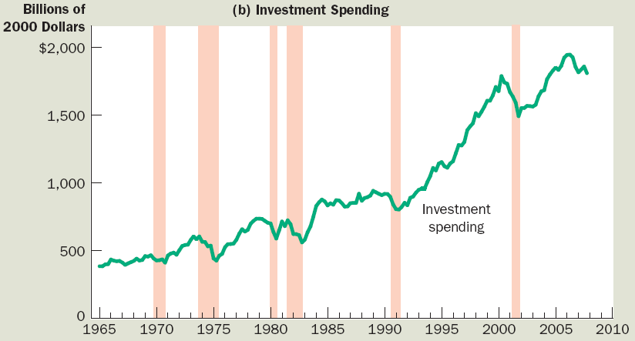
I Fluctuation of the economy in the short run and its trend in the long run
3 key facts about economic fluctuations

Slide 9
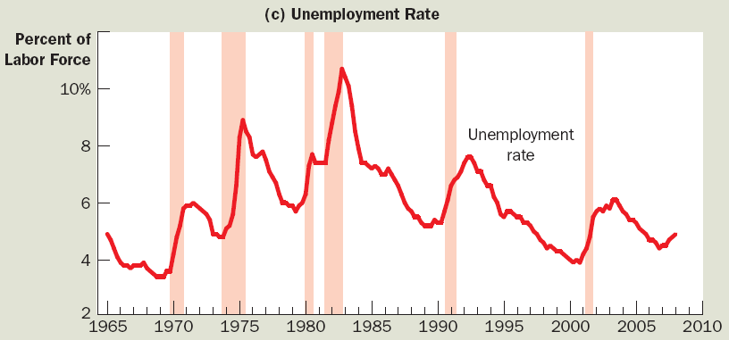
I Fluctuation of the economy in the short run and its trend in the long run
3 key facts about economic fluctuations
Notes:
Next part, we will build AD – AS model to explain short run fluctuations and long run development of the economy

Slide 10
II AD – AS model
Economists use the model of aggregate demand and aggregate supply to analyze economic fluctuations. On the vertical axis is the overall level of prices. On the horizontal axis is the economy’s total output of goods and services. Output and the price level adjust to the point at which the aggregate-supply and aggregate-demand curves intersect.

Slide 11
II AD – AS model
1 Aggregate demand
- Aggregate-demand curve shows the quantity of goods and services that households, firms, the government, and customers abroad want to buy at each price level
- Aggregate demand curve is downward sloping
In the next slides, we will examine two topics
+ Why the AD curve slopes downward
+ Why the AD curve might shift

Slide 12
II AD – AS model
1 Aggregate demand
Why the aggregate-demand (AD) curve slopes downward
Formula of AD: AD = C + I + G + NX
Three effects that causes downward sloping AD curve
  Wealth effect (C )
  Interest-rate effect (I)
  Exchange-rate effect (NX)
Assumption: government spending (G) is fixed by policy

Slide 13
II AD – AS model
Why the aggregate-demand (AD) curve slopes downward
Price level & consumption (C ): wealth effect
Decrease in price level → Increase - real value of money → Consumers – wealthier → Increase in consumer spending → Increase in quantity demanded of goods & services
Price level & investment (I): interest-rate effect
Decrease in price level → Decrease – interest rate → Increase spending on investment goods → Increase in quantity demanded of goods & services
Price level & net exports (NX): exchange-rate effect
Decrease in U.S. price level → Decrease – interest rate → Domestic currency – depreciates → Stimulates net exports → Increase in quantity demanded of goods & services

Slide 14
II AD – AS model
Why the aggregate-demand (AD) curve slopes downward
A fall in price level increases quantity of goods& services demanded because:
Consumers are wealthier - stimulates the demand for consumption goods
Interest rates fall - stimulates the demand for investment goods
Currency depreciates - stimulates the demand for net exports
A rise in price level Decreases quantity of goods and services demanded, because:
Consumers are poorer – depress consumer spending
Higher interest rates fall - depress investment spending
Currency appreciates – depress net exports

Slide 15
The aggregate-demand curve
Price
Level
P₁
1. A decrease
in the price
level . . .
P₂
Aggregate demand
Y₁
Y₂
Quantity of Output
2. . . . increases the quantity of
goods and services demanded
A fall in the price level from P₁ to P₂ increases the quantity of goods and services demanded from Y₁ to Y₂. There are three reasons for this negative relationship. As the price level falls, real wealth rises, interest rates fall, and the exchange rate depreciates. These effects stimulate spending on consumption, investment, and net exports. Increased spending on any or all of these components of output means a larger quantity of goods and services demanded.

Slide 16
II AD – AS model
Why the AD curve might shift
Changes in consumption, C : events - change how much people want to consume at a given price level
E.g. Tax cut → Increase in consumer spending → Aggregate demand - shift right
Changes in investment, I: events - change how much firms want to invest at a given price level
E.g. Better technology, Preferable Tax policy, Money supply increase → Increase in investment → Aggregate demand - shift right

Slide 17
II AD – AS model
Why the AD curve might shift
Changes in government purchases, G: policy makers – change government spending at a given price level
E.g. Build new roads → Increase in government purchases → Aggregate demand - shift right
Changes in net exports, NX: events - change net exports for a given price level
E.g. Recession in Europe → Decrease net exports → Aggregate demand – shift left
International speculators – change in exchange rate → Increase in net exports → Aggregate demand - shift right

Slide 18
The aggregate-demand curve: summary (a)
Why Does the Aggregate-Demand Curve Slope Downward?
1. The Wealth Effect: A lower price level increases real wealth, which stimulates spending on consumption.
2. The Interest-Rate Effect: A lower price level reduces the interest rate, which stimulates spending on investment.
3. The Exchange-Rate Effect: A lower price level causes the real exchange rate to depreciate, which stimulates spending on net exports

Slide 19
The aggregate-demand curve: summary (b)
Why Might the Aggregate-Demand Curve Shift?
1. Shifts Arising from Consumption: An event that makes consumers spend more at a given price level (a tax cut, a stock-market boom) shifts the aggregate-demand curve to the right. An event that makes consumers spend less at a given price level (a tax hike, a stock-market decline) shifts the aggregate-demand curve to the left.
2. Shifts Arising from Investment: An event that makes firms invest more at a given price level (optimism about the future, a fall in interest rates due to an increase in the money supply) shifts the aggregate-demand curve to the right. An event that makes firms invest less at a given price level (pessimism about the future, a rise in interest rates due to a decrease in the money supply) shifts the aggregate-demand curve to the left.
3. Shifts Arising from Government Purchases: An increase in government purchases of goods and services (greater spending on defense or highway construction) shifts the aggregate-demand curve to the right. A decrease in government purchases on goods and services (a cutback in defense or highway spending) shifts the aggregate-demand curve to the left.
4. Shifts Arising from Net Exports: An event that raises spending on net exports at a given price level (a boom overseas, speculation that causes an exchange-rate depreciation) shifts the aggregate-demand curve to the right. An event that reduces spending on net exports at a given price level (a recession overseas, speculation that causes an exchange-rate appreciation) shifts the aggregate-demand curve to the left
.

Slide 20
II AD – AS model
2 Aggregate supply
- Aggregate-supply curve shows the quantity of goods and services that firms choose to produce and sell at each price level
- Aggregate supply curve is Upward sloping in the short run and vertical in the long run
In the next slides, we will examine two topics
+ Why the long run AS curve vertical and the short run AS curve slopes upward
+ Why the long run AS curve and the short run AS curve might shift

Slide 21
II AD – AS model
2 Aggregate supply
Why the aggregate-supply curve (LRAS) is vertical in the long run
Price level does not affect the long-run determinants of GDP:
+ Supplies of labor, capital, and natural resources
+ Available technology
In other words, GDP (output) in the long run is not determined by price level. In the long run, when the economy adjusts itself, the output always stay at natural level of output or potential output (Y*).
  Potential output is the output of economy when it utilizes all available inputs at normal rate. Unemployment rate at potential output is at natural level , therefore potential output is also called full-employment output

Slide 22
The long-run aggregate-supply curve
Price
Level
Long-run
aggregate
supply
P₁
1. A change
in the price
level . . .
2. . . . does not affect
the quantity of goods
and services supplied
in the long run
P₂
Natural level
of output
Quantity of Output
In the long run, the quantity of output supplied depends on the economy’s quantities of labor, capital, and natural resources and on the technology for turning these inputs into output. Because the quantity supplied does not depend on the overall price level, the long-run aggregate-supply curve is vertical at the natural rate of output.

Slide 23
II AD – AS model
2 Aggregate supply
Why the LRAS curve might shift
Changes in labor
E.g. Quantity of labor – increases → Aggregate supply – shifts right
Natural rate of unemployment – increases → Aggregate supply –shifts left
Changes in capital
E.g. Capital stock – decrease → Aggregate supply – shifts left
Changes in natural resources
E.g. New discovery of natural resource → Aggregate supply – shifts right
Weather keeps fine → Aggregate supply – shifts right
Availability of natural resources declines → Aggregate supply – shifts left
Changes in technology
E.g. New technology, for given labor, capital and natural resources → Aggregate
supply – shifts right

Slide 24
II AD – AS model
2 Aggregate supply
Using AD and LRAS to depict long-run growth and inflation
In long run: both AD and LRAS curve shift
+ Continual shifts of LRAS curve to right because of technological progress
+ AD curve shifts to right because of monetary policy (central bank increases money supply over time) and household consumption increase
→ Result:
      Continuing growth in output
      Continuing inflation

Slide 25
Long-run growth and inflation in the model of aggregate demand and aggregate supply
Price
Level
Long-run
aggregate supply,
LRAS₁₉₈₀
1. In the long run, technological progress shifts long-run aggregate supply…
2. . . . and growth in the money supply shifts aggregate demand . . .
LRAS₁₉₉₀
LRAS₂₀₀₀
P₂₀₀₀
3. . . . leading to growth in output . . .
P₁₉₉₀
P₁₉₈₀
AD₂₀₀₀
4. . . . and
ongoing inflation
AD₁₉₈₀
AD₁₉₉₀
Y₁₉₈₀
Y₁₉₉₀
Y₂₀₀₀
Quantity of Output

Slide 26
II AD – AS model
2 Aggregate supply
Why the aggregate-supply (SRAS) curve slopes upward in the short-run
There are several theories to explain shape of SRAS: sticky wage theory, sticky – price theory, misperception theory
+) Sticky-wage theory
  Nominal wages - slow to adjust to changing economic conditions due to
    Long-term contracts: workers and firms
    Slowly changing social norms
    Notions of fairness - influence wage setting
  Nominal wages - based on expected prices: don’t respond immediately when actual price level – different from what was expected
  Sticky-wage theory
  If price level < expected: Firms – incentive to produce less output
  If price level > expected: Firms – incentive to produce more output

Slide 27
II AD – AS model
2 Aggregate supply
Why the aggregate-supply (AS) curve slopes upward in the short-run
  +) Sticky-price theory
  Prices of some goods & services slow to adjust to changing economic conditions due to for example menu costs (Costs to adjusting prices) → sticky price firms besides flexible price firms
  When price level increases, flexible price firms tend to increase price. However sticky price firms keep price unchanged → output of sticky price firms increases
+) Misperceptions theory
Changes in the overall price level Can temporarily mislead suppliers about changes in individual markets (Changes in relative prices) or changes in all markets (changes in common prices)
Suppliers - respond in the wisest way to changes in level of prices by Change - quantity supplied of goods and services (price increase/decrease by output increase/decrease)

Slide 28
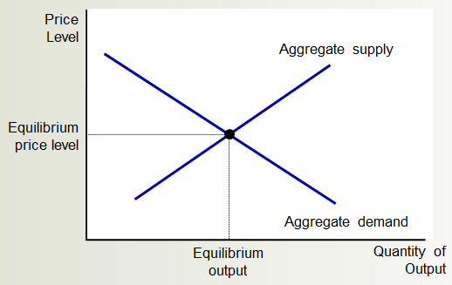
II AD – AS model
2 Aggregate supply
Using AD and SRAS to depict short run fluctuation of the economy
a) Economy in normal
b) Economy in recession

Slide 29
The short-run aggregate-supply curve: summary (a)
Why Does the Short-Run Aggregate-Supply Curve Slope Upward?
1. The Sticky-Wage Theory: An unexpectedly low price level raises the real wage, which causes firms to hire fewer workers and produce a smaller quantity of goods and services.
2. The Sticky-Price Theory: An unexpectedly low price level leaves some firms with higher-than desired prices, which depresses their sales and leads them to cut back production.
3. The Misperceptions Theory: An unexpectedly low price level leads some suppliers to think their relative prices have fallen, which induces a fall in production.

Slide 30
The short-run aggregate-supply curve: summary (b)
Why Might the Short-Run Aggregate-Supply Curve Shift?
1. Shifts Arising from Labor: An increase in the quantity of labor available (perhaps due to a fall in the natural rate of unemployment) shifts the aggregate-supply curve to the right. A decrease in the quantity of labor available (perhaps due to a rise in the natural rate of unemployment) shifts the aggregate-supply curve to the left.
2. Shifts Arising from Capital: An increase in physical or human capital shifts the aggregate-supply curve to the right. A decrease in physical or human capital shifts the aggregate-supply curve to the left.
3. Shifts Arising from Natural Resources: An increase in the availability of natural resources shifts the aggregate-supply curve to the right. A decrease in the availability of natural resources shifts the aggregate-supply curve to the left.
4. Shifts Arising from Technology: An advance in technological knowledge shifts the aggregate-supply curve to the right. A decrease in the available technology (perhaps due to government regulation) shifts the aggregate-supply curve to the left.
5. Shifts Arising from the Expected Price Level: A decrease in the expected price level shifts the short-run aggregate-supply curve to the right. An increase in the expected price level shifts the short-run aggregate-supply curve to the left.

Slide 31
III Explain behaviors of the economy via AD – AS model
Two causes of economic fluctuations: shift of the AD curve and shift of the SRAS curve
We begin short run examination with
Assumption: Economy begins in long-run equilibrium
Long-run equilibrium: Intersection of AD and LRAS curve (Output - natural rate ; Actual price level) and Intersection of AD and short-run AS curve (Expected price level = Actual price level)

Slide 32
The long-run equilibrium
Price
Level
Long-run
aggregate
supply
Short-run
aggregate
supply
Equilibrium
price
A
Aggregate
demand
Natural rate
of output
Quantity of Output
The long-run equilibrium of the economy is found where the aggregate-demand curve crosses the long-run aggregate-supply curve (point A). When the economy reaches this long-run equilibrium, the expected price level will have adjusted to equal the actual price level. As a result, the short-run aggregate-supply curve crosses this point as well.

Slide 33
III Explain behaviors of the economy via AD – AS model
Four steps for analyzing macroeconomic fluctuations
Decide whether the event shifts the aggregate demand curve or the `supply curve (or perhaps both).
Decide in which direction the curve shifts.
Use the diagram of aggregate demand and aggregate supply to determine the impact on output and the price level in the short run.
Use the diagram of aggregate demand and aggregate supply to analyze how the economy moves from its new short-run equilibrium to its long-run equilibrium.

Slide 34
III Explain behaviors of the economy via AD – AS model
1 The effects of a shift in aggregate demand: expansionary demand shock and contractionary demand shock
Contractionary demand shock
Factor: Wave of pessimism affects aggregate demand → Aggregate demand – shifts left
  Short-run: Output falls & Price level falls
  Long-run: Short-run aggregate supply curve – shifts right → Output – natural rate and Price level – falls

Slide 35
A contraction in aggregate demand
Price
Level
Long-run
aggregate
supply
Short-run
aggregate
supply, AS₁
3. . . . but over time, the short-run aggregate-supply curve shifts . . .
AS₂
P₁
A
B
4. . . . and output returns
to its natural rate.
P₂
C
P₃
A decrease in
aggregate demand . . .
AD₂
Aggregate demand, AD₁
Y₂
Y₁
Quantity of Output
2. . . . causes output to fall in the short run . . .
A fall in aggregate demand is represented with a leftward shift in the aggregate-demand curve from AD₁ to AD₂. In the short run, the economy moves from point A to point B. Output falls from Y₁ to Y₂, and the price level falls from P₁ to P₂. Over time, as the expected price level adjusts, the short-run aggregate-supply curve shifts to the right from AS₁ to AS₂, and the economy reaches point C, where the new aggregate-demand curve crosses the long-run aggregate-supply curve. In the long run, the price level falls to P₃, and output returns to its natural rate, Y₁.

Slide 36
Policy of government to respond contractionary demand shock
Price
Level
Long-run
aggregate
supply
Short-run
aggregate
supply, AS₁
(2)
(1)
AD₂
Aggregate demand, AD₁
Y₁
Quantity of Output
The government will implement policy such as increasing government spending to affect AD so that the AD curve shifts to the right. As a result, recession could be constrained

Slide 37
III Explain behaviors of the economy via AD – AS model
1 The effects of a shift in aggregate demand: expansionary demand shock and contractionary demand shock
Expansionary demand shock
Factor: Decrease of interest rate affects aggregate demand → Aggregate demand – shifts left
  Short-run: Output rises & Price level increases
  Long-run: Short-run aggregate supply curve – shifts left → Output – natural rate and Price level – rises

Slide 38
A expansionary in aggregate demand
Price
Level
Long-run
aggregate
supply
AS₂
3. . . . but over time, the short-run aggregate-supply curve shifts . . .
Short-run
aggregate
supply, AS₁
C
P₃
B
4. . . . and output returns
to its natural rate.
P₂
A
P₁
A increase in
aggregate demand . . .
Aggregate demand, AD₁
AD₂
Y₁
Y₂
Quantity of Output
2. . . . causes output to rise in the short run . . .
A rise in aggregate demand is represented with a rightward shift in the aggregate-demand curve from AD₁ to AD₂. In the short run, the economy moves from point A to point B. Output rises from Y₁ to Y₂, and the price level increases from P₁ to P₂. Over time, as the expected price level adjusts, the short-run aggregate-supply curve shifts to the left from AS₁ to AS₂, and the economy reaches point C, where the new aggregate-demand curve crosses the long-run aggregate-supply curve. In the long run, the price level falls to P₃, and output returns to its natural rate, Y₁.

Slide 39
Policy of government to respond expansionary demand shock
Price
Level
Long-run
aggregate
supply
Short-run
aggregate
supply, AS₁
(1)
(2)
AD₂
Y₁
Aggregate demand, AD₁
Quantity of Output
The government will implement policy such as decreasing government spending to affect AD so that the AD curve shifts to the left. As a result, booming could be constrained

Slide 40
III Explain behaviors of the economy via AD – AS model
1 The effects of a shift in aggregate demand: expansionary demand shock and contractionary demand shock
Summary
 | AD curve shift to | Output | Price level (inflation) | Policy of government
Contraction | Left | Decline (short run) Unchanged (long run) | Fall (short run) Fall further (long run) | Shift AD to the right
Expansion | Right | Rise (short run) Unchanged (long run) | Increase (short run) Increase further (long run) | Shift AD to the left

Slide 41
III Explain behaviors of the economy via AD – AS model
2 The effects of a shift in aggregate supply: adverse supply shock and beneficial supply shock
Adverse supply shock
Factor: Firms – increase in production costs (oil price increases) → Aggregate supply curve – shifts left
    Short-run: Output falls & Price level rises (Stagflation)
    Long-run, (if AD is held constant) SR AS shifts back to right: Output – natural rate and Price level - falls

Slide 42
An adverse shift in aggregate supply
Price
Level
Long-run
aggregate
supply
AS₂
1. An adverse shift in the short-run
aggregate-supply curve . . .
Short-run aggregate
supply, AS₁
B
3. . . . and
the price
level to rise
P₂
P₁
A
4. Long run, AS shifts back
Aggregate demand
Y₂
Y₁
Quantity of Output
2. . . . causes output to fall . . .
When some event increases firms’ costs, the short-run aggregate-supply curve shifts to the left from AS₁ to AS₂. The economy moves from point A to point B. The result is stagflation: Output falls from Y₁ to Y₂, and the price level rises from P₁ to P₂.

Slide 43
Policy of government to respond adverse supply shock
Price
Level
Long-run
aggregate
supply
AS₂
Short-run aggregate
supply, AS₁
Economy
Gov(2)
Gov(1)
Aggregate demand
Y₁
Quantity of Output
Government has 2 choices:
+ gov(1) decrease AD → shift AD to the left → keep P unchanged but Y declines further
+ gov(2) increase AD → shift AD to the right → keep Y unchanged but Y rises further

Slide 44
III Explain behaviors of the economy via AD – AS model
2 The effects of a shift in aggregate supply: adverse supply shock and beneficial supply shock
Benefitcial supply shock
Factor: Firms – decrease in production costs (oil price decreases) → Aggregate supply curve – shifts right
    Short-run: Output rises & Price level falls
    Long-run, (if AD is held constant and factor shifting AS has temporary effect) SR AS shifts back to left: Output – natural rate and Price level - rises

Slide 45
An beneficial shift in aggregate supply
Price
Level
Long-run
aggregate
supply
1. An benefitcial shift in the short-run
aggregate-supply curve . . .
Short-run aggregate
supply, AS₁
AS₂
3. . . . and
the price
level to fall
P₁
A
4. Long run, AS shifts back
P₂
B
Aggregate demand
Y₁
Y₂
Quantity of Output
2. . . . causes output to increase . . .
When some event decreases firms’ costs, the short-run aggregate-supply curve shifts to the right from AS₁ to AS₂. The economy moves from point A to point B. The result : Output rises from Y₁ to Y₂, and the price level falls from P₁ to P₂.

Slide 46
Policy of government to respond beneficial supply shock
Price
Level
Long-run
aggregate
supply
Short-run aggregate
supply, AS₁
AS₂
Economy
Gov(1)
Gov(2)
Aggregate demand
Y₁
Quantity of Output
Government has 2 choices (if it thinks adjusting economy is necessary):
+ gov(1) decrease AD → shift AD to the left → keep Y unchanged but P declines further
+ gov(2) increase AD → shift AD to the right → keep P unchanged but Y rises further

Slide 47
III Explain behaviors of the economy via AD – AS model
Summary
2 The effects of a shift in aggregate supply: adverse supply shock and beneficial supply shock
 | SRAS curve shift to | Output | Price level (inflation) | Policy of government
Adverse | left | Decline (short run) Unchanged (long run) | Rise (short run) Unchanged (long run) | Increase AD so that Y unchanged but P increases further Decrease AD so that P unchanged but Y decreases further
Beneficial (temporary effects) | right | Rise (short run) Unchanged (long run) | Decline (short run) Unchanged (long run) | Increase AD so that P unchanged but Y increases further Decrease AD so that Y unchanged but P decreases further

Slide 48
Appendix 1 Closer look to supply shock
1) Adverse supply shock
Long-run
aggregate
supply
AS₂
Price
Level
AS₃
Short-run aggregate
supply, AS₁
B
A
Aggregate demand
Y₂
Y₁
Quantity of Output
In the long run, the economy will not come back point A, initial long run equilibrium. Because, adverse supply shock potentially harms natural level of output then LRAS shift to the left. Eventually, in long run, the economy will move to the new equilibrium at point B (higher price, lower output) compared with point A

Slide 49
Appendix 1 Closer look to supply shock
2) Beneficial supply shock
Long-run
aggregate
supply
Price
Level
Short-run aggregate
supply, AS₁
AS₂
AS₃
A
B
Aggregate demand
Y₁
Y₂
Quantity of Output
In the long run, the economy will not come back point A, initial long run equilibrium. Because, beneficial supply shock usually accompanied with permanent effects potentially accelerates natural level of output then LRAS shift to the right. Eventually, in long run, the economy will move to the new equilibrium at point B (lower price, higher output) compared with point A

Slide 50
Appendix 2 Using vertical axis of inflation rate in AD – AS model
Mathematical transformations for formula of AS curve (follows Phillips curve equation) and AD curve (follow dynamic AD equation under Mundell – Fleming model), we both arrive at conclusion that:
In terms of aggregate supply, inflation rate and output have positive relationship
In terms of aggregate demand, inflation rate and output have negative relationship
lnflation
Short-run aggregate
supply
∏e
Aggregate demand
Y*
Quantity of Output

Slide 51
Key concepts
Aggregate demand
Aggregate supply
Wealth effect
Interest-rate effect
Exchange-rate effect
Sticky wage theory
Sticky price theory
Misperception theory
Potential output
Expansionary/Contractionary demand shock
Beneficial/Adverse supply shock

