Slide 1
Chapter 9 Inflation and Phillips curve
Mentor Pham Xuan Truong
truongpx@ftu.edu.vn

Slide 2
Content
I Overview of inflation
II Cost of inflation
III Phillips curve – relationship between inflation and unemployment

Slide 3
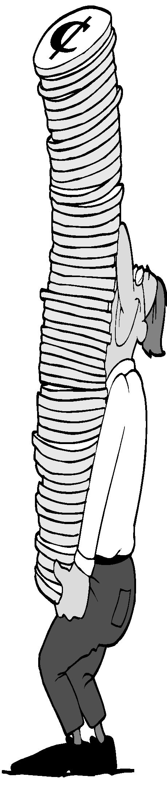
I Overview of inflation
1 Definition and computing method
Inflation is a sustained increase in the general price level of goods and services in an economy over a period of time
Or sustained reduction in the purchasing power per unit of money – a loss of real value in the medium of exchange and unit of account within the economy (each unit of currency buys fewer goods and services)
Deflation is the contrary concept as a sustained decrease in the general price level of goods and services in an economy over a period of time or sustained increase in the purchasing power per unit of money
Other related concepts: disinflation - a decrease in the rate of inflation; hyperinflation - an out-of-control inflationary spiral; stagflation - a combination of inflation, slow economic growth and high unemployment; reflation - an attempt to raise the general level of prices to counteract deflationary pressures.

Slide 4

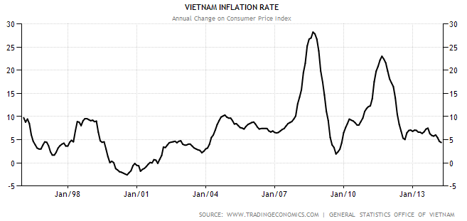
I Overview of inflation
1 Definition and computing method
Other indices could be used to calculate inflation: GDP deflator, PPI (producer price index) or core price index (core CPI)

Slide 5
I Overview of inflation
2 Classification
Moderate Inflation: inflation rate < 10%/year, prices increases slowly. Moderate inflation can spur production because price increases leading to highet profit for enterprises,therefore, firms will increases quantity.
Galloping Inflation: inflation rate is from 10% to 99% per year. This type will destroy economy and curb engines of economy.
Hyper Inflation: is defined as inflation that exceeds 100% percent per year. Costs such as shoe-leather and menu costs are much worse with hyperinflation– and tax systems are grossly distorted. Eventually, when costs become too great with hyperinflation, the money loses its role as store of value, unit of account and medium of exchange. Bartering or using commodity money becomes prevalent. In 1920s (1922-12/1923) Weimar Germany, CPI increased from 1 to 10 millions

Slide 6
I Overview of inflation
2 Classification
Expected inflation: depends on expectation of individuals about gp in the future. Its impacts is small but help to adjust production cost.
Unexpected inflation: derives from exogenous shocks and unexpected factors inside economy.

Slide 7
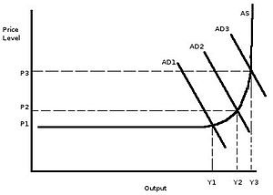
I Overview of inflation
3 Causes of inflation
Demand-pull inflation is caused by continuing rises in AD in the economy. The increase in AD may be caused by either increases in the money supply or increases in G-expenditure when the economy is close to full employment.
In general, demand-pull inflation is
typically associated with a booming
economy.

Slide 12
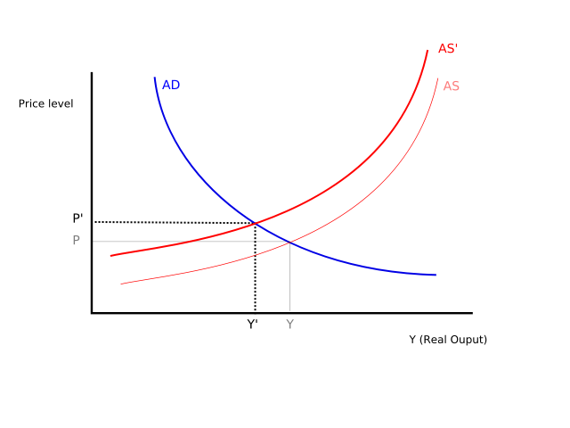
I Overview of inflation
3 Causes of inflation
Cost-push inflation is associated with continuing rises in costs. Rises in costs may originate from a number of different sources such as wage increases and other higher costs of production (e.g. raw materials).

Slide 13
I Overview of inflation
3 Causes of inflation
Money quantity theory – the classical theory of inflation
Velocity and the quantity equation
Quantity equation: M × V = P × Y
+ Quantity of money (M)
+ Velocity of money (V)
+ Dollar value of the economy’s output of goods and services (P × Y )
This quantity shows that: an increase in quantity of money must be reflected in:
+ Price level must rise
+ Quantity of output must rise
+ Velocity of money must fall

Slide 14
I Overview of inflation
3 Causes of inflation
Money quantity theory – the classical theory of inflation
Five steps - essence of quantity theory of money
1. Velocity of money: Relatively stable over time
2. Changes in quantity of money (M) will lead to Proportionate changes in nominal value of output (P × Y)
3. Economy’s output of goods and services (Y): in long run primarily determined by factor supplies and available production technology. Because money is neutral then Money does not affect output in the long run
4. Change in money supply (M): Induces proportional changes in the nominal value of output (P × Y) and Reflected in changes in the price level (P)
5. Therefore, Central bank - increases the money supply rapidly → High rate of inflation.
→ Money quantity theory explains cause of long run inflation
“Inflation is always and everywhere a monetary phenomenon.” —Milton Friedman, 1963

Slide 15
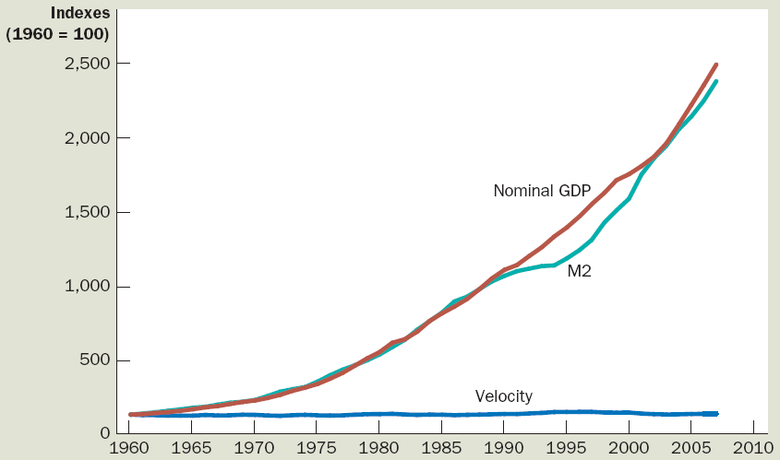
Nominal GDP, quantity of money, & velocity of money
This figure shows the nominal value of output as measured by nominal GDP, the quantity of money as measured by M2, and the velocity of money as measured by their ratio. For comparability, all three series have been scaled to equal 100 in 1960. Notice that nominal GDP and the quantity of money have grown dramatically over this period, while velocity has been relatively stable.

Slide 16
I Overview of inflation
4 Policies to deal with inflation
4.1.Fiscal policy comprises changes in government expenditure and/or taxation. The aim is to affect the level of AD through a policy known as demand management. In the case of controlling inflation, this involves reducing government expenditure and/or increasing taxation in what is called a deflationary fiscal policy. Such policies are likely to be effective if inflation has been diagnosed as demand-pull since a reduction in government expenditure or an increase in income tax will reduce aggregate demand in the economy.

Slide 17
I Overview of inflation
4 Policies to deal with inflation
4.2.Monetary policy is concerned with influencing the money supply and the interest rate. In terms of controlling inflation, the central bank can aim to reduce the money supply thus reducing spending and, therefore, the aggregate demand, or it can increase the interest rate so as to increase the cost of borrowing. Both policies can be seen as deflationary monetary policy. Since monetarists view the growth of the money supply as being the main cause of inflation, any control of inflation from a monetarist viewpoint must involve control of the money supply.

Slide 18
I Overview of inflation
4 Policies to deal with inflation
4.3.Prices and incomes policy aim to limit and, in certain cases, freeze wage and price increases. In the past they have either been statutory or voluntary. Statutory prices and incomes policies have to be enforced by government legislation, such as the EU minimum wage legislation. With a voluntary prices and incomes policy the government aims to control prices and incomes through voluntary restraint, possibly by obtaining the support of the unions and employers.

Slide 19
I Overview of inflation
4 Policies to deal with inflation
4.4. Supply-side policy is concerned with instituting measures aimed at shifting the aggregate supply curve to the right. Supply-side economics is the use of microeconomic incentives to alter the level of full employment and the level of potential output in the economy. If inflation is caused by cost-push pressures, supply-side policy can help to reduce these cost pressures in two ways:
(1) by reducing the power of trade unions and/or firms (e.g. by anti-monopoly legislation) and thereby encouraging more competition in the supply of labour and/or goods,
(2) by encouraging increases in productivity through the retraining of labour, or by investment grants to firms, or by tax incentives, etc.

Slide 20
I Overview of inflation
4 Policies to deal with inflation
4.5.Learning to live with inflation involves accepting the fact that inflation is here to stay when standard anti –inflationary policy measures appear ineffective. In such a situation we just have to learn to live with inflation. Learning to live with inflation involves the government, employers and workers taking inflation into account in their everyday transactions. For example, the government/employers may use indexation in wage/pensions contracts. Indexation is when wages or pensions are increased in line with the current rate of inflation. Indexation is aimed at nullifying the effects of inflation.

Slide 21
II Cost of inflation
The inflation tax
  Revenue the government raises by creating (printing) money
  Tax on everyone who holds money
Shoe-leather costs
  Resources wasted when inflation encourages people to reduce their money holdings
  Can be substantial
Menu costs
  Costs of changing prices
  Inflation – increases menu costs that firms must bear

Slide 22
II Cost of inflation
Relative-price variability & misallocation of resources
Market economies: rely on relative prices to allocate scarce resources
Consumers - compare
      Quality and prices of various goods and services
      Determine allocation of scarce factors of production
Inflation - distorts relative prices
    Consumer decisions – distorted
    Markets - less able to allocate resources to their best use

Slide 23
II Cost of inflation
Inflation-induced tax distortions
Taxes – distort incentives: many taxes are more problematic in the presence of inflation
(1) Tax treatment of capital gains
  Capital gains – Profits:
    Sell an asset for more than its purchase price
  Inflation discourages saving
    Exaggerates the size of capital gains
    Increases the tax burden
(2) Tax treatment of interest income
  Nominal interest earned on savings
    Treated as income
    Even though part of the nominal interest rate compensates for inflation

Slide 24
How inflation raises the tax burden on saving
 | Economy A (price stability) | Economy B (inflation)
Real interest rate Inflation rate 0.08 Nominal interest rate (real interest rate + inflation rate) Reduced interest due to 25 percent tax (.25 × nominal interest rate) After-tax nominal interest rate (.75 × nominal interest rate) After-tax real interest rate (after-tax nominal interest rate – inflation rate) | 4% 0 4 1 3 3 | 4% 8 12 3 9 1
In the presence of zero inflation, a 25 percent tax on interest income reduces the real interest rate from 4 percent to 3 percent. In the presence of 8 percent inflation, the same tax reduces the real interest rate from 4 percent to 1 percent.

Slide 25
II Cost of inflation
Confusion and inconvenience
Money is the yardstick with which we measure economic transactions
The central bank’s job is to Ensure the reliability of money. But when the central bank increases the money supply, it will creates inflation and erodes the real value of the unit of account → 1 unit of money value in year t is no longer equal to 1 unit of money value year t +x → direct comparison is inaccurate
A special cost of unexpected inflation: arbitrary redistributions of wealth
Inflation - volatile & uncertain when the average rate of inflation is high
Unexpected inflation: redistributes wealth among the population Not by merit and Not by need
In details, unexpected inflation redistribute wealth among debtors and creditors, workers and employers, tax payers and state

Slide 26
II Cost of inflation
Notion: A fall in purchasing power? Inflation fallacy
“Inflation robs people of the purchasing power of his hard-earned dollars” – Right or wrong
Actually, when prices rise
  Buyers – pay more
  Sellers – get more
  Inflation in incomes - goes hand in hand with inflation in prices
→ Inflation does not in itself reduce people’s real purchasing power. Real purchasing power of one person is indeed reduced when inflation in incomes of the person is lower than inflation in price

Slide 27
III Phillips curve – relationship between inflation and unemployment
Background
Phillips curve initially shows the short-run trade-off between inflation and unemployment
Origins of the Phillips curve
- 1958, economist A. W. Phillips wrote the article “The relationship between unemployment and the rate of change of money wages in the United Kingdom, 1861–1957”. Then later economics generalized it under the negative correlation between the rate of unemployment and the rate of inflation

Slide 28
III Phillips curve – relationship between inflation and unemployment
  Background
  - 1960, economists Paul Samuelson & Robert Solow wrote “Analytics of anti-inflation policy” that emphasized again negative correlation between the rate of unemployment and the rate of inflation
  - The most valuable implication from Phillips curve is for policymakers: Monetary and fiscal policy To influence aggregate demand Choose any point on Phillips curve Trade-off: High unemployment and low inflation Or low unemployment and high inflation

Slide 29
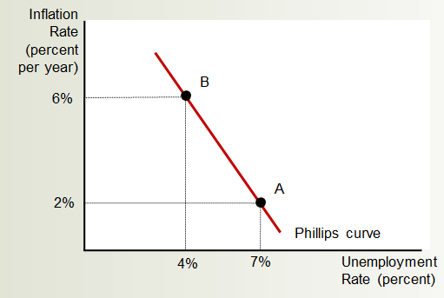
III Phillips curve – relationship between inflation and unemployment
Short run

Slide 30
III Phillips curve – relationship between inflation and unemployment
Short run
AD and AS and the Phillips curve
Phillips curve: is the combinations of inflation and unemployment that arise in the short run. As shifts in the aggregate-demand curve, move the economy along the short-run aggregate-supply curve
Higher aggregate-demand
  Higher output & Higher price level
  Lower unemployment & Higher inflation
Lower aggregate-demand
  Lower output & Lower price level
  Higher unemployment & Lower inflation

Slide 31
How the Phillips curve is related to the model of aggregate demand and aggregate supply
(a) The Model of AD and AS
(b) The Phillips Curve
Price
level
Short-run
aggregate
supply
Inflation
Rate
(percent
per year)
B
6%
B
106
A
High aggregate
demand
102
Low aggregate
demand
A
2
Phillips curve
0
15,000
unemployment
=7%
16,000
unemployment
=4%
Quantity
of output
0
4%
output
=16,000
7%
output
=15,000
Unemployment
Rate (percent)
This figure assumes price level of 100 for year 2020 and charts possible outcomes for the year 2021. Panel (a) shows the model of aggregate demand & aggregate supply. If AD is low, the economy is at point A; output is low (15,000), and the price level is low (102). If AD is high, the economy is at point B; output is high (16,000), and the price level is high (106). Panel (b) shows the implications for the Phillips curve. Point A, which arises when aggregate demand is low, has high unemployment (7%) and low inflation (2%). Point B, which arises when aggregate demand is high, has low unemployment (4%) and high inflation (6%).

Slide 32
Long run
III Phillips curve – relationship between inflation and unemployment
Inflation
Rate
Long-run
Phillips curve
High
inflation
B
Low
inflation
A
Natural rate of
unemployment
Unemployment
Rate
According to Friedman and Phelps, there is no trade-off between inflation and unemployment in the long run. Growth in the money supply determines the inflation rate. Regardless of the inflation rate, the unemployment rate gravitates toward its natural rate. As a result, the long-run Phillips curve is vertical.

Slide 33
III Phillips curve – relationship between inflation and unemployment
Long run
- Phillips curve is vertical
- If the central bank increases the money supply slowly, in the long run: Inflation rate is low + Unemployment – natural rate
If the central bank increases the money supply quickly, in the long run: Inflation rate is high + Unemployment – natural rate
→ Unemployment - does not depend on money growth and inflation in the long run
- Expression of the classical idea of monetary neutrality: Increase in money supply then Aggregate-demand curve – shifts right
      Price level – increases = Inflation rate – increases
      Output – natural rate = Unemployment – natural rate

Slide 34
How the long-run Phillips curve is related to the model of aggregate demand and aggregate supply
(a) The Model of AD and AS
(b) The Phillips Curve
Price
level
Long-run
aggregate supply
Inflation
Rate
Long-run
Phillips curve
B
B
P₂
1. An increase in
the money supply
increases aggregate
demand . . .
3. . . . and
increases the
inflation rate . . .
A
P₁
A
2. . . . raises
the price
level . . .
AD₂
Aggregate demand, AD₁
0
Natural rate
of output
Quantity of output
0
Natural rate
of output
Unemployment
Rate
4. . . . but leaves output and unemployment
at their natural rates.
Panel (a) shows the model of AD and AS with a vertical aggregate-supply curve. When expansionary monetary policy shifts the AD curve to the right from AD₁ to AD₂, the equilibrium moves from point A to point B. The price level rises from P₁ to P₂, while output remains the same. Panel (b) shows the long-run Phillips curve, which is vertical at the natural rate of unemployment. In the long run, expansionary monetary policy moves the economy from lower inflation (point A) to higher inflation (point B) without changing the rate of unemployment

Slide 35
III Phillips curve – relationship between inflation and unemployment
The shift of Phillips curve
+ long run: Labor-market policies that affect the natural rate of unemployment will shift the Phillips curve. Policy change - reduce the natural rate of unemployment → Long-run Phillips curve shifts left, Long-run aggregate-supply shifts right → For any given rate of money growth and inflation , we have lower unemployment and higher output
+ short run: Each short-run Phillips curve reflects a particular expected rate of inflation. Expected inflation – changes short-run Phillips curve shifts.
Changes of expected inflation (or expected price) induces shift of AS curve

Slide 36
III Phillips curve – relationship between inflation and unemployment
The shift of Phillips curve
The equation of short run Phillips curve could be given as
→ short run Phillips curve shifts upward/rightward as expected inflation increases or AS curve shifts downward/leftward
short run Phillips curve shifts downward/leftward as expected inflation decreases or AS curve shifts downward/rightward
Notion: supply shock plays the same role as expected inflation in terms of Short run AS shift
Unemployment rate = Natural rate of unemployment - a(Actual inflation – Expected inflation)
where a - parameter that measures how much unemployment responds to unexpected inflation

Slide 37
How expected inflation shifts short-run Phillips curve
Inflation
Rate
Long-run
Phillips curve
2. . . . but in the long run, expected
inflation rises, and the short-run
Phillips curve shifts to the right.
B
C
Short-run Phillips curve
with high expected
inflation
1. Expansionary policy moves
the economy up along the
short-run Phillips curve . . .
A
Short-run Phillips curve
with low expected
inflation
Natural rate of
unemployment
Unemployment Rate
The higher the expected rate of inflation, the higher the short-run trade-off between inflation and unemployment. At point A, expected inflation and actual inflation are equal at a low rate, and unemployment is at its natural rate. If the Fed pursues an expansionary monetary policy, the economy moves from point A to point B in the short run. At point B, expected inflation is still low, but actual inflation is high. Unemployment is below its natural rate. In the long run, expected inflation rises, and the economy moves to point C. At point C, expected inflation and actual inflation are both high, and unemployment is back to its natural rate

Slide 38
How shift of the short-run Phillips curve is related to the model of aggregate demand and aggregate supply: An adverse shock to aggregate supply
(a) The Model of AD and AS
(b) The Phillips Curve
1. An adverse shift
in aggregate supply . . .
4. . . . giving policymakers
a less favorable trade-off
between unemployment
and inflation.
Price
level
3. . . . and raises
the price level . . .
Inflation
Rate
AS₂
Aggregate
supply, AS₁
B
B
P₂
A
P₁
A
Aggregate
demand
PC₂
Phillips curve, PC₁
0
Y₂
Y₁
Quantity of output
0
Unemployment
Rate
2. . . . lowers output . . .
Panel (a) shows the model of aggregate demand and aggregate supply. When the aggregate-supply curve shifts to the left from AS₁ to AS₂, the equilibrium moves from point A to point B. Output falls from Y₁ to Y₂, and the price level rises from P₁ to P₂. Panel (b) shows the short-run trade-off between inflation and unemployment. The adverse shift in aggregate supply moves the economy from a point with lower unemployment and lower inflation (point A) to a point with higher unemployment and higher inflation (point B). The short-run Phillips curve shifts
to the right from PC₁ to PC₂. Policymakers now face a worse trade-off between inflation and unemployment.

Slide 39
Key concepts
Inflation, deflation, disinflation, reflation
Demand pull inflation
Cost push inflation
Money quantity theory
Velocity of money
Phillips curve
Inflation unemployment trade off
Shoe-leather cost, menu cost, inflation tax, inflation fallacy
Expected inflation

